Slide 1

Specialized Residential Standardized Progress Note Training Ryan Morgan, LMSW – Director, Residential Services (313) 989-9513 | (313) 989-9525 residentialreferral@dwihn.org

Slide 2

Purpose of Progress Notes
To monitor progress (or lack thereof) and/or concerns related to the Member’s achievement of goals in accordance with least-restrictive residential settings
To improve the collaboration, coordination, and communication between the supports coordinator/case manager and the residential provider
*To capture the actual service time connected with providing clinically, meaningful activities as indicated by the Michigan Medicaid Provider Manual
*Red text indicates recent change to process.

Slide 3
Purpose of Progress Notes
To justify reimbursement for the services rendered
To understand the connection between the Residential Assessment¹ and the Individual Plan of Service (IPOS)²
¹Completed by DWIHN residential staff
²Completed by the CRSP SC/CM in coordination with Member/Guardian, & Residential Provider
Allows direct care staff to work with Member to promote independence in the least restrictive setting

Slide 4
Progress Note DOs and DON’Ts
DO: Document a summary of services provided (WHAT you did)
DO NOT: Do not write your own personal opinions, frustrations, reactions or feelings: “The Member seems a little unstable. / I didn’t like how Member folded his laundry.”
DO: BE SPECIFIC - For example, include details such as, “Member raised her voice at Staff multiple times and called them stupid.”
DO: Use quotations for facts explaining Member’s comments (“ …”)
DO NOT: Do not scribble, scratch out, or write side-notes
DO: If progress note are handwritten, ensure writing is legible.

Slide 5
Progress Note Instructions
*Utilize the specific Progress Note for the Member’s setting:
Specialized Licensed; or
Specialized Unlicensed | In-Home CLS Staffing Services
Complete Member information at the top of Face Sheet:
Select Program Designation (AMI or IDD)*
Member Name and MHWIN ID#*
Note Date*
Now auto-populates onto PAGE #2
Clinically-Responsible Service Provider (CRSP) with Support Coordinator (SC)/Case Manager (CM) Name
Enter Facility Name
*Red text indicates recent change to process.

Slide 6
Instructions (continued)
List Identified Goal(s) from Member’s Individual Plan of Service (IPOS)
Any significant behavioral/medical changes in Member’s condition must be reported to the CRSP SC/CM to be addressed in the IPOS
Enter approved CLS, PC, and/or *Respite hours confirmed by Residential Assessment
Located in MHWIN
*Respite Services does not require a Residential Assessment.
Staff indicates their Initials and Number of Minutes spent rendering services for each identified Objective
Shift Columns: AM, PM, or MN (Midnight)
Unlicensed settings can utilize “Hours-to-Minutes” conversion chart
*Red text indicates recent change to process.

Slide 7
Instructions (continued)
Each staff enters the START Time for when they begin working with the member on the FIRST CLS/PC service, and the STOP Time for when they stop working with member (regardless of work shift start/stop time).*
Per Medicaid Compliance
Residential Provider (or Designee) is responsible to review and tally total minutes for rendered services of 24-hour note.
Respite Care Services Only*: Member’s/Guardian’s signature are required as verification of rendered respite services as documented by CLS staffing provider.*
Digital signatures are prohibited.*
*Red text indicates recent change to process.

Slide 8
Instructions (continued)
Staff initials each entry, listing the associated Objective Code, Task ID Code, and Progress Code of the note being written.
Drop-down options are now available in .pdf (fillable) document.*
Each staff member during their respective shifts must PRINT, INITIAL, and SIGN their name when documenting each rendered service.
Digital signatures are prohibited.*
If there is a need for more space to complete the daily progress note, please utilize additional copies of Page #2.
*Red text indicates recent change to process.

Slide 9
Standardized Progress Note
Training Video for
Specialized LICENSED Settings

Slide 10
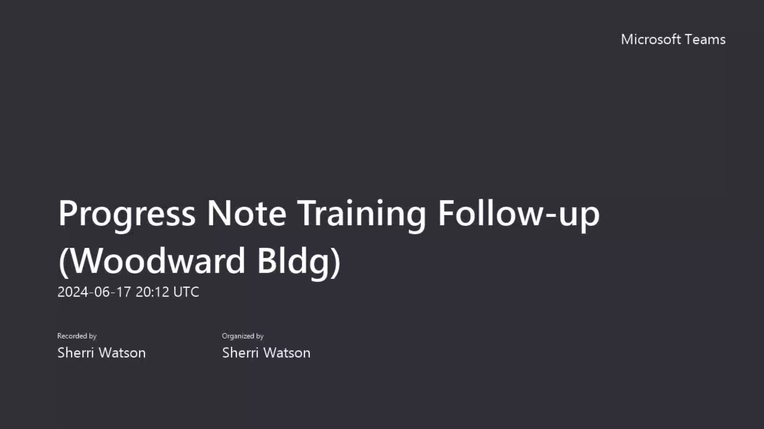

Slide 11
Standardized Progress Note Training Video,
Instruction Packet, and Notes
are also available on the DWIHN website: www.dwihn.org/providers/forms

Slide 12


