Slide 1

Presentation to Detroit Wayne Integrated Health Network
Sheilah P. Clay Executive Director
David Bowser, Deputy Director
November 13, 2020

Slide 2
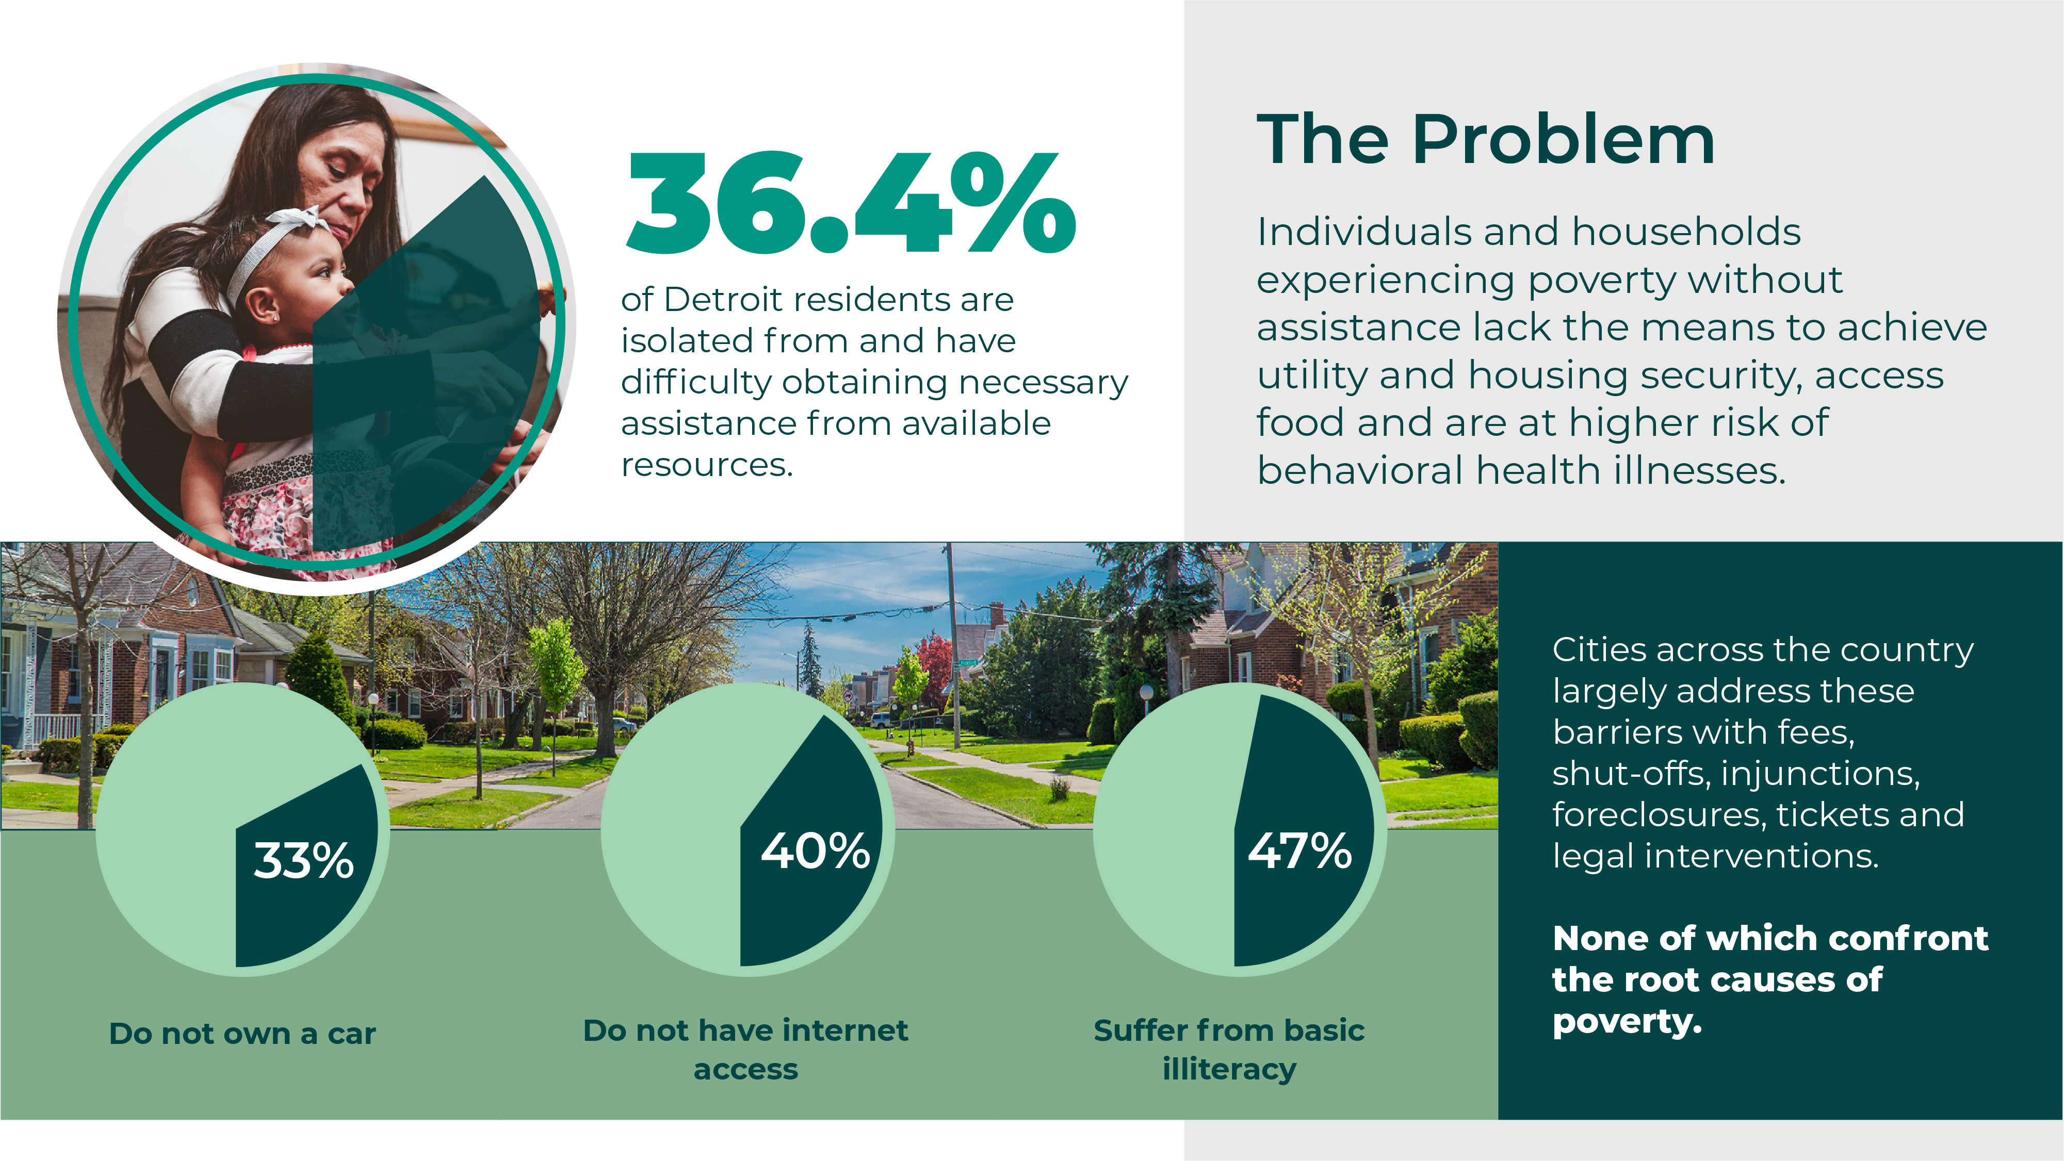

Slide 3
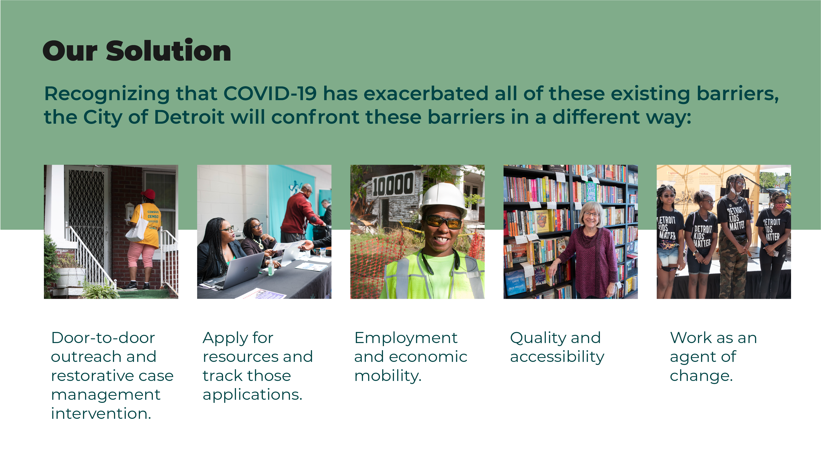
Health is Personal.
The Community Health Corps takes an individual-centered total care approach to overcome poverty and provide connection to available resources.

Slide 4
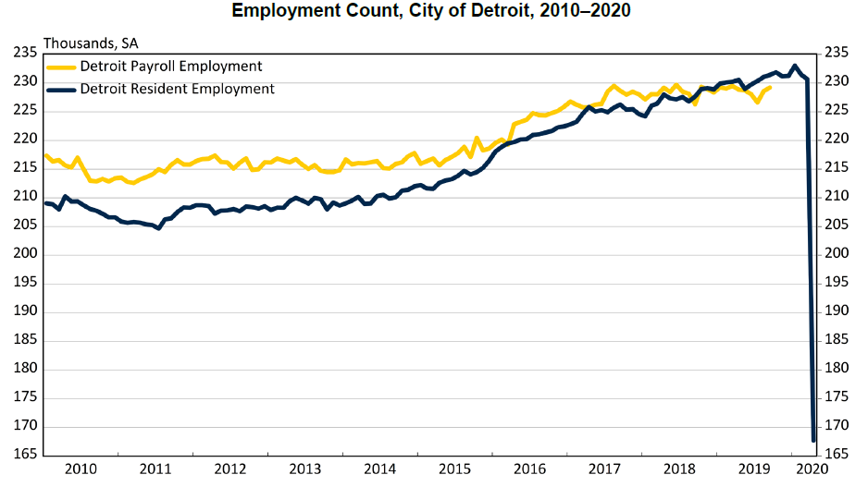
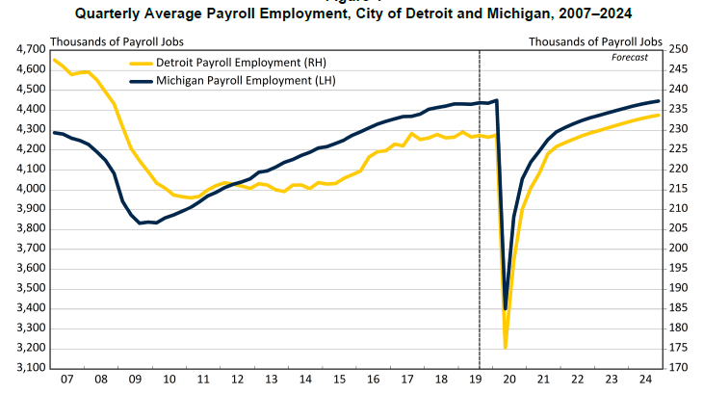
That was prior to COVID-19.
Detroit residents who were isolated and in crisis before still need support.
Detroit residents who were on the edge of isolation or crisis have likely tipped over that edge,
making the need for the Community Health Corps even more acute.
The next three years are critical to Detroit’s recovery.
The Community Health Corps connects residents to supports and services,
and confronts this challenge by investing in people.

Slide 5
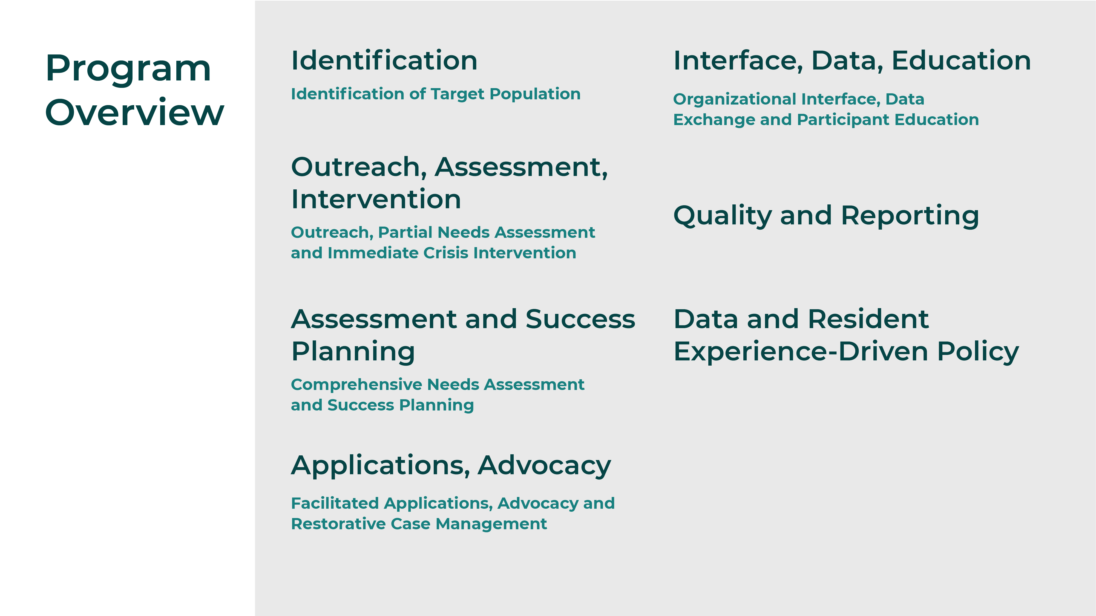

Slide 6
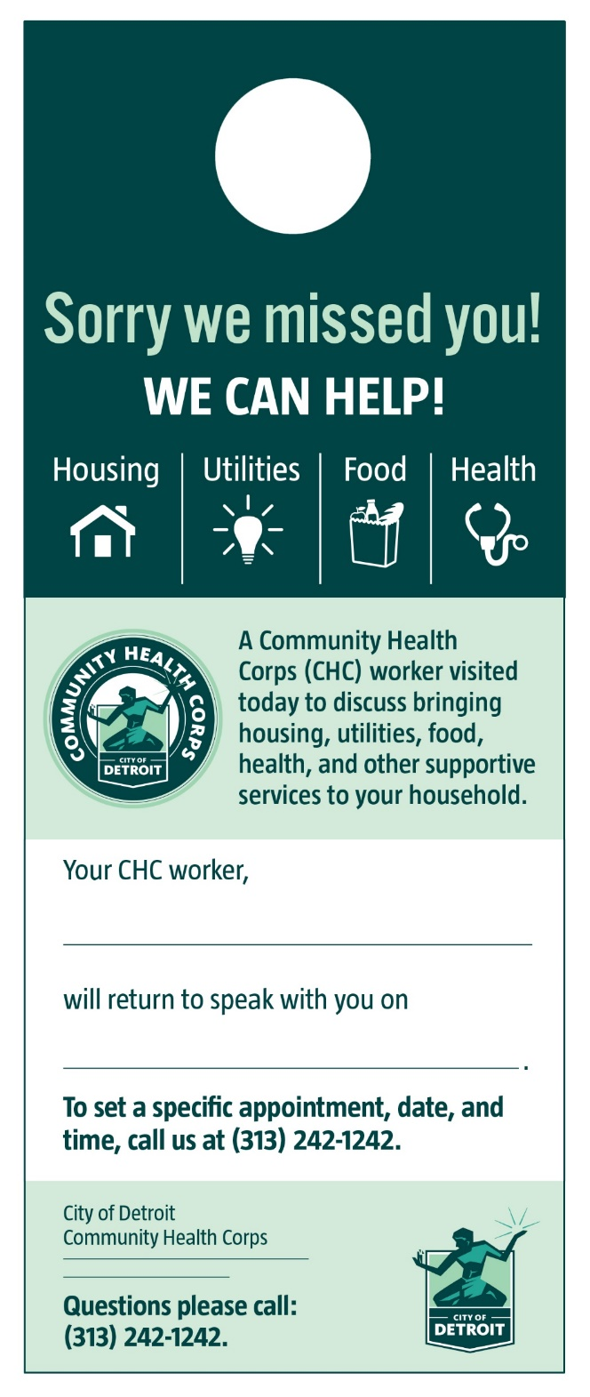

Door-to-Door CHC Material

Slide 7
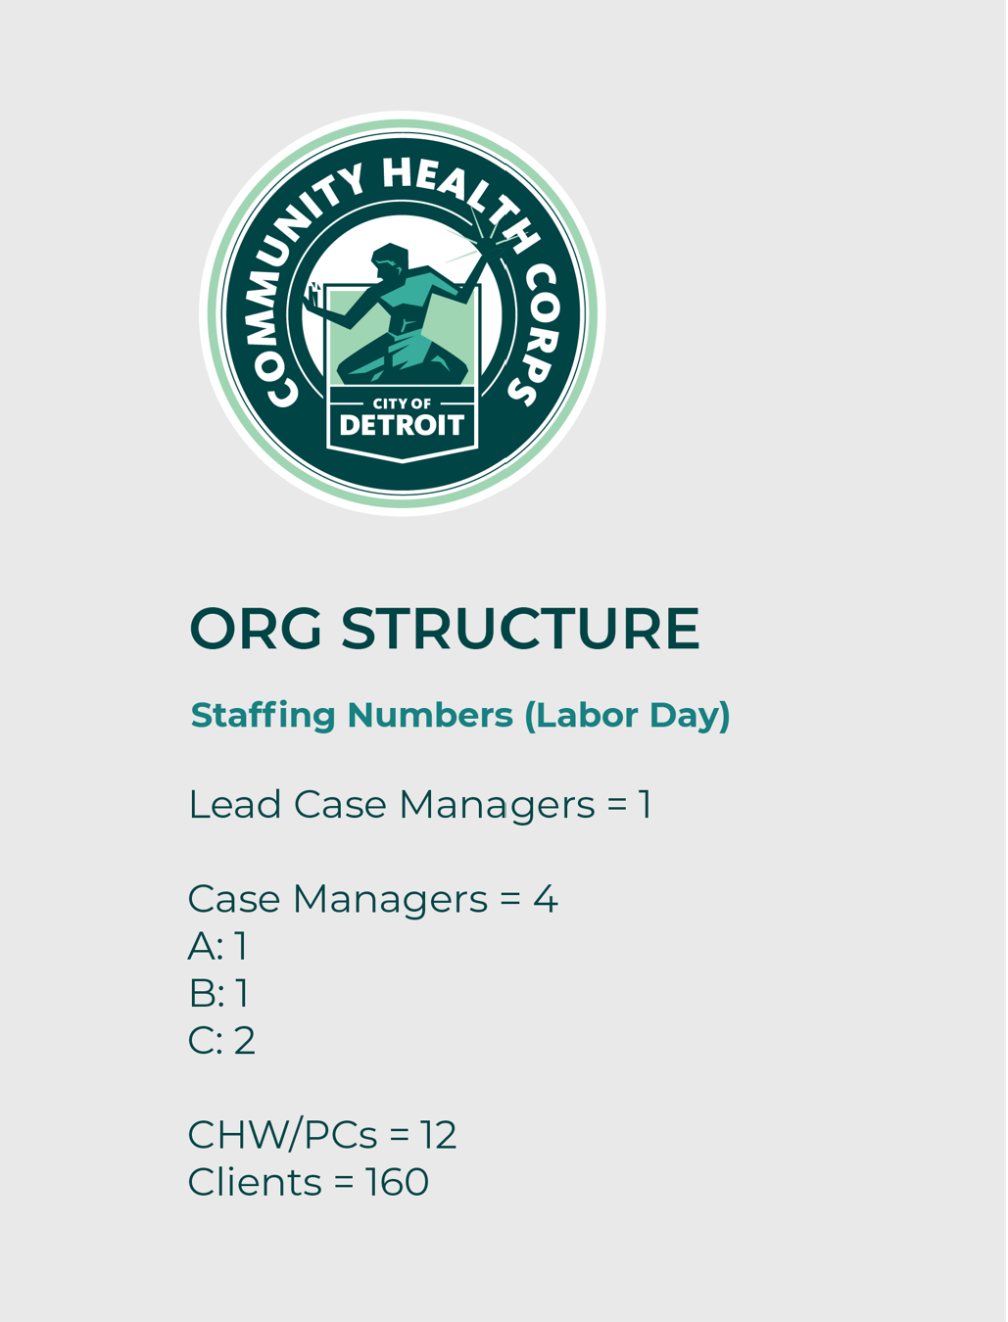
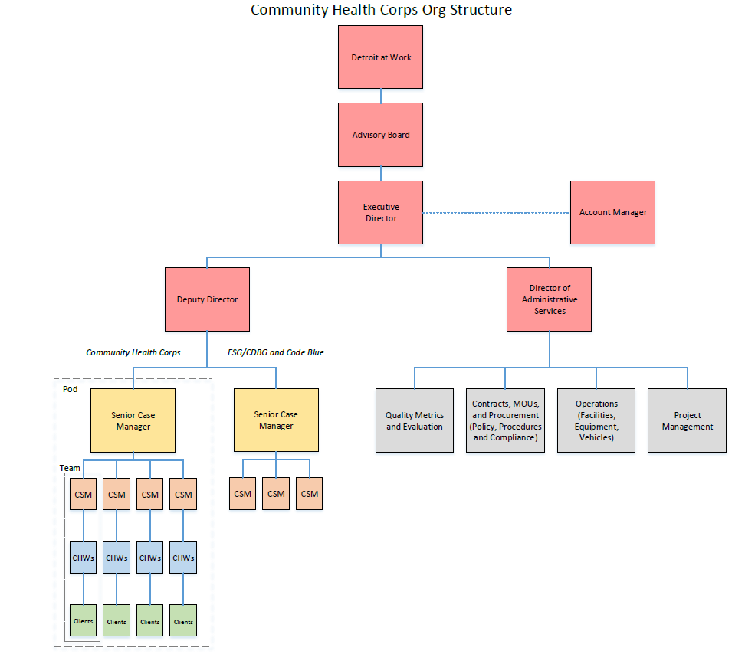

Slide 8
CHC Emergency Housing & Disaster Relief Branch (ESG/CDBG)
Precariously Housed Outreach
Door-to-door outreach to Detroit Land Bank Authority (DLBA) or land developer-owned, occupied properties
Many homes are in a state of uninhabitable disrepair with no utilities
Restorative, wraparound case management to transform occupants into homeowners and renters
CODE BLUE
Multi-organizational, emergency response to mass housing displacement events (5+ units): Fires, condemned residential buildings and other emergencies escalated by the media and the City of Detroit Mayor’s Office
Participants: CHC, Mayor’s Office, Law, DPD, DFD, BSEED, HRD, Homeland Security, Parks and Recreation, American Red Cross, UCHC
Emergency case management to connect displaced individuals to permanent housing, and to replace items that were lost in the disaster

Slide 9





CODE
BLUE
The CHC does not act alone.
Overcoming poverty is a big goal.
Unemployment rates have increased, and food, utility and housing insecurity directly tied to the lack of income magnify the risks of physical and behavioral health challenges.
Black and Brown workers have been more likely to lose their jobs or to work in industries with increased COVID-19 risk. The entry-level jobs held by many Detroiters and people of color are most at risk of automation.

Slide 10

Comprehensive assessment by CHC Lead CSM that includes behavioral health questions.
Client includes and agrees to behavioral health services in Passport (service plan).
Contact DWIHN Access Center to refer client and/or check for current or past service status.
Assist client in connecting with DWIHN service provider. This includes providing transportation, if needed.
If approved by client and ROIs signed, serve on wrap-around team and follow-up with provider on minimum monthly basis for client status and progress.
CHC will have direct partnership relationship with MRS, CAM, and the Detroit Health Department.

Slide 11
October 1, 2020 – March 31, 2021
Hire 1 pod, and 4 additional case managers dedicated to Code Blue and housing support
Integrate CHC case management and referral support for 60 existing clients, and on-ramp support for at least 100 additional clients.
Track the number of clients who transition to lighter touch support to better understand 1 pod average-caseload capacity.
As additional funding is secured, expand to 3 pods, each with the capacity to serve at least 160 clients, for a total program caseload of at least 480 Detroit residents
Phase 1
April 1, 2021 – December 31, 2021
As additional funding is secured, ramp to full scale of pilot: 3 pods
Initial evaluation of program impact will emerge – assess progress from the client’s perspective in addition to evaluating outcomes reported by the referral partners
Validate caseload capacity and scale-ability of model
Phase 2
January 1, 2022 – December 31, 2022
Maintain active caseload for 5 pods
Continue evaluation of program impact, and validation of scale-ability
If CHC pilot shows significant multiplier effect over traditional referrals, develop program design and sustainability model to continue scaling
If CHC pilot does not show improved impact over traditional referrals, begin wind down of program and transition of remaining clients
Phase 3

Slide 12
Q & A
Contact Info:
Sheilah P. Clay
clays@detroitmi.gov
David Bowser
bowserd@detroitmi.gov

