Slide 1
DWIHN FY 24-25 PRE-CONTRACTING INSTRUCTIONS GUIDE

Slide 2
BUSINESS INFORMATION QUESTIONAIRE
The Business Information Questionnaire includes general questions about your goals and ownership/leadership style as well as more specific questions relating to your business. It is important for you to be honest and accurate. Please note any incomplete information could result in a delay in the contracting process or denial of contract renewal.
Please fill in the following questionnaire on the basis of the facts of your company.
Please answer all questions.
If any question is not applicable to your company, please check not applicable.

Slide 3
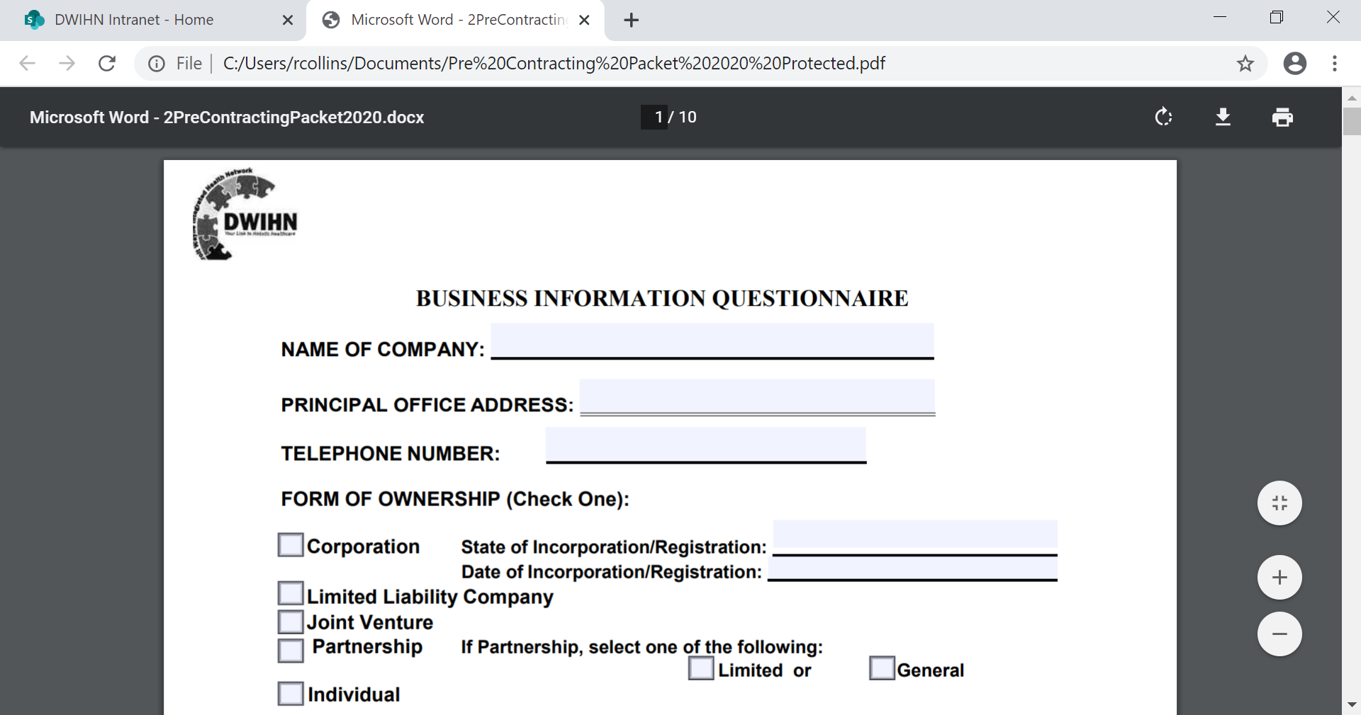
Please Complete Name of Company.
Please Complete the address of your company.
Please complete your company’s Telephone Number
To show your ownership please check one of the boxes.. If Limited or General please check one of the boxes below.
Please list the State that your company is incorporated/registered in.
Please list the date your company was incorporated//registered.

Slide 4
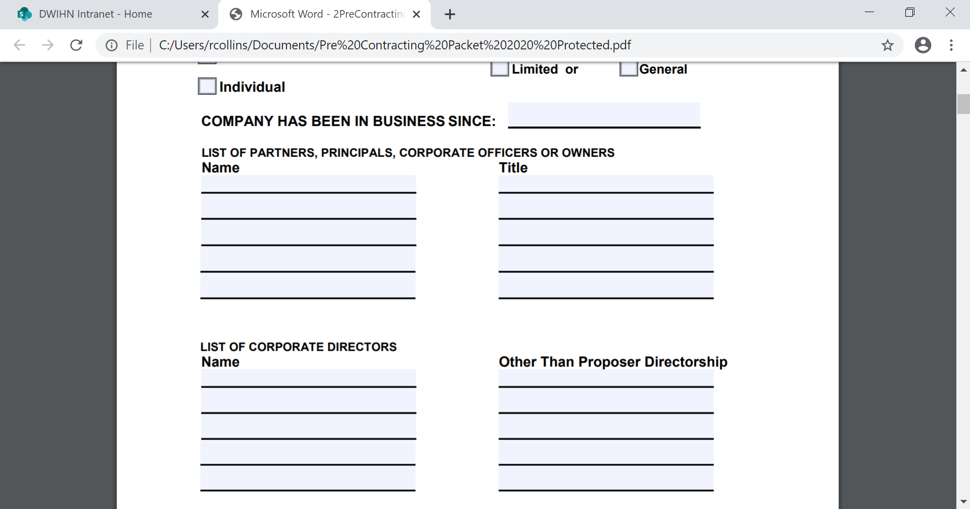
How long has your company been in business? Put in the year your business started.
List of partners, principals, corporate officers or owners name.
List the title of the partners, principals, corporate officers or owners.
List the name of the corporate directors.
List the names other than proposer directorship

Slide 5
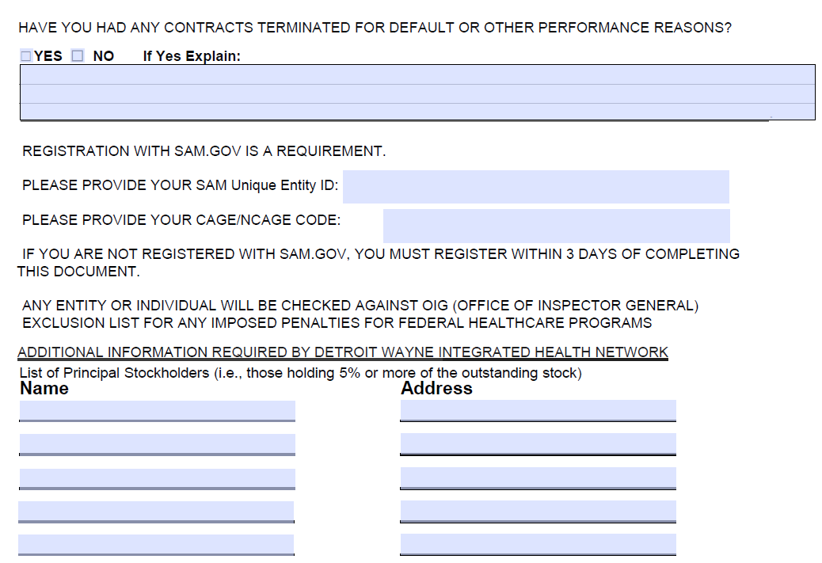
Please list if you had any contracts terminated for default or other performance reasons.
SAM Unique Entity ID and CAGE numbers are required for your contract.
List the names and addresses of principal stockholders holding 5% or more of outstanding stock.

Slide 6
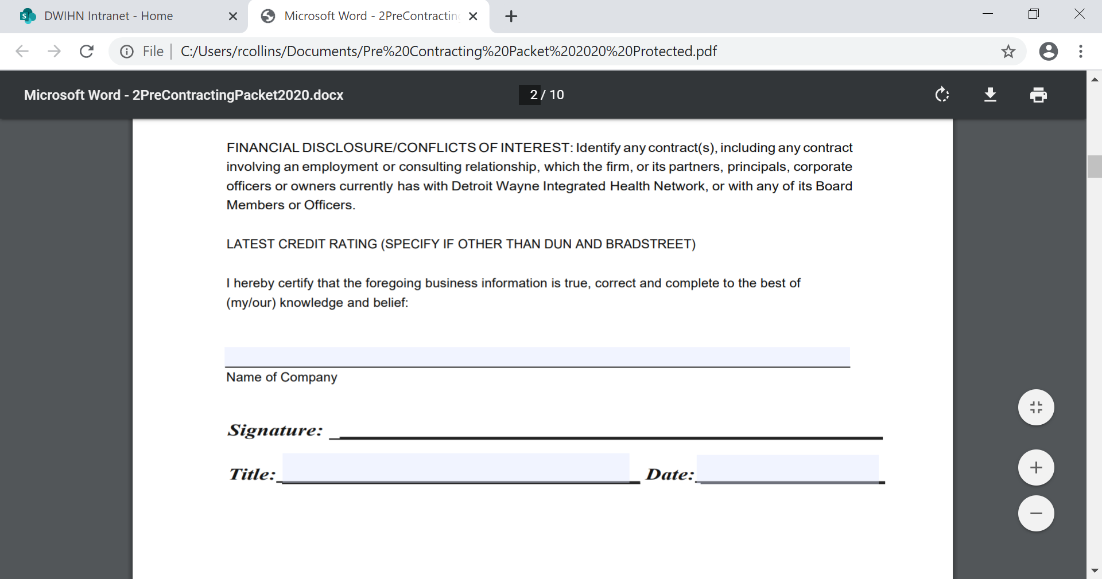
Please list the name of your company.
Please have contract signer sign. CEO/President/Executive Directors
Please list the date that you signed.
Please list your title. Ex. CEO/President/Executive Directors

Slide 7
DEBARMENT/SUSPENSION AGREEMENT AND CERTIFICATION & LIST OF SUBCONTRACTORS
The Debarment/Suspension Agreement and Certification & List of Subcontractors process protects the federal government from fraud, waste and abuse by using a number of tools to avoid doing business with non-responsible contractors. Suspensions, Proposals for Debarment, and Debarments are the most widely known tools as these actions are visible to the public via SAM.
The first page of the Debarment Suspension and Certification should have your name listed as the Provider, the program title and the term.
The last page of the Debarment Suspension and Certification should have the authorized contract signer’s signature and title.

Slide 8
Contract title Examples
MI- Health Link (Outpatient)
SUD- Substance Use Disorder (Prevention and Treatment )
Autism- Children (Outpatient)
Specialized Residential (Residential)
Unlicensed Residential Services ( SIL) Semi- Independent Living (owner/service provider to members) (Residential)
Financial Management Services: formerly known as Fiscal Intermediary (Fiscal)
MH Out-Patient Services (Outpatient)
MH Inpatient Services (Inpatient)
Staffing Agents/ Respite (Residential)
Skill Building/Supported Employment ( Outpatient)
**If you have multiple programs, enter both program titles.**

Slide 9
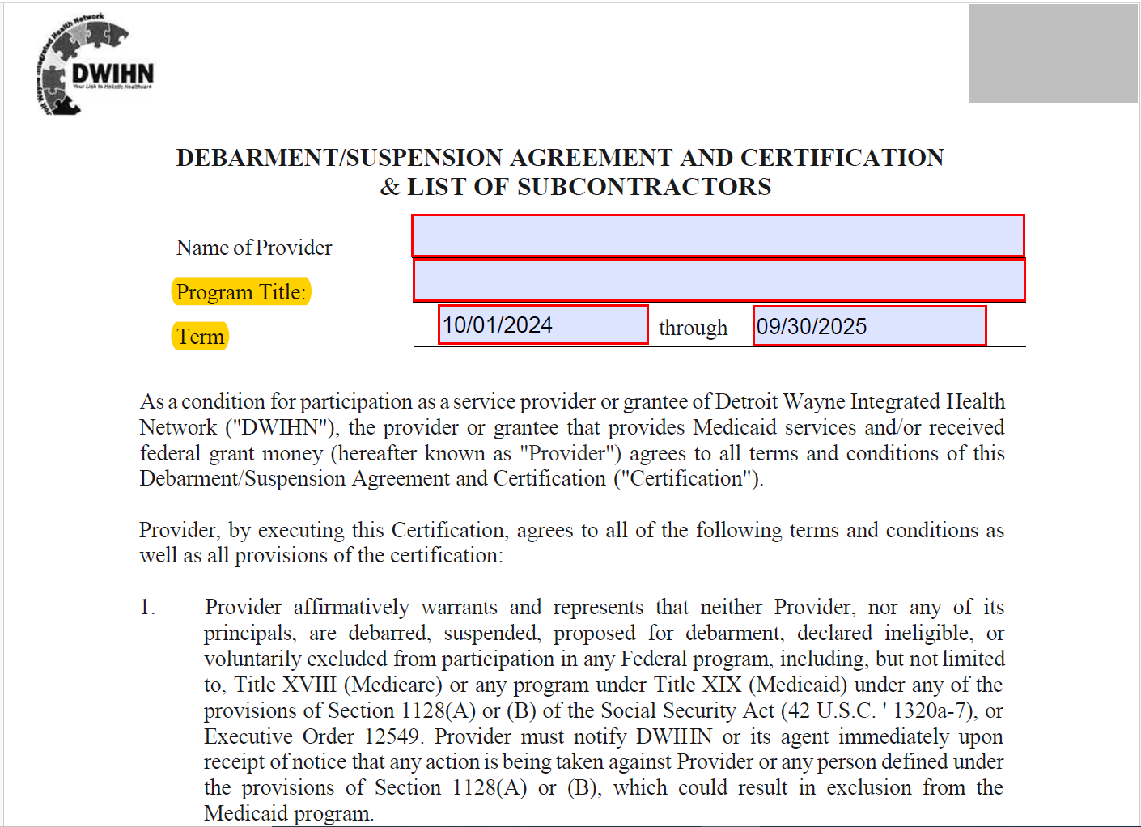
List the name of your company.
List the Contract Type– Outpatient, Residential, Fiscal, and SUD

Slide 10
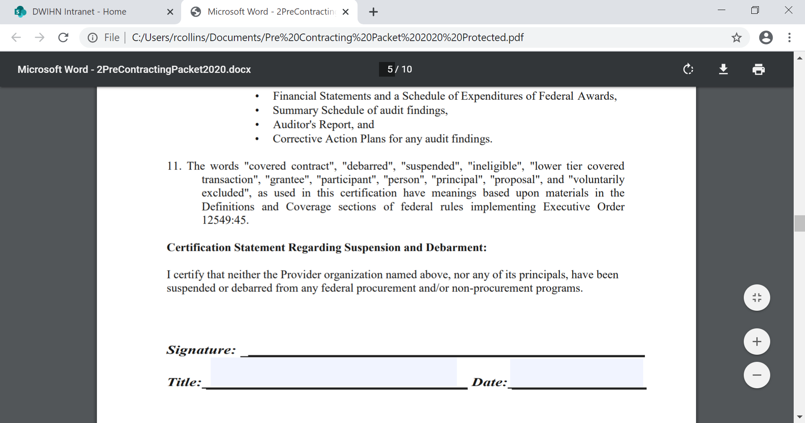
Please have contract signer sign. CEO/President/Executive Directors and date form

Slide 11
DETROIT WAYNE Integrated HEALTH NETWORK FIRST TIER SUBCONTRACTOR DESIGNATION FORM
First-Tier Subcontract means a subcontract awarded directly by the contractor for the purpose of acquiring supplies or services for performance of a prime contract.
This form must be completed even if you have no subcontractors.
#1 the contract number is only applicable if there is a bid announcement.
#2 Please check the box to indicate if your contract is over $50,000.

Slide 12
DETROIT WAYNE Integrated HEALTH NETWORK FIRST TIER SUBCONTRACTOR DESIGNATION FORM (Continuation)
#3 Please check the box indicating if you will use subcontractors for this contract.
The box below must be completed in its entirety even if there are no subcontractors being used for this contract.
Please print your name, add title, authorized contract signer name and date the bottom

Slide 13
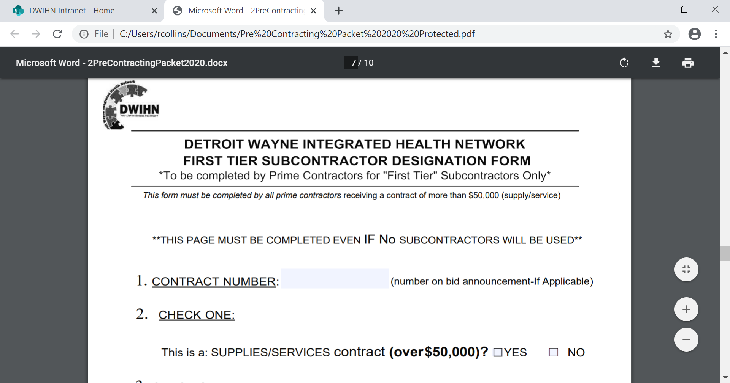
Please check if your services are over $50.000.

Slide 14
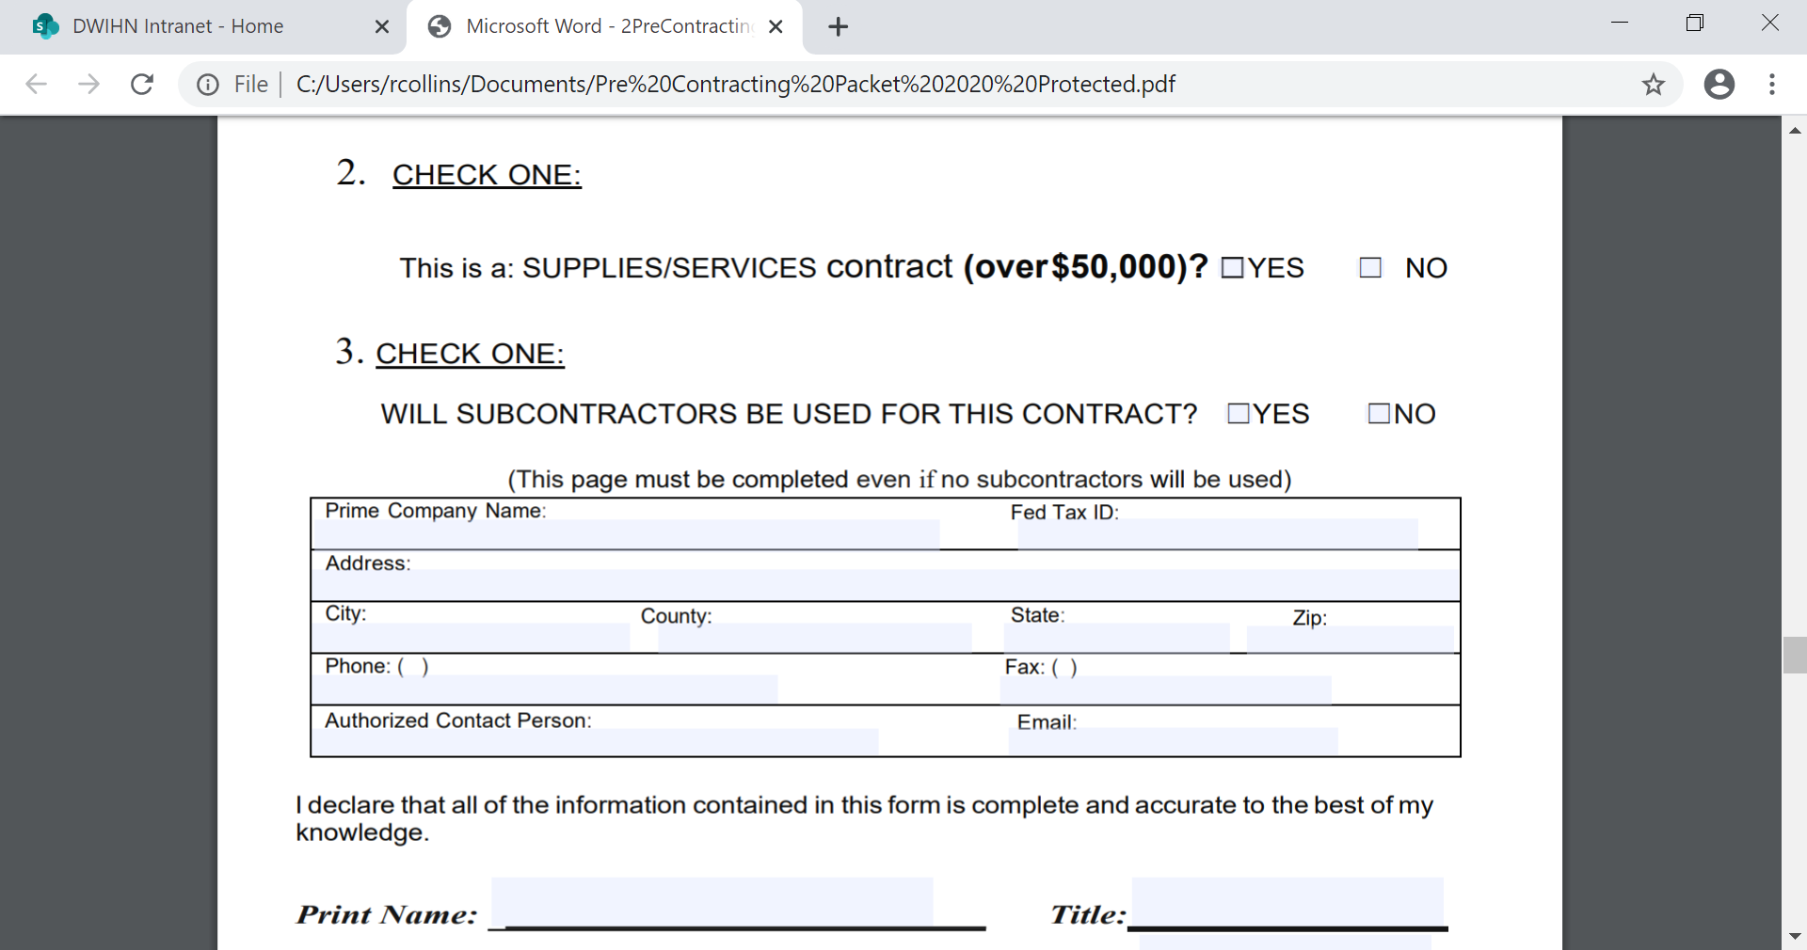
This box must be completed even if there are no subcontractors (all fields must be completed)
Please check if you will be using subcontractors.
Please print your name and add your title.

Slide 15
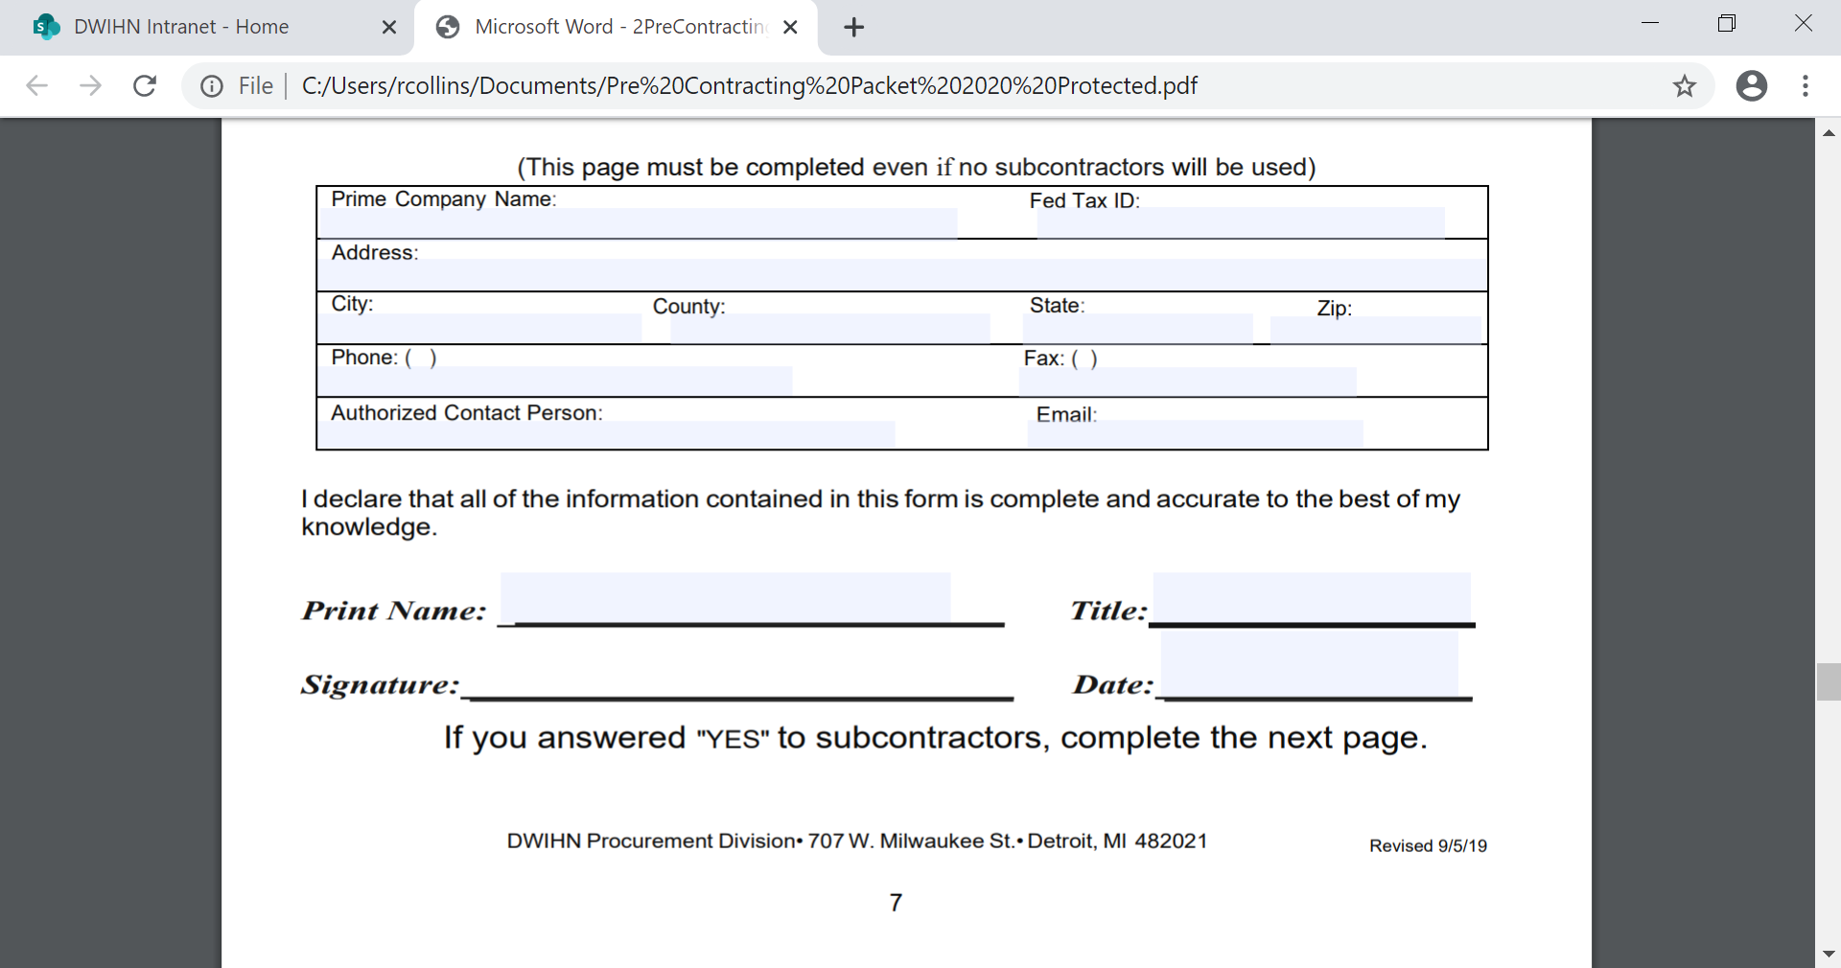
Please sign your name and date Here.

Slide 16
SUBCONTRACTOR LIST
Definition of a Subcontractor: A “subcontractor” is a company or person whom a prime contractor (or main contractor) hires to perform a specific task as part of an overall project or contract and normally pays the subcontractor directly for services provided.
Please make additional copies if you need to list additional subcontractors
There is a box for each subcontractor that must be completed in its entirety. Including the Fed Tax ID or the last 4 digits of the subcontractor owners Social Security Number.

Slide 17
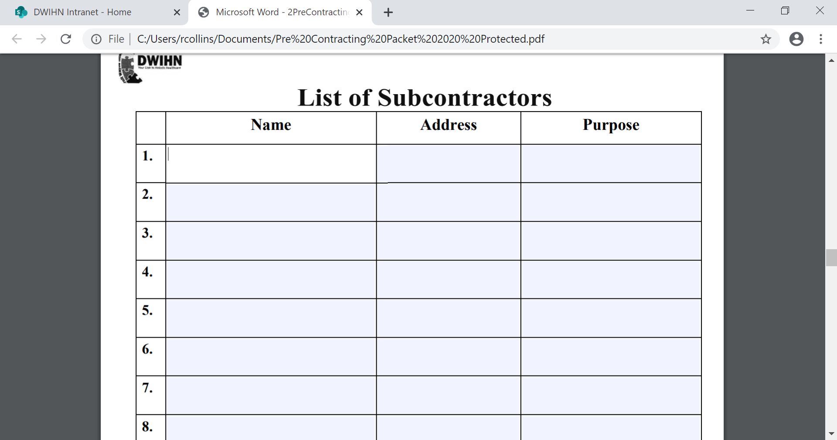
This form is for you to list the name, address and the purpose of all of your subcontractors

Slide 18
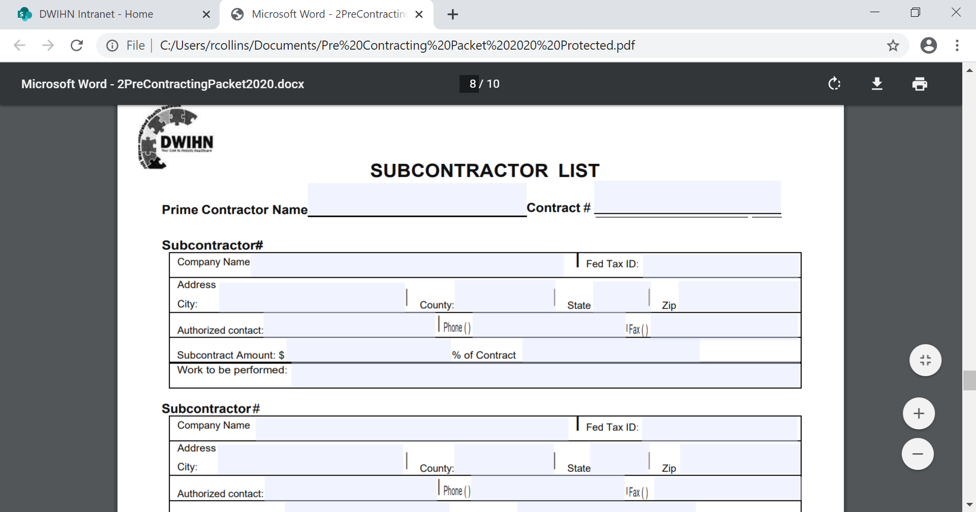
Please list your company nae here.
Please complete each box for each subcontractor. A federal tax ID must be provided or the last 4 digit of their social security number.

Slide 19
ETHICS
Ethics form is made up of a series of questions, which aim to help the principal investigator identify whether the project is 'high risk' and requires further formal ethical review.
Please answer each question fully and truthfully.
Please print your name, sign your name, add the date, the company name and the company tax id#

Slide 20
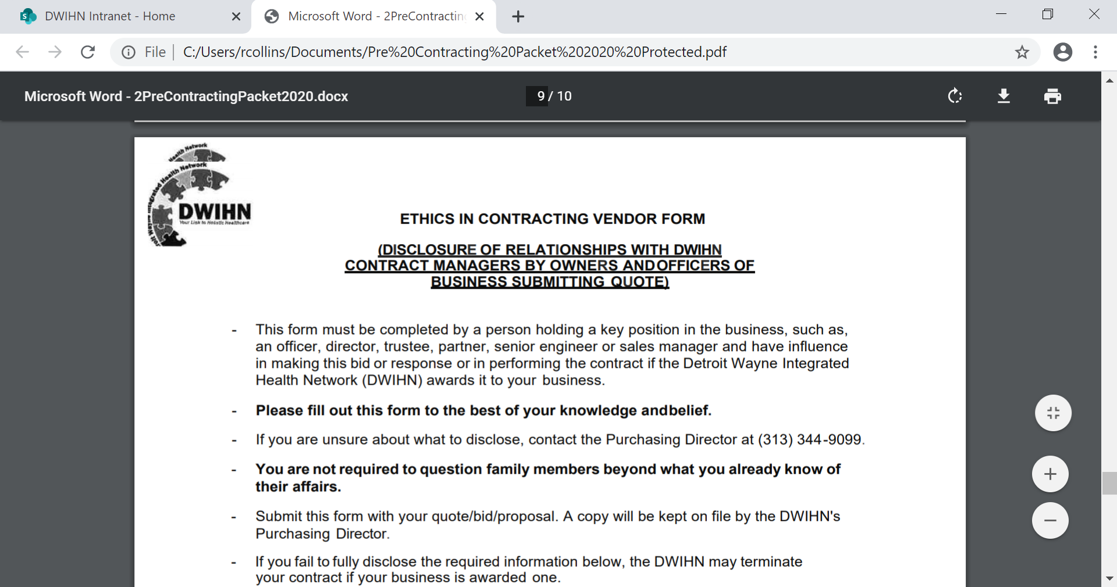

Slide 21
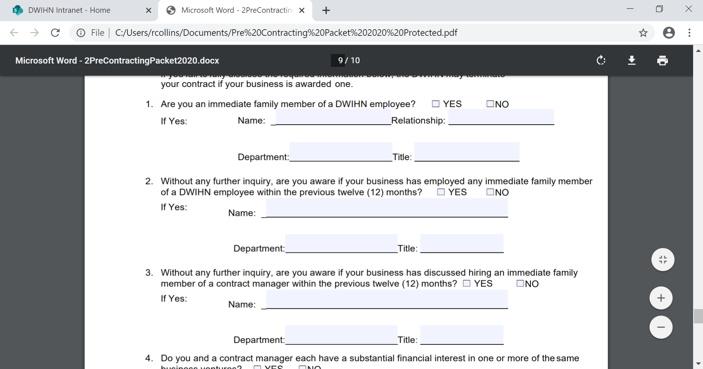
This form should be completed to the best of your knowledge.

Slide 22
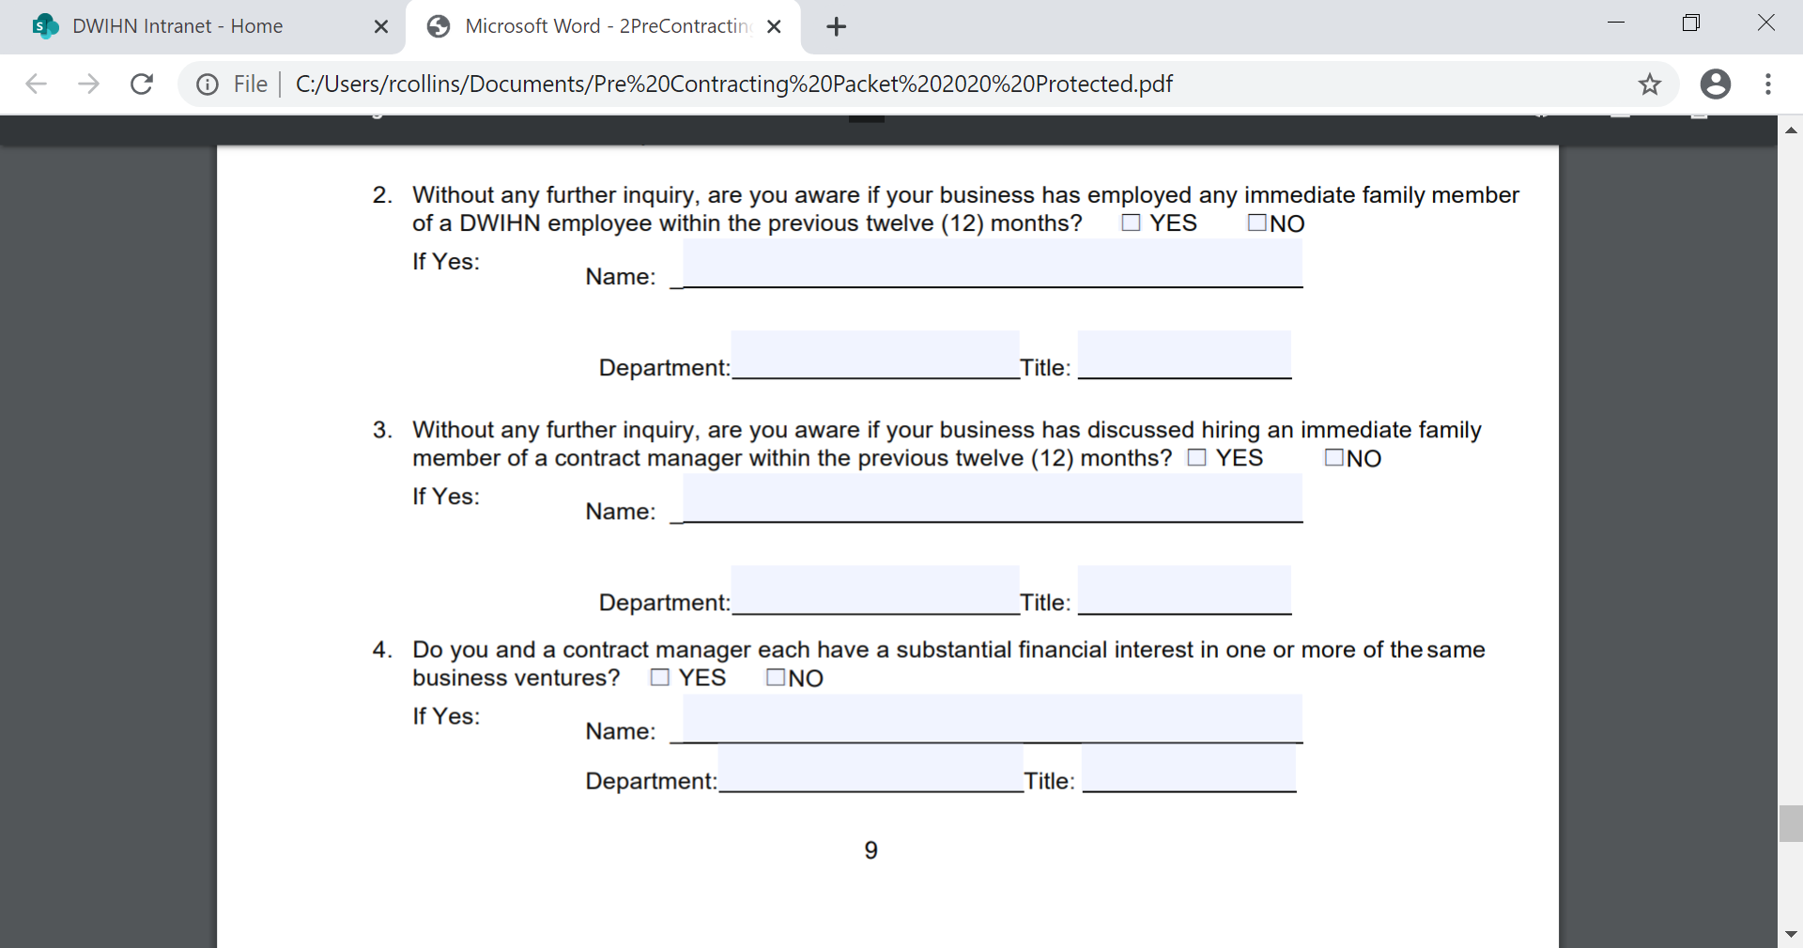
This page should be completed to the best of your
knowledge.
You must choose Y or N for each question

Slide 23
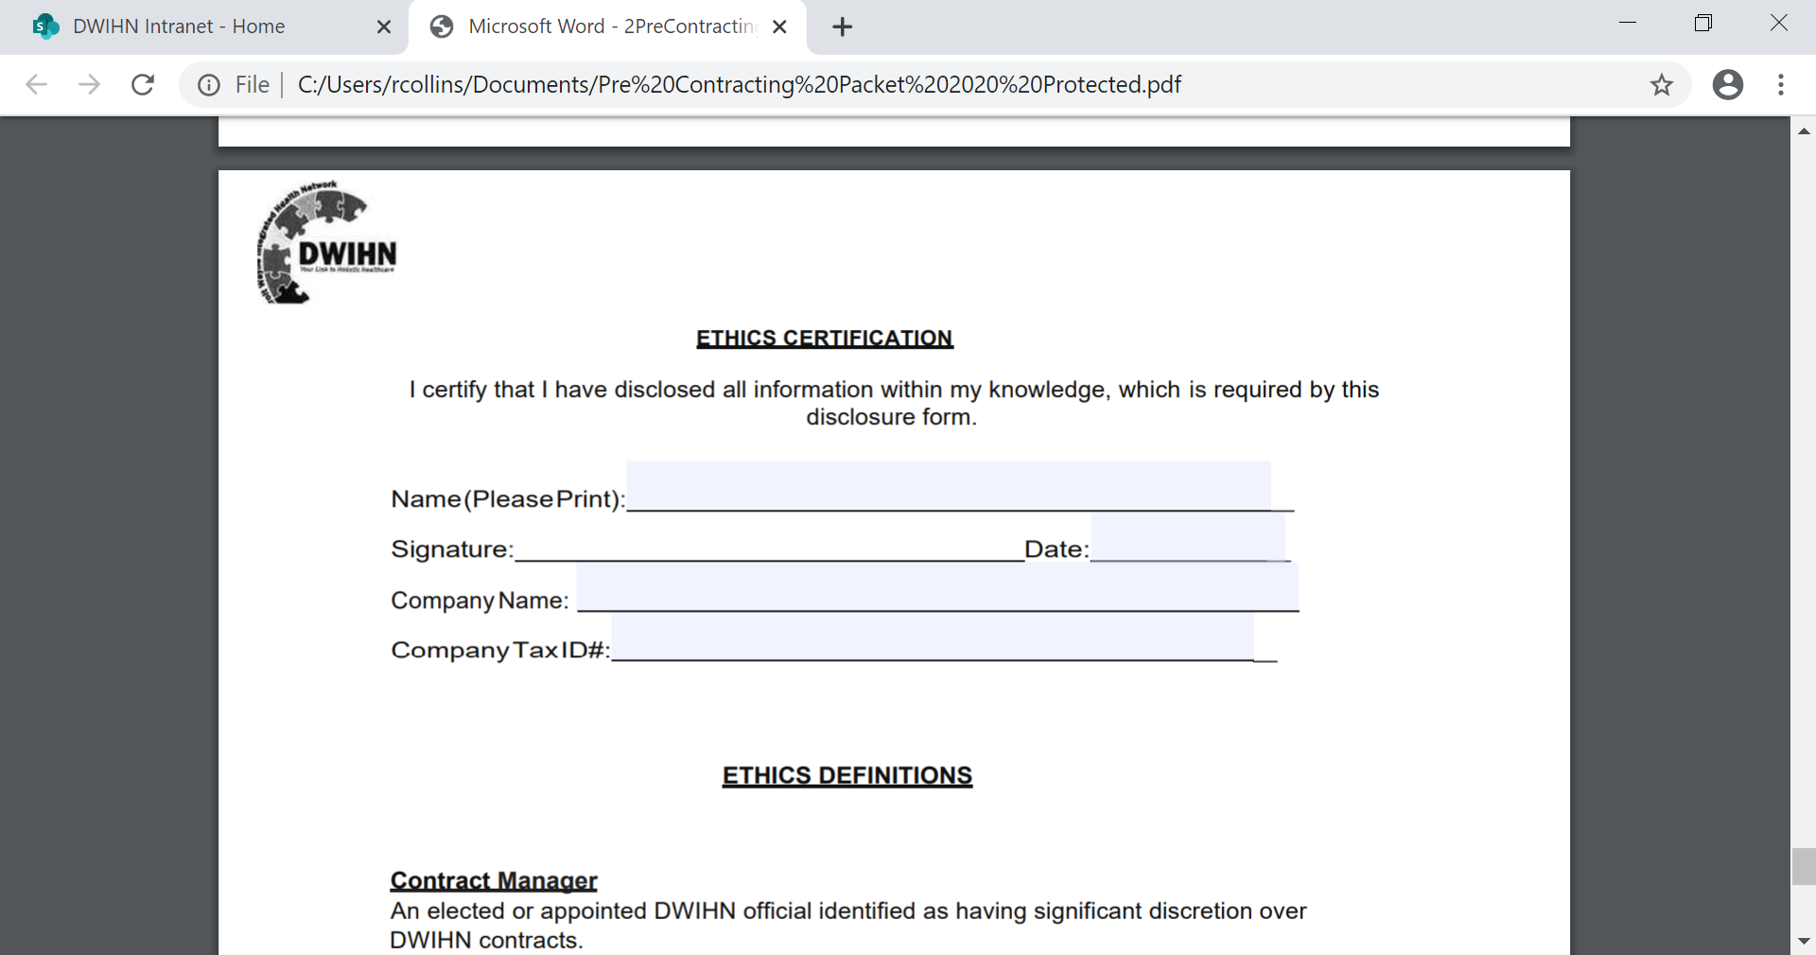
Please print, sign your name, date, list your company name and your tax ID #.

Slide 24
DISCLOSURE of OWNERSHIP and CONTROLLING INTEREST
The Disclosure of Ownership and Control Interest form is a federal regulation requirement under 42 CFR Part §455, applicable to all providers that participate in state-based health care programs, such as Medicaid & CHIP, and provide services pursuant to a contract between a Medicaid Managed Care Organization.
Please follow instructions in the form to complete

Slide 25
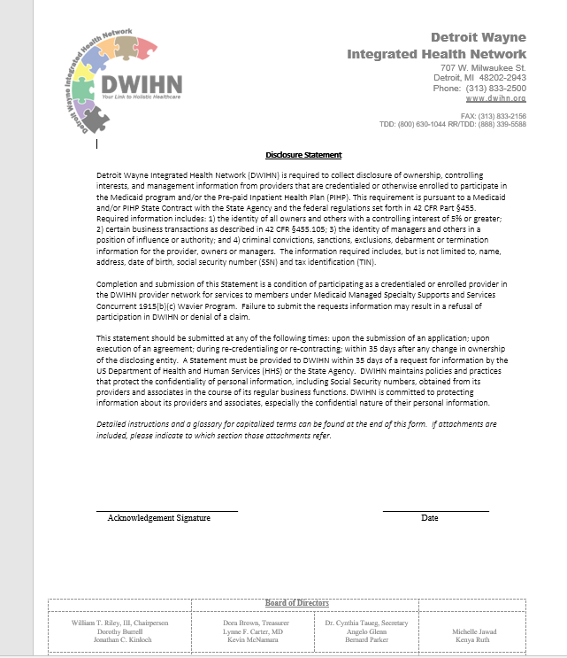

Slide 26
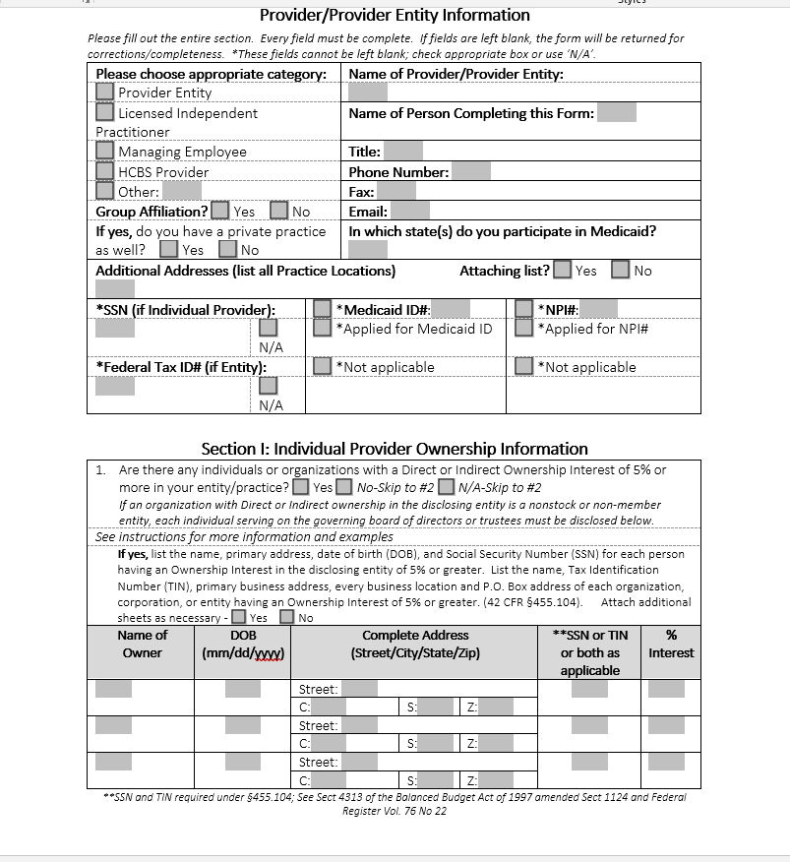

Slide 27
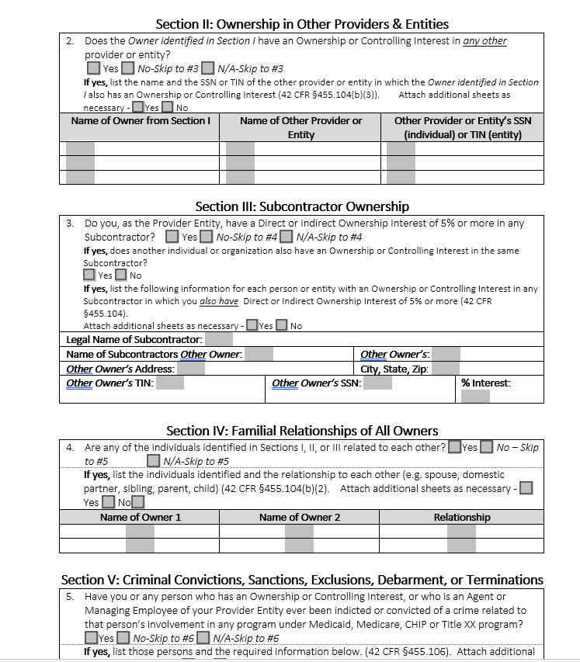

Slide 28
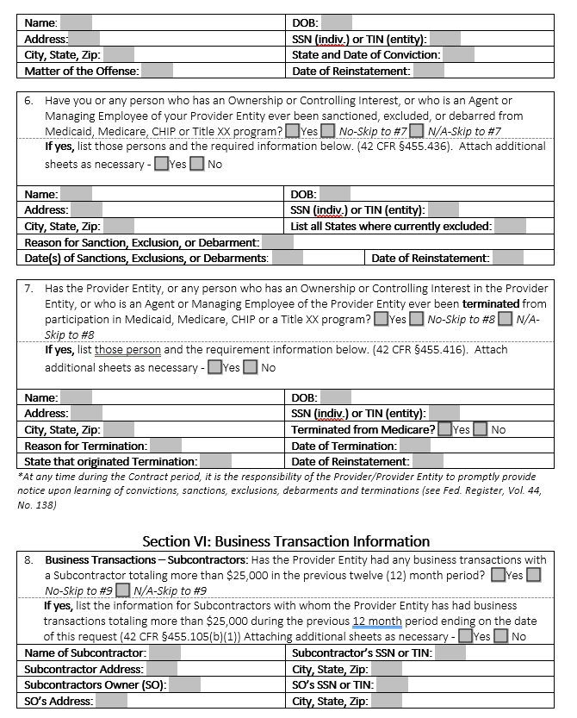

Slide 29
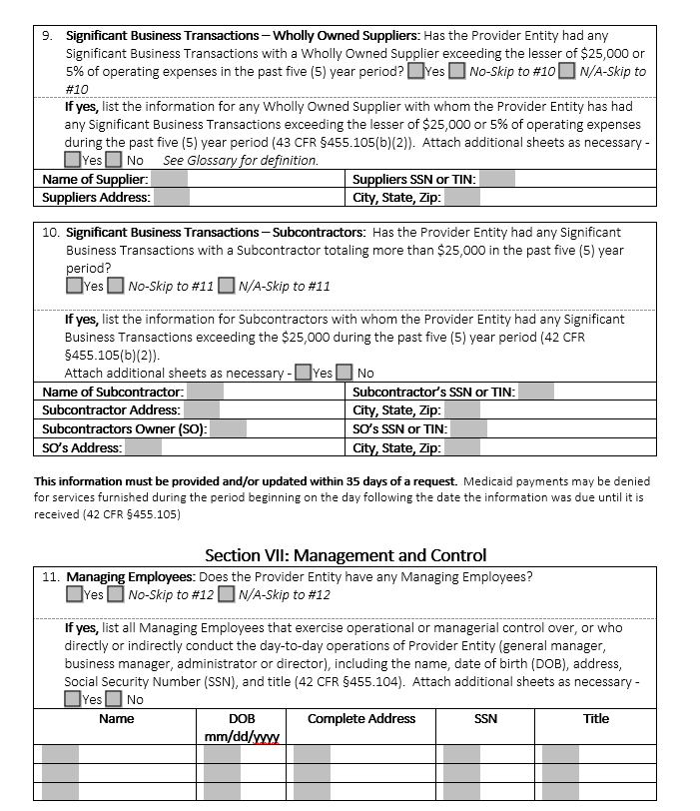

Slide 30
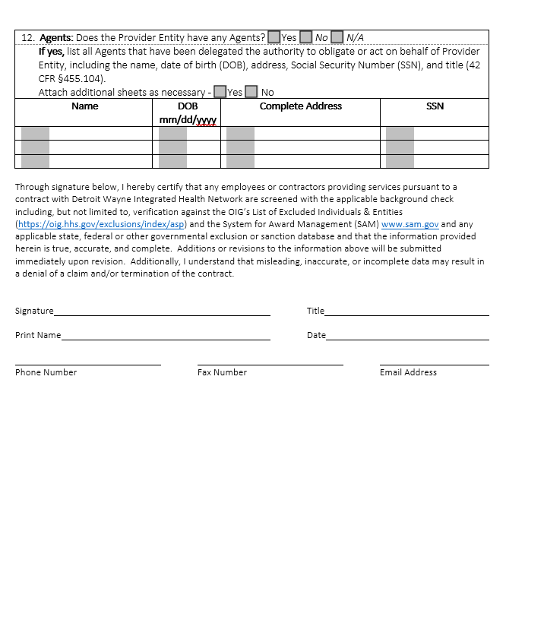

Slide 31
W9
Line 1 – Name
This should be your full name. It should match the name on your individual tax return.
Line 2 – Business name
If you have a business name, trade name, DBA name or disregarded entity name, fill it in here. If you do not have a business, you can leave this line blank.
Line 3 – Federal tax classification
This section defines how you, the independent contractor, is classified when it comes to federal taxes. You will check the first box if you are filing as an individual, sole proprietor or single-member limited liability company (LLC) owned by an individual and disregarded for U.S. federal tax purposes. A sole proprietor business operates under the owner’s Social Security number and hasn’t been registered as another type of business. Taxes apply to single-member LLCs in the same way.

Slide 32
W9 (Continuation)
Line 4 – Exemptions
You do not need to fill in this section as an individual. Only certain businesses or entities with any reason for exemption need to fill out these spaces. If this applies to you, you’ll need to provide a number or letter code that indicates that reason.
If your entity is exempt from backup withholding, you’ll fill in the first line with your code. This should apply to most entities. However, if your business is not, the company who hired you for your services will need to withhold income tax from your pay at a flat rate of 24% and send it to the IRS. This is known as backup withholding.
If you are exempt from reporting required by the Foreign Account Tax Compliance Act (FACTA), you will fill in the second line. The latter only applies if you hold your accounts outside the United States. If you maintain your account in the U.S., you can leave the second line blank or write “N/A.” If you’re unsure about your exemptions, Page 3 of the form outlines situations that would make you exempt.

Slide 33
W9 (Continuation)
Lines 5 & 6 – Address, city, state, and ZIP code
Line 5 requires the address (number, street, and apartment or suite number) where your employer will mail your information returns. The following line, Line 6, leaves a space for you to enter the city, state and ZIP code of this address.
Line 7 – Account number(s)
This is an optional line where you can fill in any account numbers your employer may need. Most individuals can leave this blank.

Slide 34
W9 (Continuation)
Part I – Taxpayer Identification Number (TIN)
You have two options in this section. You can enter either your Social Security number (SSN) or your employer identification number (EIN). Typically, you provide your SSN if you file as an individual or single-member LLC. Use your EIN if you file as a multi-member LLC classified as a corporation or partnership. If you are a sole proprietor, you could use either number, but your SSN is preferable.
If you are a resident alien and you are not eligible for a SSN, you should use your IRS individual taxpayer identification number (ITIN).
Again, you may want to check with your tax advisor or contact the IRS directly to double check your information. Providing an incorrect TIN can cause issues with your payments or tax return. It can also lead to future backup withholding.

Slide 35
W9 (Continuation)
The other boxes correspond to C corporation, S corporation, Partnership and Trust/estate businesses.
The Limited liability company box is for a Partnership or LLC businesses with multiple members. You can check this box if you own an LLC treated as a partnership for federal taxes (fill in “P” in the adjacent space), an LLC that has filed Form 8832 or 2553 and is taxed as a corporation (fill in “C” or “S” in the adjacent space depending on the type) or an LLC whose owner is another LLC not disregarded for federal tax purposes (fill in the appropriate letter in the adjacent space). If your LLC has not filed a request to be taxed as a C or S corporation, it is taxed as a Partnership. The “Note” on the form clarifies the LLC-specific rules. You can always seek your attorney’s or tax advisor’s help to ensure you complete your form(s) correctly

Slide 36
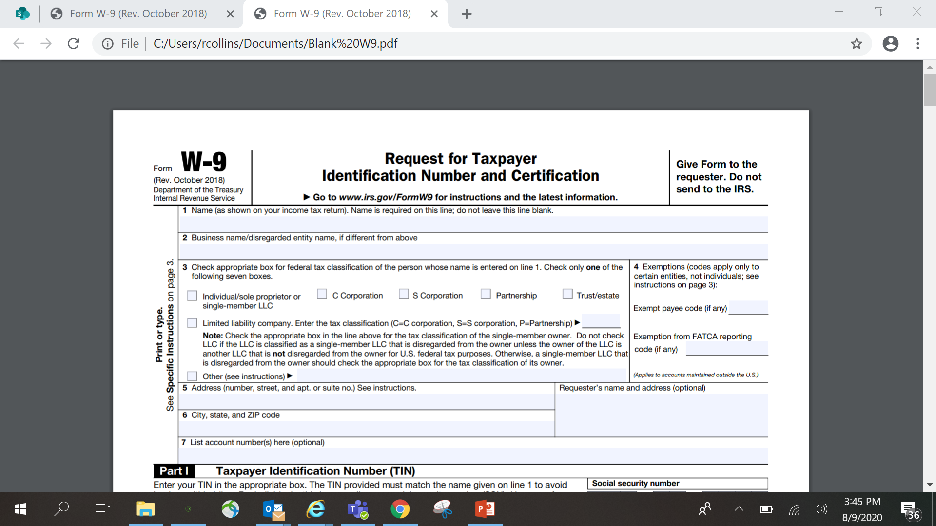
W-9
This form should be completed in its entirety.

Slide 37
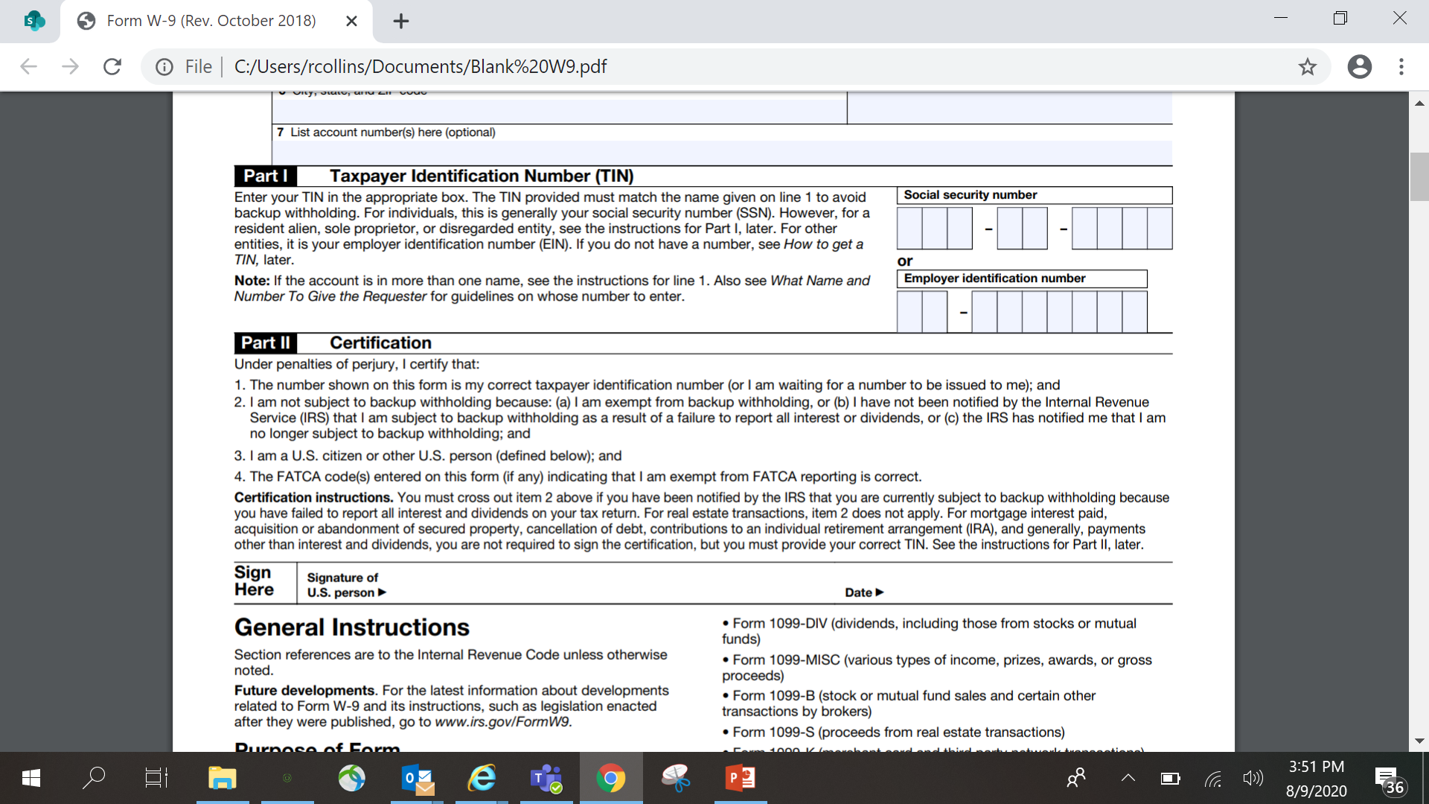
This form should be completed in its entirety.

Slide 38
CERTIFICATE of INSURANCE
A Certificate of Insurance (COI) is a statement of coverage issued by the company that insures your business. Usually no more than one page, a (COI) provides a summary of your business coverage. It serves as verification that your business is indeed insured.
Please provide a copy of your current Certificate of Insurance for your company.

Slide 39
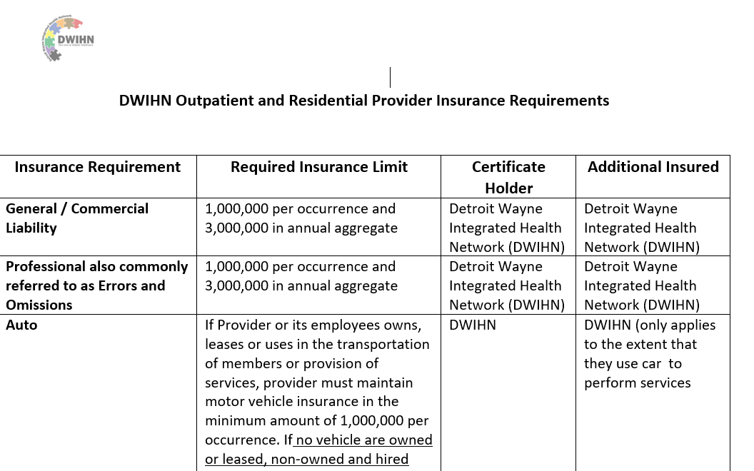

Slide 40
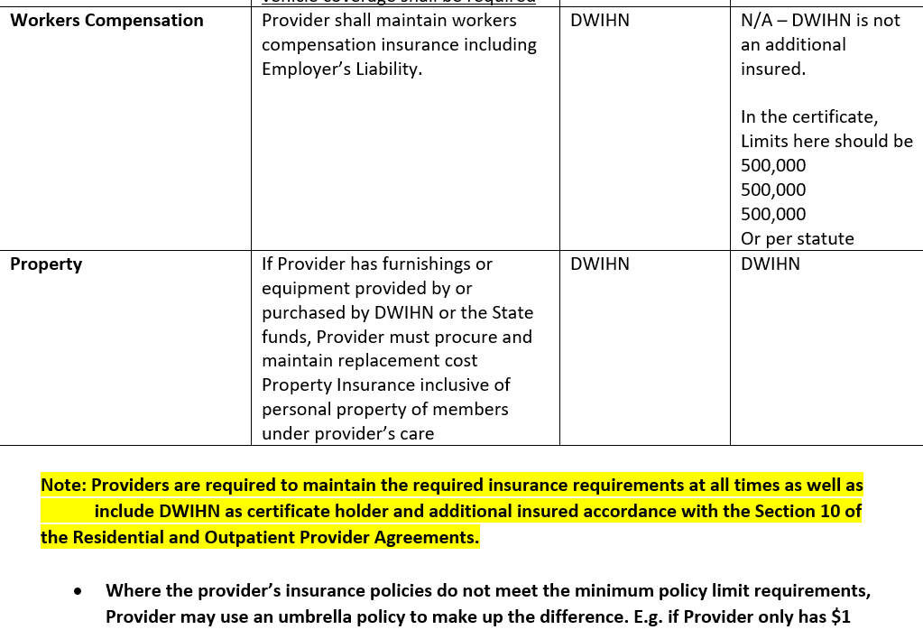

Slide 41
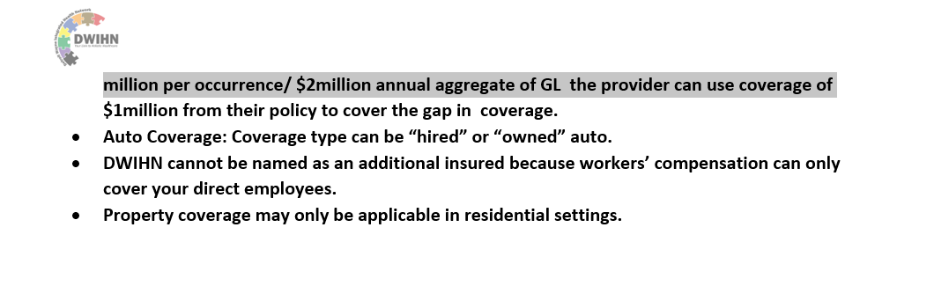

Slide 42
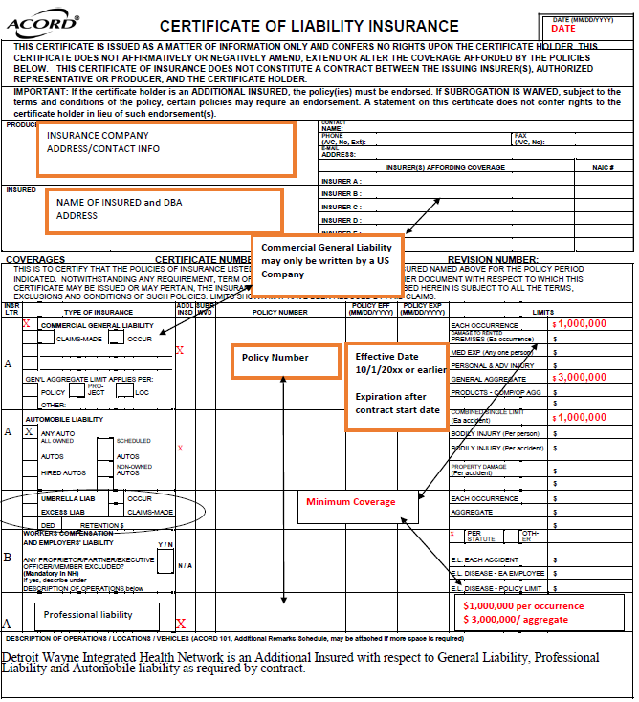

Slide 43
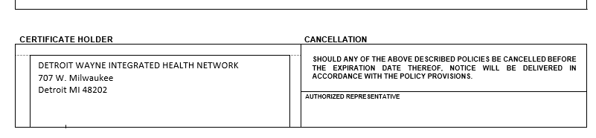

Slide 44
Sam.Gov
The System for Award Management (SAM) is an official website of the U.S. government. There is no cost to use SAM. You can use this site for FREE to:
Register to do business with the U.S. government
Update or renew your entity registration
Check status of an entity registration
Search for entity registration and exclusion records

Slide 45
OIG
Your Provider Network Manager will check OIG for Provider Status prior to contracting
Office of Inspector General(OIG) maintains a list of all currently excluded individuals and entities called the List of Excluded Individuals/Entities (LEIE). Anyone who hires an individual or entity on the LEIE may be subject to civil monetary penalties (CMP). To avoid CMP liability, health care entities should check the list monthly to ensure that new hires and current employees are not on it.

Slide 46
Pre-contracting Packet Checklist:
Business Information Questionnaire
Debarment/Suspension Agreement and Certification & List of Subcontractors
Ethics in Contracting Vendor Form
Disclosure of Ownership/ Statement
W9 *(new provider or if changes have occurred)
Certificate of Insurance *( ensure proper limits/DWIHN named as additional insured)*
EFT Form -*( new providers or if changes have occurred)
Note: before submitting the pre-contracting packet please review, the email address and CEO/Authorized signer name for accuracy. All signatures are electronic and the provider will get a copy of the contract sent to them once all signatures are finalized by email.

