Slide 1


How to set up a Self-Directing Service Arrangement SD Team Beverly Thompson, Chaundrika Baldwin, Lucinda Brown

Slide 2
Welcome The DWIHN SD Team wants to Support You!
The author of the Individual Plan of Service have the crucial responsibility for linking, coordinating, and monitoring services for multiple people who receive services. We understand it is hard to be an expert in everything. It is a requirement/question in every Pre-Plan that and explanation and offering to Self-Direct (SD) Service is provided. Therefore, it is expected that the “Support Coordinator” minimally know how to explain what Self-Directing Service is. DWIHN’s website has multiple training resources/tools to accommodate different learning styles. If the tools are not enough, the DWIHN SD Team is only an email or phone call away to help walk the author and the individual through the process to ensure a smooth SD set-up.
Delays in set-up impact the person served. The author of the IPOS play a crucial role in initiating services. For the purpose of this presentation, this person is referred to as the “Support Coordinator”.

Slide 3
~Meet the Team~
Beverly Thompson, Clinical Specialist; primarily responsible for authorizations, Durable Medical Equipment, and Enhanced Pharmacy.
Chaundrika Baldwin, Financial Management Service Coordinator; primarily responsible for agreements, all coordination that involves the FMS agencies, triaging various issues regarding starting an SD Arrangement or billing issues.
Lucinda Brown, Program Administrator; primarily responsible for all of the above in addition to ORR allegations, SD to Residential moves, Habilitative Support Waiver (HSW) team, and Applied Behavioral Analysis (ABA) Teams.

Slide 4
-What is Self-Directing Services and Self-Determination -How to support a person in setting up a SD Arrangement -Things to consider for the budget and flexible spending. -Details of the Welcome Meeting and the Spending Plan Meeting
LEARNING OBJECTIVES

Slide 5


Although many people use the terms
self-determination
and
self-directed services
as if they mean the same thing,
they actually have two different
meanings.
Self-Directed Services
Self-Determination

Slide 6
Self-Determination
Self-Determination is the broader term, and is based on the principles of Freedom, Authority, Support, Responsibility, and Confirmation.
These principles focus on the rights of all individuals:
to decide how to live their own lives (where and with whom)
to have knowledge of their funding
to have help to organize their resources
to be responsible for the wise use of public resources
to have the ability to play important roles in their communities if they choose to do so
We must use the principles of Self-Determination with every person we support!

Slide 7
Self-Directed Services
Self-Directed Services is a partnership between DWIHN and the MEMBER. All members (adults and children) have the option to self-direct. It is a method for moving away from professionally managed models of supports and services. It is the act of selecting, directing and managing one's services and supports.
People who self-direct their services are able to use support to decide how to spend their Behavioral Health dollars in a creative manner. All creative spending must meet Medicaid requirements.
Self-Directed Service is a method of service delivery.

Slide 8

The Benefits
Self-Directing Services gives the individual:
Greater control over who directly provides the authorized
services, the member /legal representative is the Employer
Flexibility to use services how you want to meet the goals
identified in the Individual Plan of Service (IPOS)
Greater staff retention as well as fewer required staff trainings
Control over staff rate of pay (direct hire rates are generally higher)
Out of network providers can be used after Medicaid qualifications are verified
Flexibility over using behavioral health dollars (up to DWIHN standardized rates)

Slide 9
Self-Directing Services
Self-Directing services (formerly referred to as Self-Determination) is one of two methods of services delivery at DWIHN and is required to be offered at every Pre-Plan. During the Person-Centered Plan meeting where services are discussed, “how” the services will be delivered must be decided by the member/legal representative.
Two methods of service delivery at DWIHN
Traditional service delivery | Non-traditional service delivery
Network Providers, Licensed Homes, SIP/SIL -DWIHN has a contract with the provider, the authorization would be in the provider’s name; staff may choose the agency and interview potential staff from the agency. -The provider is the employer. *A RESIDENTIAL ASSESSMENT MUST BE COMPLETED | Self-Directing Services -The member/Legal Rep are the employer. -Puts the member/Legal Rep in control of how to use their Behavior Health funds. -The member/Legal Rep can select family, friend, or an agency to provide authorized services. -The member/Legal Rep are not required to use a DWIHN contracted provider but all providers must meet Medicaid qualification requirements. -The Financial Management Service (formerly referred to as Fiscal Intermediary) pays the employees on behalf of the member.

Slide 10
FIRST STEP TO SELF-DIRECTING SERVICES
Follow the DWIHN Checklist for Self-Directing Services as a guide.
Through the Person-Centered Planning process when services are discussed, “how” the services will be delivered must be decided by the member/ legal representative.

Slide 11
Next Steps to SDS set-up
The SC (or Independent Facilitator) should facilitate the Individual Plan of Service (IPOS) or an Addendum to the IPOS to identify and authorize the self-directed services and supports selected by the member.
The services (typically Community Living Support- H2015 or respite- T1005) must have the FMS as the “provider”.

Slide 12
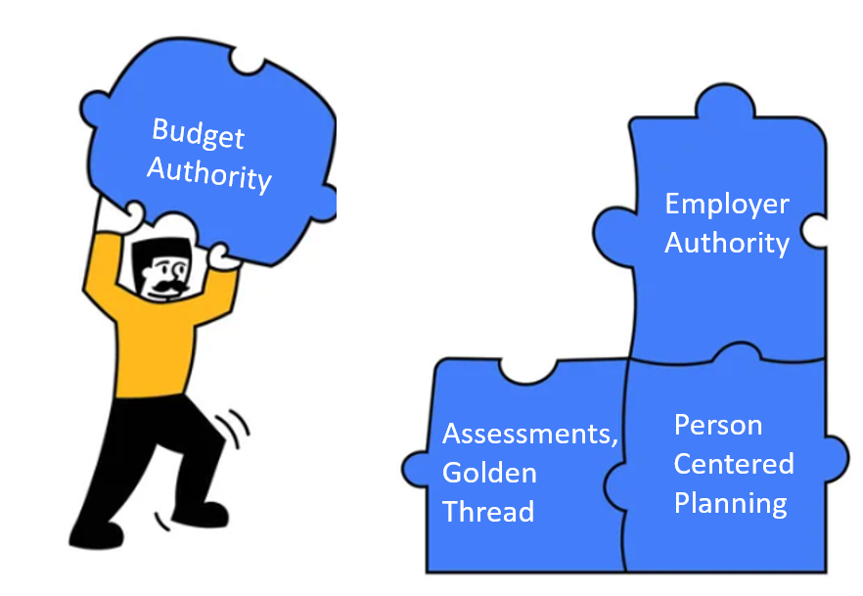
What should a good goal in a PCP include?
Good Person-Centered Planning is a Foundation for
Self-Directing Services

Slide 13
Goal Statements & Objectives
The Goal Statement (life goals- what is my good life), :
In the member’s own words (person who speaks on their behalf if they do not use words to communicate)
Identifies what the member wants to achieve or what is the intended outcome.
Must be in first-person language (ex. I will...) or with identifying legal rep speaking on behalf of the person.
The Objective (how will I know I meet my goal)
Must be S.M.A.R.T. Specific, Measurable, Attainable, Relevant, Time-Bound
Should be short, simple, and to the point.
Answers the question, how will anyone reading the plan know if the goal is achieved?

Slide 14
INTERVENTIONS
The Intervention:
Details what the member can currently do(baseline/their contribution)/why this is important.
Identifies what community or natural supports have been exhausted before CMH services requested.
Identifies what and why the service is needed to help achieve the outcome/goal.
Identifies what services the person will self-direct with a statement such as, "X will self-direct his community living supports. However, other services may be used in lieu of this service to accomplish the goals in the IPOS as long as the total budget is not exceeded".
Identifies how often (hours, # of times per week/month) the person needs help/the service to have the best opportunity to achieve goals; the amount, scope, and duration of services (ie. authorization). This total should be reasonable to accomplish the intended outcome.
Identifies if the person will be using their budget in a flexible manner to accomplish the goal (ie. To purchase memberships, classes, activities). Individual activities are not required.
Is detailed enough to be a “job description” or details the steps to give the member the best opportunity to learn/achieve his/her goal. Must detail what method of teaching, training, or guiding the staff will perform to help the member achieve his/her goal.
Identifies how staff will document progress.
Identifies the SC will review/document progress on goals.
*Bolded areas must be included in the interventions

Slide 15

STEPS TO SELF-DIRECTING SERVICES
The member/Legal Representative is offered a choice of Financial Management Service Agency (FMS)(formerly called Fiscal Intermediary Services)
-Money Minders Plus, LLC (MMP)
-Personal Accounting Services (PAS)
-Guardiantrac (GT Independence)
-The ARC of Northwest Wayne County (ARC)
The member/Legal Representative selects the method of staffing support desired: Direct Hire Staff and/or Staffing Agent.
The Case holder/plan authorwill put the authorization for the self-directed service (usually H2015 or T1005) with the selected FMS as the provider.

Slide 16
FMS Authorizations
The Case holder/plan author enters a single/separate authorization with no other service in the same auth for T2025 with the correct modifier for 1x/month for the selected FMS service provider.
-T2025 x7- Member has the FMS as a representative payee for entitlements or has a direct hire for CLS and/or Respite services (formerly called Full Budget).
-T2025 x4- Independent Support Coordinator/broker. Rarely used externally (in MHWIN).
-T2025 x3- Member has an Agency Supported Self-Direction Model.

Slide 17
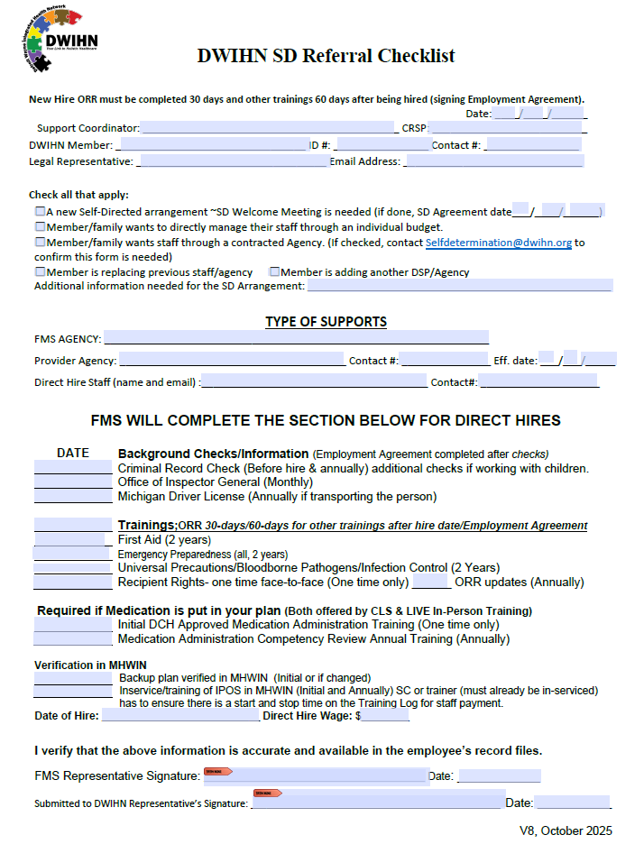
Next step: The SC must complete a SD Referral Checklist
The Case holder/plan author must complete the top three sections of this form (Stop at FMS section).
If the IPOS/Addendum is complete, SC must in-service the staff and send the Training Verification Log with the referral to prevent delays in staff starting. If not, SC must complete the in-service within 7 calendar days and upload to MHWIN.
*Email the form to the FMS and selfdetermination@dwihn.org (DWIHN).
*This initiates the system setup. FMS will start onboarding. DWIHN will send Welcome Meeting information and confirm a timely arrangement set up.

Slide 18
New Process Improvement
We all want members to get services ASAP!!!!
The FMS will give staff the okay to work after the minimal employment verification factors have been obtained (application, Criminal Background Checks, and verification to work in the US). An employment agreement is signed (staff is hired) much quicker with this process.
In a self-directed arrangement, Support Coordinators will need to have an in-service for the direct hire or the employer before the FMS gives a start date. If the employer is in-serviced, they can then in-service their employees. The in-service needs to be sent with the referral.
After being hired, staff will have 30 days to complete New Hire ORR and 60 days for all other trainings.

Slide 19
Next Steps to set up a SD Arrangement
SC completes a backup or crisis plan with the member/legal representative identifying what happens if staff cannot work and uploads the document into MHWIN with IPOS as the document type.

Slide 20
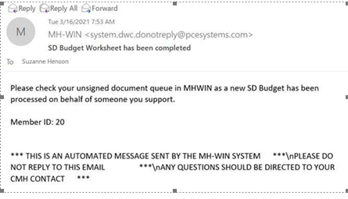


SIGNING THE BUDGET
Once the DWIHN SD Staff has completed the budget and designated the signers, an email notification that a document needs to be signed will be sent to the person completing the auth (usually the SC). The CRSP has 30 days from the date of the email to sign and obtain the member's or guardian's signatures.
Budgets are found in this section.

Slide 21
Final Steps
Within 30 days- The Case holder/plan author will work with the individual (or legal representative, if applicable) to get the budget and IPOS (or Addendum signed) and upload it to MHWIN. Signatures confirm a mutual agreement.
After the budget and IPOS are signed, based on when the individual (or legal representative, if applicable) is available, the Case holder/plan author will schedule a Spending Plan Meeting with the FMS. The FMS and Employer of Record are required to be present, and the Case holder/plan author is encouraged to be present.
FMS will facilitate a Spending Plan Meeting no later than 30 days after the budget is signed.
Spending Plan Meeting Contacts
Guardiantrac/GT Independence- Heather Quaak, email; hquaak@gtindependence.com, 269-503-7408 x572
Money Minders Plus, LLC, Ashley Wilson, 734-522-0080, email; ashleyw@mmpbiz.com
Personal Accounting Services (PAS), Christine Delozier, 734-729-3100, email; cdelozier@passelfdirection.com
The ARC of Northwest Wayne County, Lisa King, 313-532-7915, email; lking@thearcnw.org

Slide 22
What is a Spending Planning Meeting?
A Spending Plan Meeting is the time to meet with the FMS to put the dollars into action. DWIHN uses the information from the IPOS to create general categories in the Budget Worksheet. Costing out/spending up to the maximum in the Budget Worksheet becomes the Individual Budget. Monthly reports will be based on the rate determined by the Individual budget.
The Individual Budget will include amounts of flexible spending (costing out) that was discussed during the Person-Centered Planning meeting. In the Spending Plan Meeting, the FMS uses the categories to put dollars in “buckets” for the Individual Budget.
As long as the person uses or interchanges funds within an existing category/bucket, no change to the IPOS is needed. A person must use the budget as identified in the plan. If any thing new or different is requested outside of the original agreement, the IPOS (and possibly the budget or category) must be reviewed, agreed upon, signed by DWIHN and the individual, and updated.
The FMS will provide Monthly Budget Reports to report the status of budget use.

Slide 23
Individual Budget
What must be included in the Budget
Required employment taxes
Worker’s compensation
Earned Sick Time
Staff pay rate
What can be included in the Budget
Not an exhaustive list….
Mileage
Paid training
Meeting attendance (staff)
Holiday pay
Built-in overtime
Memberships
Classes
Insurance
Cost of local activities
Retention incentives

Slide 24
Things to Consider for Budget Items
The request must be clearly and directly related to an identified need or goal achievement.
The item cannot otherwise be provided through a Medicaid Waiver or Medicaid State Plan.
The item or service would promote inclusion in the local community; and/or increase the participant’s safety in the home environment; and/or promote productivity.

Slide 25
Things to Consider for Budget Items pt.2
Is this request for the benefit of the person served?
Does this address the goals of the plan?
Would an average citizen justify the purchase as a wise use of public taxpayer dollars? Is this a good value?
Examples (not an exhaustive list):
Reduction of need for Medicaid services due to purchase (spending 2 hours at a class means 2 hours less of staffing).
Prevention of increased Medicaid costs down the road (Purchasing an item known to reduce stress will prevent future inpatient hospitalization).
Purchase will allow the individual to invest in activities that build their circle of support/increase belonging with the intent of moving from reliance on the service system to interdependence in their community. (Membership fees for club activities or associations, local bus passes to travel to see friends, and other various activities with costs that build long-term relationships).

Slide 26
What is the Welcome Meeting?
The Self-Directed Service team has several days and times of the week that are set aside specifically to be available to “Welcome” anyone (Support Coordinators, CRSP staff, stakeholders, individuals, or their family member receiving services, etc) who has questions, concerns, or needs anything related to Self-Directed Services. Time is also used to welcome new individuals who wish to self-direct their services. A member of the SD team goes over the roles and responsibilities related to a SD Arrangement by reviewing the Self-Directed Service Agreement and allowing new employers the opportunity to ask any questions.

Slide 27

The Self-Directed Services Agreement is discussed at the Welcome Meeting
The Self-Directed Service Agreement is a contract between
The Purpose of the Self-Directed Services Agreement:
Describe the responsibilities of the Detroit Wayne Integrated Health Network (DWIHN), including ways that the DWIHN can support the individual in creating and using self-directed services
Describe the authority and responsibilities of the individual/Employer of Record
Describe how the agreement, the IPOS, and or the individual budget can be changed
Describe the Financial Management Service Arrangements

Slide 28
Some Essential Responsibilities Related to Self-Directing Services for the Employer of Record (Discussed in detail at the Welcome Meeting)
Cannot exceed the budget
Must receive written confirmation that staff can begin working and billing for services from the Financial Management Service Agency.
Hiring staff is a responsibility; employment, equal opportunity, as well as all labor laws must be followed.
If staff training expires and they are directly hired (person is the employer) and continue to work, the employer may be responsible for paying the staff.
Signing timesheets is a legal Medicaid verification of service delivery and falsifying times can have legal consequences.
All documentation must meet Medicaid requirements; be detailed enough to support the service provided.
Cannot use Medicaid dollars to pay a provider unless their Medicaid credentialing for the specific service has been verified by DWIHN.

Slide 29
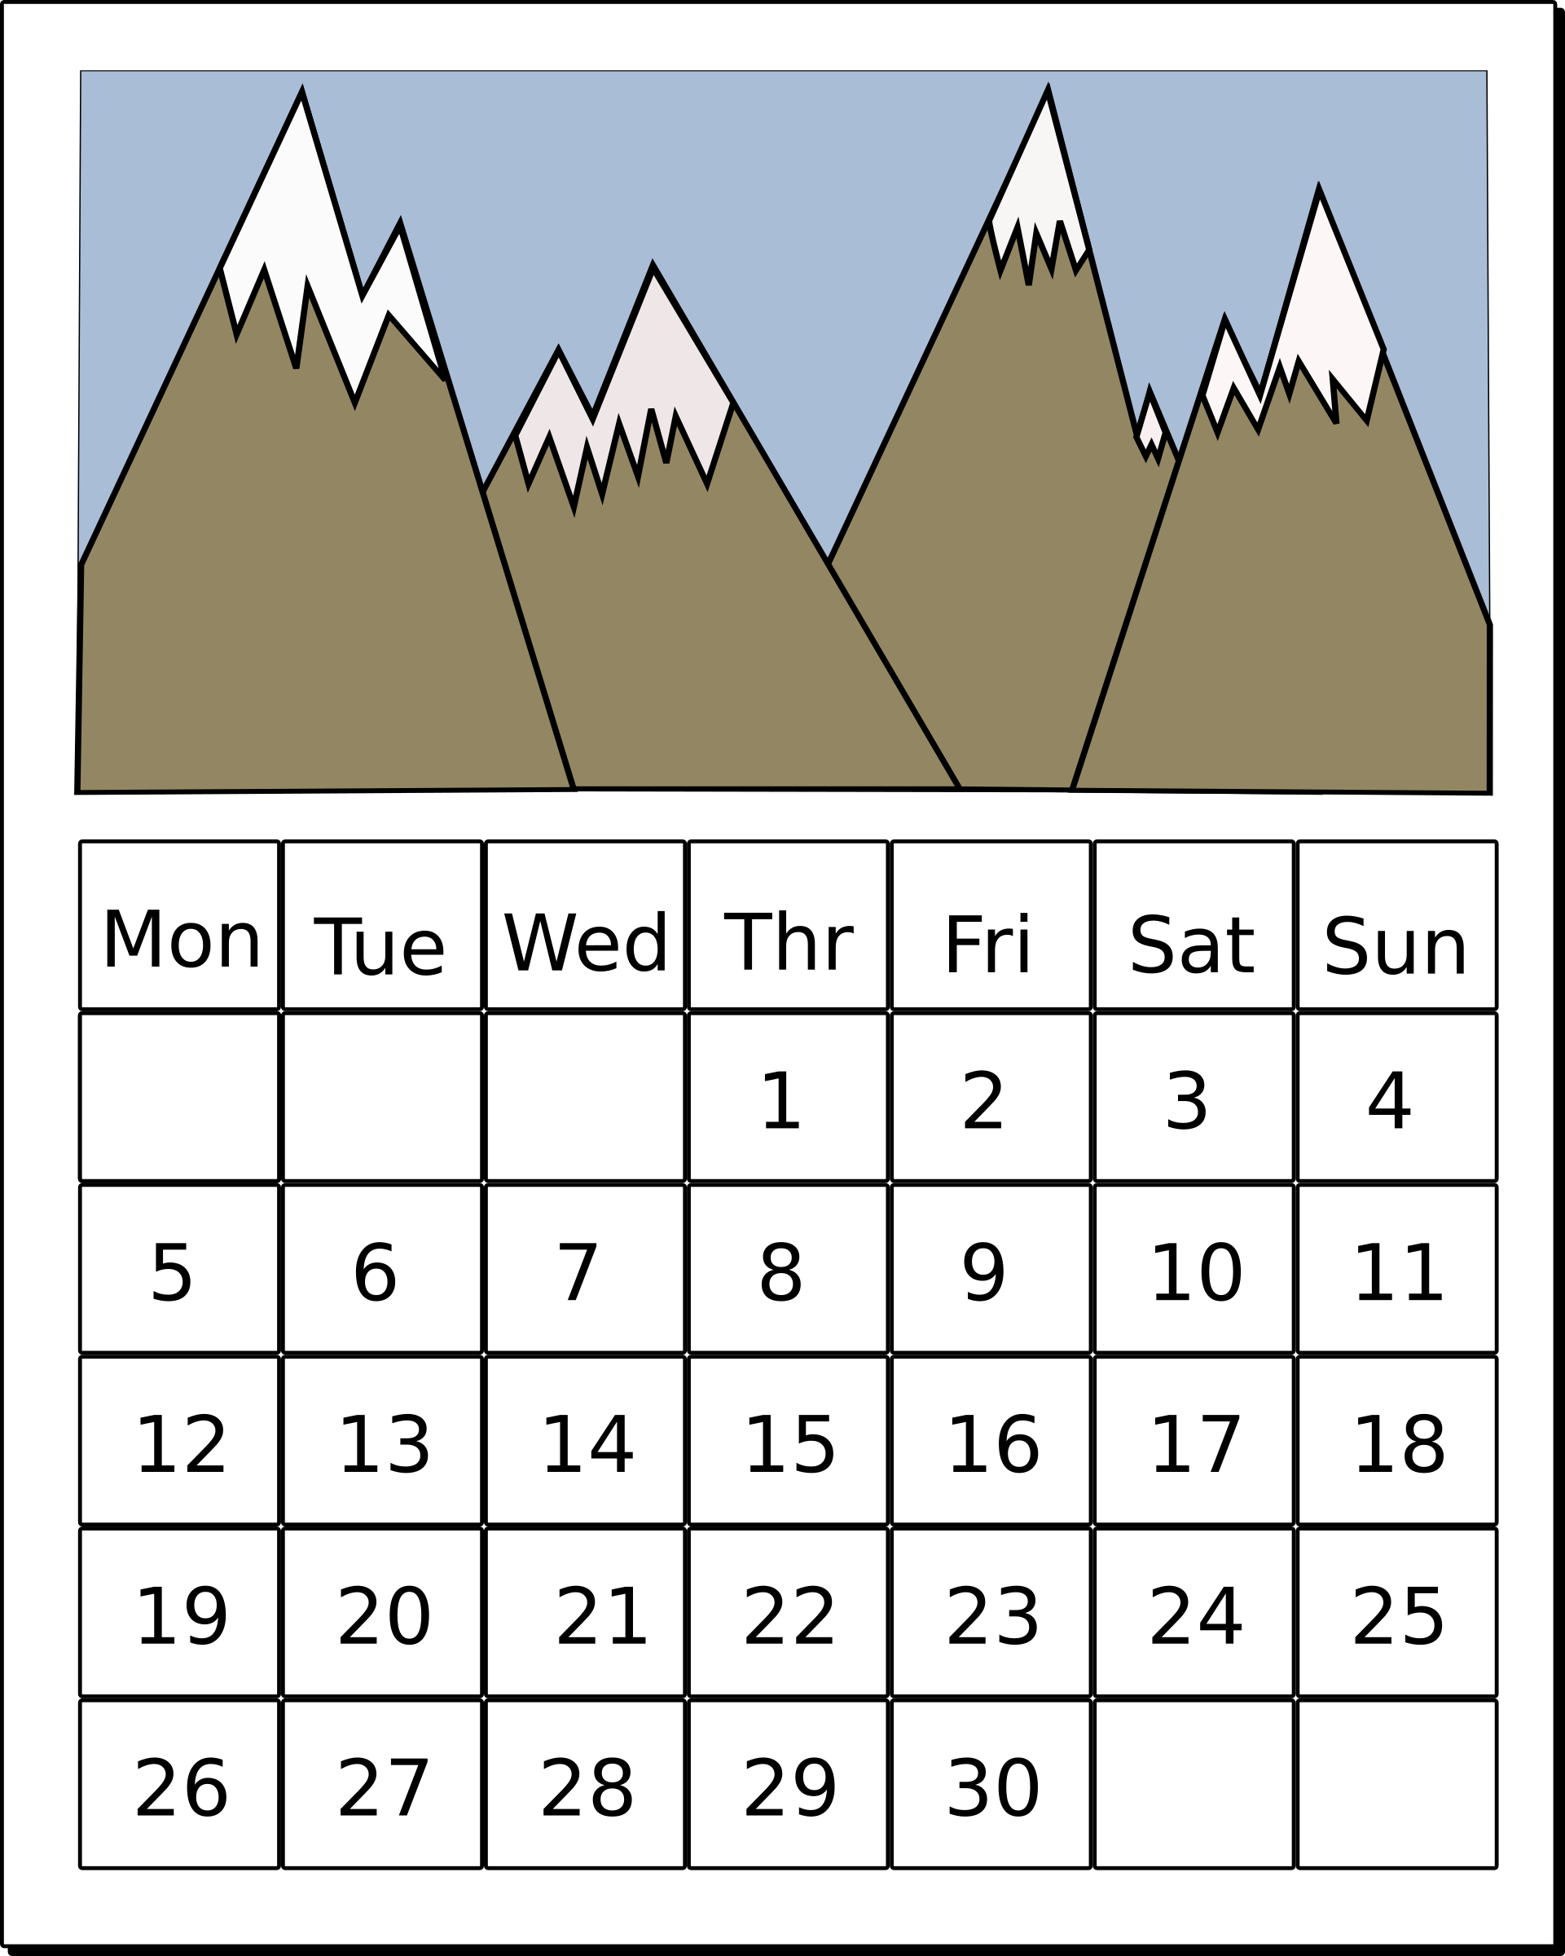
Self-Directing Services Welcome Meetings
Monday 4:00pm ~ Tuesday 1:00pm
Wednesday 12:00pm ~ Thursday 10:00am
Please register at least 24 hours in advance
After registering, you will receive a confirmation email containing information about joining the meeting.
Required for Employers starting new arrangements (after the SD Referral is sent to the FMS and DWIHN) cannot happen before the authorization is approved
SCs are welcome/encouraged to attend
Direct Hires are not required to attend
Anyone (individual/family/SC) who has questions about SD
Email; selfdetermination@dwihn.org for the link

Slide 30


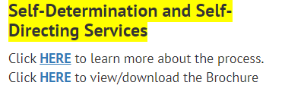
How to find more information related to Self-Directed Service Arrangements
DWIHN.org (Detroit Wayne Integrated Health Network Homepage) is frequently updated with pertinent education and training resources.
Access Our Services
Intellectual/Development Disabilities
Self-Determination and Self-Directing Services process
Links for Procedures, Forms, Training References, and more.

Slide 31

The end result is the person/family get the services they need, from the person they want, and have the life they choose!

Slide 32

Beverly Thompson
LMSW
Chaundrika
Baldwin
MSA
Lucinda Brown
LMSW ​
SD-Network Provider
Program Administrator ​
Email
lbrown@dwihn.org ​
​
SD-Clinical
Specialist
SD-Clinical Specialist
Email
bthompson@dwihn.org
SD-Financial
Management
Service (FMS)
Coordinator​
Email
Cbaldwin@dwihn.org
SELF-DETERMINATION TEAM
Detroit Wayne Integrated Health Network
707 W. Milwaukee Street
Detroit, MI 48202-2943
Or
selfdetermination@dwihn.org

