Slide 1


Fourth and Final SD Quarterly Training for 2025;
Focus on Essential Areas from
Lessons Learned
SD Team
Beverly Thompson, Chaundrika Baldwin , Lucinda Brown
December 9, 2025

Slide 2
~Who to contact on the SD Team~
Beverly Thompson, Clinical Specialist; primarily responsible for authorizations, Durable Medical Equipment, and Enhanced Pharmacy.
Chaundrika Baldwin, Financial Management Service Coordinator; primarily responsible for agreements, all coordination that involves the FMS agencies, triaging various issues regarding starting an SD Arrangement or billing issues.
Lucinda Brown, Program Administrator; primarily responsible for all the above in addition anything not listed above as well as ORR allegations, SD to Residential moves, Habilitative Support Waiver (HSW) team, and authorizations for Applied Behavioral Analysis (ABA) Teams.

Slide 3
What is Self-Directing Services
Self-Directed Services is a partnership between DWIHN and the MEMBER. All members (adults and children) have the option to self-direct. It is a method for moving away from professionally managed models of supports and services. It is the act of selecting, directing and managing one's services and supports.
People who self-direct their services can use support to decide how to spend their Behavioral Health dollars in a creative manner. All creative spending must meet Medicaid requirements.
Self-Directed Service is a method of service delivery.

Slide 4

The Benefits to Self-Directing Services
Self-Directing Services gives the individual:
  Greater control over who directly provides the authorized
  services, the member /legal representative is the Employer
  Flexibility to use services how you want to meet the goals
  identified in the Individual Plan of Service (IPOS)
  Greater staff retention as well as fewer required staff trainings
  Control over staff rate of pay (direct hire rates are generally higher)
  Out of network providers can be used after Medicaid qualifications are verified
  Flexibility over using behavioral health dollars (up to DWIHN standardized rates)

Slide 5
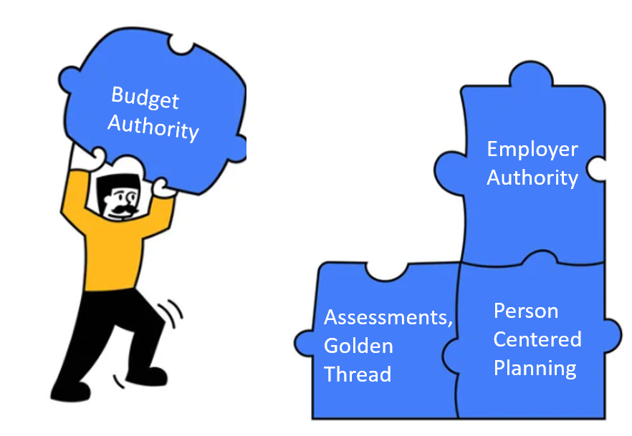
A good goal supports the service authorized.
Goals are developed at the Person-Centered Plan.
Where does Self-Directing Services start?
Good Person-Centered Planning the foundation for Self-Directing Services

Slide 6
Goal Statements & Objectives should include;
The Goal Statement (life goals- what is my good life), :
  In the member’s own words (person who speaks on their behalf if they do not use words to communicate)
  Identifies what the member wants to achieve or what is the intended outcome.
  Must be in first-person language (ex. I will...) or with identifying legal rep speaking on behalf of the person.
The Objective (how will I know I meet my goal)
  Must be S.M.A.R.T. Specific, Measurable, Attainable, Relevant, Time-Bound
  Should be short, simple, and to the point.
  Answers the question, how will anyone reading the plan know if the goal is achieved?

Slide 7
INTERVENTIONS should include;
The Intervention:
  Details what the member can currently do(baseline/their contribution)/why this is important.
  Identifies what community or natural supports have been exhausted before CMH services requested.
  Identifies what and why the service is needed to help achieve the outcome/goal.
  Identifies what services the person will self-direct with a statement such as, "X will self-direct his community living supports. However, other services may be used in lieu of this service to accomplish the goals in the IPOS as long as the total budget is not exceeded".
  Identifies how often (hours, # of times per week/month) the person needs help/the service to have the best opportunity to achieve goals; the amount, scope, and duration of services (ie. authorization). This total should be reasonable to accomplish the intended outcome.
  Identifies if the person will be using their budget in a flexible manner to accomplish the goal (ie. To purchase memberships, classes, activities). Individual activities are not required.
  Is detailed enough to be a “job description” or details the steps to give the member the best opportunity to learn/achieve his/her goal. Must detail what method of teaching, training, or guiding the staff will perform to help the member achieve his/her goal.
  *Identifies how staff will document progress.
  Identifies the SC will review/document progress on goals.
*Bolded areas must be included in the interventions

Slide 8
Explanations of the most frequently used Medicaid Services

Slide 9
Respite (T1005)
Respite care services are provided on a short-term, intermittent basis to relieve the beneficiary’s family or other primary caregiver(s) from the daily stress of caregiving. Temporary relief to the primary caregiver.
• "Short-term" means the respite service is provided during a limited period of time (e.g., a
few hours, a few days, weekends, or for vacations).
• "Intermittent" means the respite service does not occur regularly or continuously. The
service stops and starts repeatedly or with periods in between.
• "Primary" caregivers are typically the same people who provide at least some unpaid
supports daily.
• "Unpaid" means that respite may only be provided during those portions of the day when
no one is being paid to provide the care, i.e., not a time when the beneficiary is receiving
a paid Medicaid State Plan (e.g., home help)
Documentation when respite is provided must only include “giving the caregiver a break” no active teaching.

Slide 10
Community Living Supports (H2015)
Community Living Supports are authorized to facilitate an individual’s independence, productivity, and promote inclusion and participation.
Teaching, training, and guiding the person to development a skill
Meal preparation
Laundry
Household care
Bathing, dressing, personal hygiene
Shopping
Socialization and relationship building
Transportation
Participation in community activities
It is essential that the staff document and perform the task from a teaching, training, and guiding perspective, and NOT do the task for the person.

Slide 11
Home Help
The Home Help program is administered by the Michigan Department of Health and Human Services (MDHHS) and provides personal care services to individuals who need hands-on assistance with Activities of Daily Living.
“Hands on” means doing the skill for the person
-Personal Care like bathing, grooming, and dressing
-Cleaning, light housekeeping
-Laundry
-Shopping
-Meal Preparation
Home Help cannot be provided at the same time as any other service.

Slide 12

Along with the Benefits of Self-Directing Services, the employer is also responsible for
Documentation
And Staff Training

Slide 13
Per the Michigan Medicaid Provider Manual,
“The employer will decide through the person-centered planning process how their staff will document services provided.”
The employer determines how documentation is organized, as long as the documentation: Meets Michigan’s Medicaid rules
• Is complete, concise, and accurate, including the face-to-face time spent providing services
• Is legible, signed, and dated https://arcmi.org/wp-content/uploads/2024/07/Self-Direction-FAQ-7.24.pdf.
*How Staff will Document Progress

Slide 14
Medicaid Documentation Requirements
Documentation can only be directly related to the goals in the Individual Plan of Service, or Medicaid funds should not be used for payment and can be subject to recoupment if audited. Documentation must be detailed enough to support the time provided.
For example;
#1. If the service being billed is for respite, the staff should not be documenting or performing tasks related to teaching the person to grocery shop or washing clothes.
#2. If the staff worked an 8-hour shift and documented, I helped Tina make her bed. This would not support an 8-hour shift.
Services are not about being present with the person but about doing the specific tasks/reasons for the services identified in the Individual Plan of Service.

Slide 15
Where Can Documentation be Kept?
Logs
Notebooks
Journals
Documentation sheets that align with the goals
Electronic Visit Verification- as long as the employer and Coordinator can review the content. Confirm with your FMS
Ultimately, it is determined by the employer, included in the Individual Plan of Service, and monitored by the employer and coordinator (Support Coordinator, Casemanager, Therapist, Wrap Facilitator, etc).

Slide 16
What are the Documentation Responsibilities of the Employer?
The employer must review and approve employee timesheets and documentation. The employer will decide through the person-centered planning process how their staff will document services provided. The employer will review supporting Medicaid documentation to ensure it meets their standard.
The Case Holder (Support Coordinator, Wrap facilitator, Therapist etc) is responsible for monitoring the documentation.

Slide 17
Required Training
Medicaid Provider Qualifications: Blood Borne Pathogens (once), First Aid (2 yrs), IPOS in-service (annually), Recipient Rights (2 yrs), Emergency Preparedness and Procedures (2 yrs)
After notification from the FMS, new staff may start working after application, in-service, and Employment Agreement is signed. Then they have 30 days to complete ORR and 60 days for the other trainings.
Medicaid requires that these trainings be current to use Medicaid funds for payment of the service provided.
FMS should send at least 2 notices of upcoming expiration dates BUT it is the employer’s responsibility to ensure their employees maintain training.
Examples of monitoring tips; Get a list of all the dates, put it as a reminder on your calendar or in your phone, ask the Support Coordinator to help with tracking/reminders.

Slide 18
The Budget

Slide 19

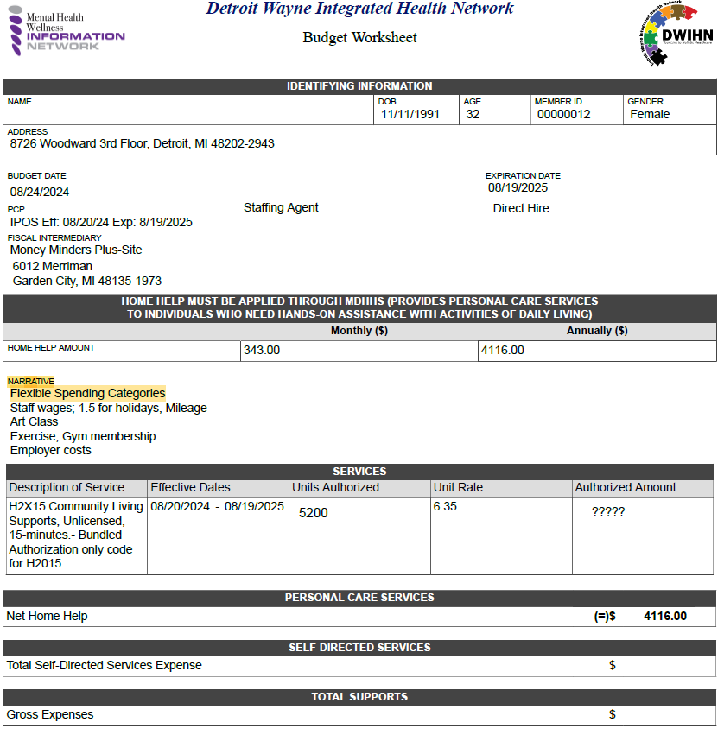
How is the Budget Developed
Goals and authorizations are developed at the Person-Centered-Plan. If a person wants to use the budget in a flexible manner, that must be clearly identified in the intervention and costed out during the planning process. After costing out is completed, a category such as “activities” will be in the Narrative of the Budget Worksheet. The intent is to have broad categories to prevent the need for additional addendums for similar requests.
Units Authorized x Unit Rate (DWIHN Standardized Rate) = Potential Budget Max

Slide 20
More than payment for staff can be a part of the budget
What must be included in the Budget
Required employment taxes
Worker’s compensation
Earned Sick Time
Staff pay rate
What can be included in the Budget (Non-traditional item- NTI)
  Not an exhaustive list….
Mileage
Paid training
Meeting attendance (staff)
Holiday pay
Built-in overtime
Memberships
Classes
Insurance
Cost of local activities for the person and staff
Retention incentives

Slide 21
Things to Consider for Budget Items
The Employer has a Responsibility to be a good steward over Medicaid funds.
The NTI must be clearly and directly related to an identified need or goal achievement.
  The item should not include targeted Medicaid language to stretch the significance of the support/item identified (For example, X item is needed to treat or ameliorate the disability to prevent institutionalization or hospitalization).
The item cannot otherwise be provided through another Medicaid Waiver or Medicaid State Plan.
The item or service would promote inclusion in the local community; and/or increase the participant’s safety in the home environment; and/or promote productivity.

Slide 22
Things to Consider for Budget Items pt.2
Is this request for the benefit of the person served?
Are there free or low-cost activities to meet the same need?
Can the person served (or representative); justify the purchase as a wise use of public taxpayer dollars? Is this a good value?
Will this reduce the need for Medicaid services due to purchase (spending 2 hours at a class means 2 hours less of staffing).
Will this prevent increased Medicaid costs down the road).

Slide 23
Things to Consider for Budget Items pt.3
Purchase will allow the individual to invest in activities that build their circle of support/increase belonging with the intent of moving from reliance on the service system. (Membership fees for club activities or associations, local bus passes to travel to see friends, and other various activities with costs that build long-term relationships).
Think of the outcome/goal and how XXXX can help the person achieve the outcome. Do not think of an item and come up with a goal.
Supports identified and goals should originate from an assessed need.
This is not an all-inclusive list.

Slide 24
All essential requirements of Medicaid still apply with Budget Authority:
Person-Centered Planning
Home and Community Based
Medical Necessity
Reasonable to meet the outcome
Wise use of public dollars
Golden Thread
Amount, Scope, and Duration

Slide 25
Final Steps for Budgets
Within 30 days-The Support Coordinator will work with the individual (or legal representative, if applicable) to get the budget and IPOS (or Addendum signed) and uploaded to MHWIN. Signatures confirm a mutual agreement between the person and DWIHN.
After the budget and IPOS is signed, based on when the individual (or legal representative, if applicable) is available, the Case Holder (Support Coordinator, Wrap Coordinator, Therapist etc) will schedule a Spending Plan Meeting with the FMS. The FMS and individual are required to be present and the Case Holder is encouraged to be present. A DWIHN representative will be present as needed.
FMS will facilitate a Spending Plan Meeting no later than 30 days after the budget is signed by the individual.
Spending Plan Meeting Contacts
Guardiantrac/GT Independence- Heather Quaak, email; hquaak@gtindependence.com, 269-503-7408 x572
Money Minders Plus, LLC, Ashley Wilson, 734-522-0080, email; ashleyw@mmpbiz.com
Personal Accounting Services (PAS), Christine Delozier, 734-729-3100, email; cdelozier@passelfdirection.com
The ARC of Northwest Wayne County, Lisa King, 313-532-7915, email; lking@thearcnw.org

Slide 26
What is a Spending Planning Meeting?
A Spending Plan Meeting is the time to meet with the FMS to put the dollars into action. DWIHN uses the information from the IPOS to create general categories in the Budget Worksheet. Costing out/spending up to the maximum in the Budget Worksheet becomes the Individual Budget. Monthly reports will be based on the rate determined by the Individual budget.
The Individual Budget will include amounts of flexible spending (costing out) that was discussed during the Person-Centered Planning meeting. In the Spending Plan Meeting, the FMS uses the categories to put dollars in “buckets” for the Individual Budget.
As long as the person uses or interchanges funds within an existing category/bucket, no change to the IPOS is needed. A person must use the budget as identified in the plan. If any thing new or different is requested outside of the original agreement, the IPOS (and possibly the budget or category) must be reviewed, agreed upon, signed by DWIHN and the individual, and updated.
The FMS will provide Monthly Budget Reports to report the status of budget use.

Slide 27
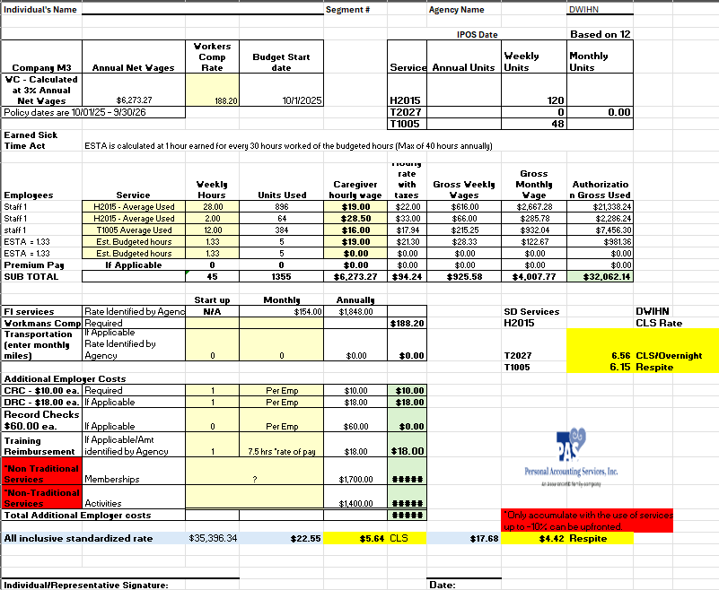
What happens at a Spending Planning Meeting?
Supports that were detailed in the Person-Centered Planning meeting are put into action (costed out) in a similar document. This document includes all traditional supports and services and non-traditional supports listed on page 20 of this presentation.
Example of Personal Accounting Service’s Spending Plan Document

Slide 28
Essential Changes
The amount, scope, and duration of services must be determined at the
Person-Centered Plan.
The Individual Budget will be developed based on the Spending Plan; the plan for spending will be upfront.
Monthly Budget Reports will be based on the Individual Budget.
DWIHN will provide the FMS with 1/12th of the Individual Budget.
Impact of this Change
A person is within budget or not within budget (not there is “surplus”).
The Spending Plan Adjustment form will no longer be used.
Monthly Budget Reports should be an accurate reflection of the Individual Budget.

Slide 29
Are you using services?
Are you satisfied with services?
Have you gotten your monthly reports?
Review the documentation for the services and supports.
Review the monthly budget report with the person.
Do you understand the status of your budget?
(if not, reach out to the FMS or DWIHN)
If there is a positive net, you are within budget.
If there is a deficit, use the PCP process to discuss future areas to use less.
Confirm employees are keeping up on training.
On-going Support Coordination monitoring should minimally include asking and documenting these areas:

Slide 30
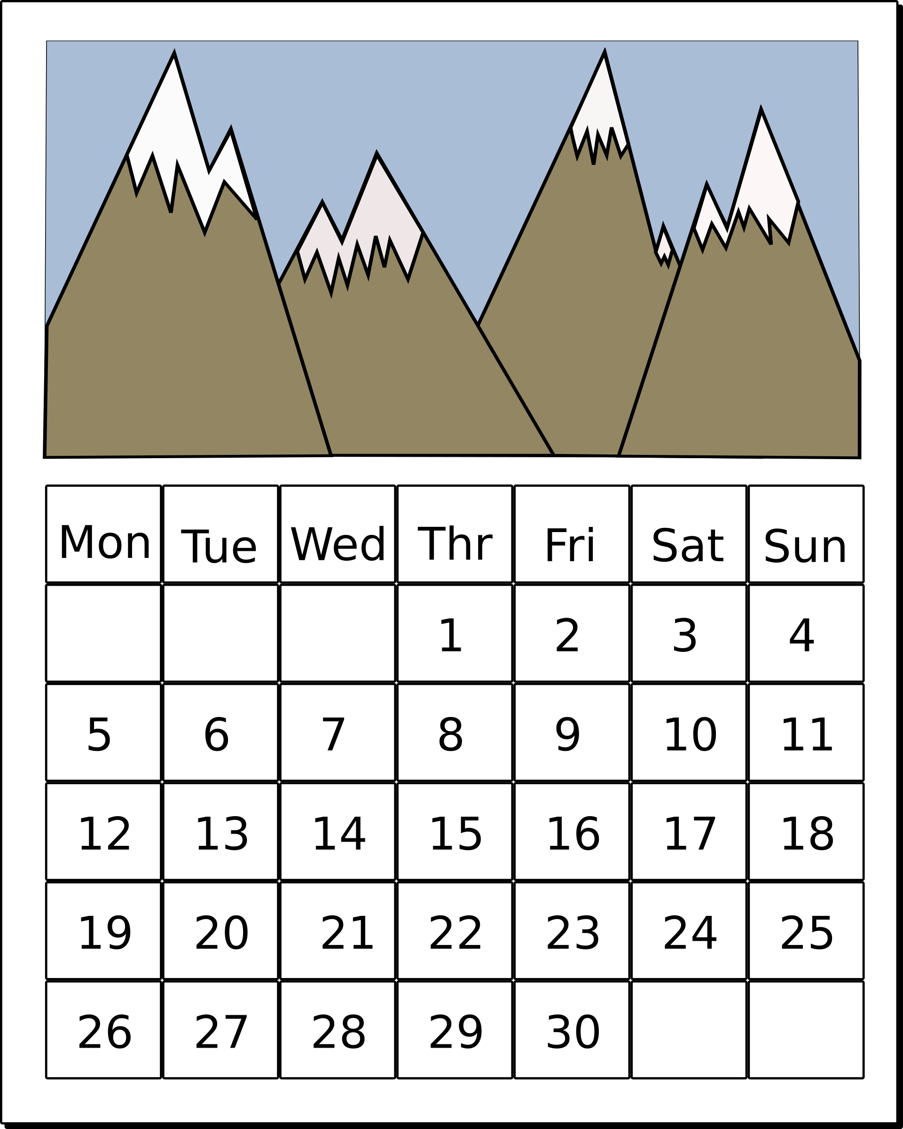
Self-Directing Services Welcome Meetings
Monday 4:00pm ~ Tuesday 1:00pm
Wednesday 12:00pm ~ Thursday 10:00am
Please register at least 24 hours in advance
After registering, you will receive a confirmation email containing information about joining the meeting.
Required for Employers starting new arrangements (after the SD Referral is sent to the FMS and DWIHN) cannot happen before the authorization is approved
SCs are welcome/encouraged to attend
Direct Hires are not required to attend
Anyone (individual/family/SC) who has questions about SD
Email; selfdetermination@dwihn.org for the link

Slide 31


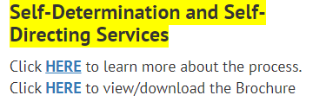
How to find more information related to
Self-Directed Service Arrangements
DWIHN.org (Detroit Wayne Integrated Health Network Homepage) is frequently updated with pertinent education and training resources.
Access Our Services
Intellectual/Development Disabilities
Self-Determination and Self-Directing Services process
Links for Procedures, Forms, Training References, and more.

Slide 32
Budget Development Process Flow
Assessments (Identify needs/inform the PCP)
Pre-plan (Decides who, what, when, where for the PCP)
*Person-Centered Plan (Determines amount, scope, and duration needed to achieve goals)
*Budget Worksheet (PCP authorization X Standardized Units- Individual Budget Maximum)
Spending Plan Meeting (Putting plans/dollars identified at the PCP into action)
Individual Budget (How the person will spend their dollars)
Monthly Budget Report (Report from the FMS for +/- budget use)
*Must be signed by the person or legal representative (if applicable)

Slide 33

The end result is the person/family get the services they need, from the person they want, and have the life they choose!

Slide 34
2026 SD Quarterly Training Series
January 13, 2026 Individual Budgets and Monthly
https://dwihn-org.zoom.us/meeting/register/_KoJmnt7Q9W8UQ9TlZW5uw.
April 14, 2026 TBD
https://dwihn-org.zoom.us/meeting/register/LhEswdMdSly-WC0nbtiFyg.
July 14, 2026 TBD
https://dwihn-org.zoom.us/meeting/register/a1E9zlp-Tdu4YvXQ6rY_Xw.
October 13, 2026 TBD
https://dwihn-org.zoom.us/meeting/register/LQLws2cPQXKZp8yWL_h23w.

Slide 35

Beverly Thompson
LMSW
Chaundrika
Baldwin
MSA
Lucinda Brown
LMSW ​
SD-Network Provider
Program Administrator ​
Email
lbrown@dwihn.org ​
​
SD-Clinical
Specialist
SD-Clinical Specialist
Email
bthompson@dwihn.org
SD-Financial
Management
Service (FMS)
Coordinator​
Email
Cbaldwin@dwihn.org
SELF-DETERMINATION TEAM
Detroit Wayne Integrated Health Network
707 W. Milwaukee Street
Detroit, MI 48202-2943
Or
selfdetermination@dwihn.org

