Slide 1

PECFAS® Reliability Booster Training
Adapted from Presentations Created by:
Master Trainers
Heidi Wale Knizacky, MS, LLP 2020
and
Susan Sabin, Ph. D. 2017

Slide 2

Welcome and Housekeeping Items
Remember to follow proper virtual learning etiquette
Remain muted when not speaking
Sharing video is a requirement of this training at all times (with certain exceptions, i.e. bathroom breaks)
Using Zoom
Chat Options (Direct Chats to Moderator)
Sharing screen/sharing documents

Slide 3

Training Objectives
Receive most up-to-date info on the PECFAS
Learn how to use the PECFAS clinically with families
Learn how to score each subscale of PECFAS
Complete an evaluation of your reliability (“test”- 6 vignettes)
Reminder: You are being trained as a rater of the PECFAS and not as a trainer for others

Slide 4
What is the
PECFAS
Preschool and Early Childhood Functional Assessment Scale
?

Slide 5

Reminder: PECFAS is used…
As criteria to consider in determining level of care (intensity of services)
As an outcome measure (pre/post) to aid in tracking progress in treatment
To aid the management cases during course of treatment
To assess strengths and weaknesses for setting treatment goals
For agency tracking, quality improvement, etc.
As a common language for treatment collaboration and supervision

Slide 6

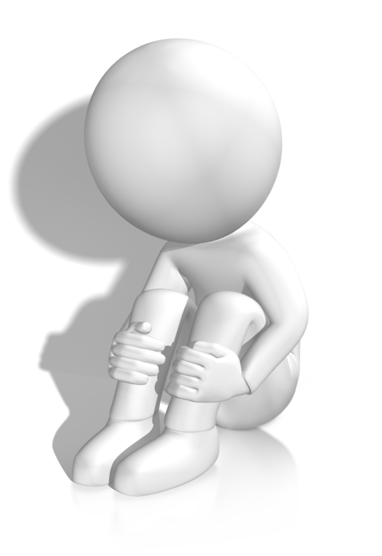


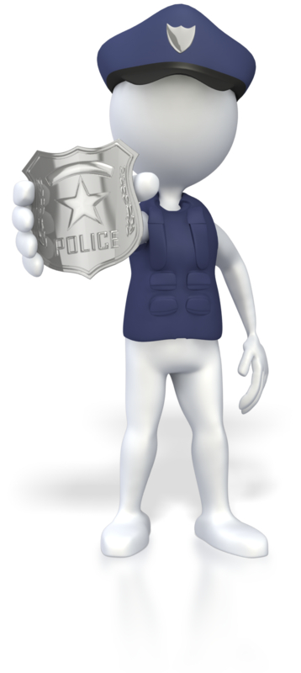
Areas of Functioning
PECFAS Subscales
1
School/Daycare
2
Home
3
Community
4
Behavior Toward Others
5
Moods
6
Self-Harm
7
Thinking
Notes:
Distribute/reference PECFAS tool

Slide 7
PECFAS Subscale Refresher
Subscale | Measures:
School/Daycare /Childcare | Functionality in group education, daycare or childcare setting
Home | Observation of reasonable rules and performance of age-appropriate tasks
Community | Whether or not the rights of others and their property are respected/acts lawfully
Behavior Toward Others | Appropriateness of Child’s daily behavior
Moods/Emotions | Modulation of the child’s emotional life
Self-Harmful Behavior | Extent to which the child can cope without self-harmful behavior or verbalizations
Thinking | Ability of child to use rational thought processes and communicate with others

Slide 8

Reminder: Using EXCEPTION Items
EXCEPTION appears as the last item on every level of every PECFAS subscale. Use EXCEPTION when the child exhibits a behavior at a level of impairment where no items describe the behavior.
After choosing the EXCEPTION item number, explain the reason for your rating in the box labeled “Explanation:.”
Use EXCEPTION cautiously because it may jeopardize reliability.
Another use of the EXCEPTION items is to provide additional context and balance to understanding items that were selected.
Encopresis is always scored as a “30” 085-Exception

Slide 9
Reminder: Using “Could Not Score”
Appears on every subscale
If under rare circumstances, there is insufficient information to rate the child on a scale, select “Could Not Score”
ALWAYS try to get the information so that you can knowledgeably rate every subscale
Use “Could Not Score” as a last resort

Slide 10


School / Daycare
30
20
10
0
SEVERE
Severe disruption or incapacitation
MODERATE
Major or persistent disruption
MILD
Significant problems or distress
MINIMAL/NO
No disruption in functioning
Behaviors to Assess
Attention
Following directions
Adhering to rules
Attendance
Learning achievement
Interactions with classmates

Slide 11
Environments to Consider
Preschool / School
School Bus
Sunday School / Story Hour
Daycare / Childcare
What about children who aren’t enrolled in school or daycare?
Consider the child’s functioning in any environment that requires interacting with peers, listening to authority figures, structured activity transitions, and age-typical learning activities.

Slide 12

Learning
007 Learning at least 1 year behind due to poor attention or high activity (despite special accommodations) 008 Learning at least 1 year behind and is not known to be due to an established learning problem (e.g. intellectual disability) | 014 Achievement below average due to poor attention or high activity and special accommodations needed or implemented 015 Achievement below average and is not due to an established learning problem | 020 Attention problems or high activity levels are present but manageable 021 Fails to listen, follow instructions or routines, or do activities/tasks (but achievement is not below average)
30
20
10

Slide 13
Learning Consideration
Do not rate if poor academic performance is solely due to:
Intellectual Disability or other serious, documented
learning problems
Sensory deficits (EX: hearing problems)
Physical disability/impairment
Items on the “No Impairment” level allow you to document these challenges

Slide 14
Attendance
001 Asked to leave preschool or daycare during rating period due to behavior 002 Refuses to attend program 002 Excessive absences due to any reason other than physical illness | 012 Frequently absent from program (i.e. once every two weeks) 012 Absent from program for several consecutive days | N/A
30
20
10

Slide 15


Problematic Behavior
001 Asked to leave program due to behavior in program occurring during the rating period 003 Viewed as potentially harmful to others because of actions or statements 004 Harmed or made threat to hurt a teacher/peer/staff 005 Unable to meet even minimum requirements for program behavior 006 Disruptive behavior persists despite special accommodations at program | 010/011 Persistent or repeated disruption of group activities 010/011 Known to supervisory staff due to chronicity of problems 010/011 Known to supervisory staff due to severity of problems 013 Special accommodations are needed due to behavior problems | 017/018 Can be managed by regular teacher/program staff with attention (EX: verbal reminder, time-out) 017/018 Can be managed by regular teacher/program staff with structure (EX: moving seat) 019 Occasional disobedience with no harm to property or people 020 Behavior problems present but not disruptive
30
20
10

Slide 16

School Rating: Remote Learning
Severe Impairment
Youth refuses to participate in Remote Learning (002)
Youth is physically aggressive with family during learning times (003)
Moderate Impairment
Youth refuses direction from caregivers when participating in Remote Learning activities (e.g. Tantrums) (010, 011)
Youth participates in less than 90% of Remote Learning expectations (012)
Youth cannot remain focused and/or is highly active resulting in special accommodations being needed/implemented (014)
Mild Impairment
Caregiver needs to provide extra structure or accommodation for youth to successfully participate in Remote Learning (017, 018, 020)
Youth is not completing all activities as assigned (021)
Notes:
Considerations for rating during the COVID-19 Pandemic and new education strategies
When rating during a pandemic, remember…
- CAFAS® items depict WHAT is going on in a youth’s life, not WHY it is going on. (Items don’t attribute blame.)
- Identifying functional needs (scores greater than “0”) marks areas of impaired growth or opportunity that could benefit from support.

Slide 17
Subscale Review Question #1
Cathy, age 5, is enrolled in a well-structured childcare program; after a few days of attending, for the past 3 weeks she refuses to go to the program.
30
Item: 002 Rationale: Refuses to attend/excessive absences.

Slide 18
Subscale Review Question #2
Terri, age 5, is frequently off-task – she runs around the pre-school classroom grabbing the belongings of other children and pushing their books and papers to the floor; this is affecting the other students’ ability to work. Teacher has implemented an incentive program for Terri – she earns a star each time she remains on-task for a (brief) activity.
20
Item: 013 Rationale: Child’s behavior is disruptive to others and requires special accommodation (incentive program).

Slide 19
Subscale Review Question #3
4-year-old is happy and sociable at pre-school, but often doesn’t listen to instructions or listen to the teacher.
10
Item: 021 Rationale: Fails to listen, to follow instruction

Slide 20
Subscale Review Question #4
Johnny, age 4, consistently performs well below other students in his class although he does not have any documented learning problem. Despite teacher providing additional assistance, Johnny is still more than a year behind what could be expected given his age.
30
Item: 008 Rationale: Learning is more than one year behind, with no established learning problem.

Slide 21
Subscale Review Question #5
Child care staff must sometimes remind child, age 6 not to put his hands down his pants during circle time. They have him sit next to teacher or an aide, so he can be more easily cued.
10
Item: 018 Rationale: Inappropriate behavior results in staff frequently structuring activities to avoid predictable difficulties.

Slide 22
Subscale Review Question #6
Childcare staff must regularly separate Sally, age 5 from two other children during small-group activities because it leads to arguing and them all being generally off-task. If allowed to play with these two, Sally is disobedient to teacher when asked to sit down or stop arguing.
20
Item: 010, 013 Rationale: Disobedient behavior (010) – disruption of other children’s activities; requires structuring activities to avoid problems (013).

Slide 23
Subscale Review Question #7
6-year-old typically acts his age but has occasional temper tantrums at school since his parents got divorced last month.
0
Item: 028 Rationale: Occasional temporary regression in behavior due to specific family circumstances.

Slide 24
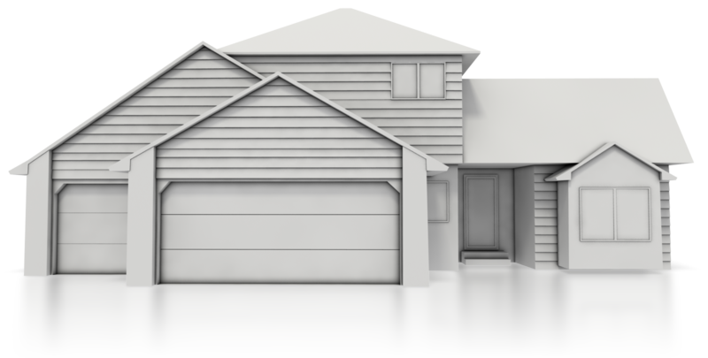

Home
30
20
10
0
SEVERE
Severe disruption or incapacitation
MODERATE
Major or persistent disruption
MILD
Significant problems or distress
MINIMAL/NO
No disruption in functioning
Behaviors to Assess
Home safety behaviors
Following directions
Adhering to rules
Following home routines
Age-appropriate self-care
Diet and eating routines

Slide 25
Helpful Hints: Terms Referring to Frequency
In PECFAS, the word persistent is used to describe problem behaviors that are not especially dangerous but that happen more often than not (half the time or more). Persistent problems are of Moderate severity.
The word frequent (or frequently) is used to describe problems that occur more often than is typical and healthy, but tend to cause more inconvenience than developmental disruption. These problems are of Mild severity.
The word occasionally is often scored as a “0”.

Slide 26

Safety
031 Child was placed outside of the home due to child’s unmanageable or dangerous behavior in the home which occurred during the rating period. 033 High degree of supervision needed due to potentially dangerous behavior (e.g., head-banging, tries to hurt younger children, “plays” with electricity). | N/A | N/A
30
20
10

Slide 27
Compliance: Rules, Routines, Chores
032 Extensive management by others required in order for child to be maintained in the home 033 High degree of supervision due to potentially dangerous behavior 034 Behavior demands constant attention (wanders away, extreme temper tantrums, destroys things) 034 Efforts to reduce problem behavior are not successful 035 Clings to caregiver, interfering with caregiver’s ability to work, etc. | 039 Persistent disobedience or uncooperativeness EX: bedtime, brushing teeth 040 Persistent failure to follow rules or instructions 041 Persistent refusal to meet age-appropriate expectations EX: pick up toys 042 Markedly disobedient for several days at a time (otherwise often adequate) 043 Consistently demanding behavior (always "on the go") | 046 Frequently fails to comply 047 Has to be “watched” or prodded to get compliance 048 Frequently frustrates caregiver. EX: purposeful dawdling, following caregiver 049 Insists on caregiver's help for age-appropriate tasks 050 Frequently “balks” or resists but will comply if caregiver insists
30
20
10

Slide 28

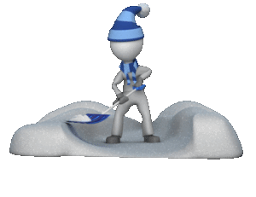

Notes on Compliance
Compliance is doing what you are asked to do, when you are asked to do it.
Household expectations may vary greatly by culture and circumstance.
Rate all non-compliant behavior UNLESS parent requests are abusive or illegal.

Slide 29

Runaway Behavior
036 Leaves home with the intent to “run away” | N/A | N/A
30
20
10

Slide 30

Eating/Mealtime
037 Must be fed due to refusal to eat or not eating | 044 Must be coaxed due to not wanting to eat or not eating | 052 Very finicky about eating
30
20
10

Slide 31
Subscale Review Question #1
4-year-old boy says that he’s going to run away and leaves home, goes to a friend’s house, asking friend’s mother if he can stay.
30
Item: 036 Rationale: Leaves home with intent to run away

Slide 32
Subscale Review Question #2
6-year-old typically acts age-appropriately but sometimes cries and whines to compete for attention with new baby in the family.
0
Item: 056
Rationale: Occasional temporary regression due to specific family circumstances

Slide 33
Subscale Review Question #3
Parents don’t take Frank, age 5 to a restaurant because he is such a picky eater that he often can find nothing that he “likes” on the menu.
10
Item: 052
Rationale: Child is very finicky eater

Slide 34
Subscale Review Question #4
Pat, a 4-year-old repeatedly throws temper tantrums and screams at her parents that she hates them when she does not get her way.
20
Item: 043
Rationale: Child reacts very strongly if something happens that she does not like.

Slide 35
Subscale Review Question #5
5-year-old is placed in temporary foster care after trying to smother baby brother with a pillow.
30
Item: 031
Rationale: Placed outside the home due to dangerous behavior in the home.

Slide 36
Subscale Review Question #6
Even though 6-year-old Mandy knows how to tie her shoes, she sometimes insists on having mom or dad do it for her.
10
Item: 049
Rationale: Insists that caregiver do things for her that she could do without help

Slide 37
Subscale Review Question #7
George, age 4, repeatedly takes his clothes back off after dad helps him to get dressed.
20
Item: 039
Rationale: Persistently uncooperative – interferes with routine care

Slide 38


Community
30
20
10
0
SEVERE
Severe disruption or incapacitation
MODERATE
Major or persistent disruption
MILD
Significant problems or distress
MINIMAL/NO
No disruption in functioning
Behaviors to Assess
Respect for property
Stealing
Adhering to laws
Playing with/setting fires
Sexual inappropriate behavior
Association with delinquent youth

Slide 39
Important Considerations: Community
Do NOT endorse if:
Youth’s sole involvement was as a victim
Act was accidental
Youth was just playing or “kidding around” (no intent to harm)
Youth was truly acting in self-defense (ignore unconvincing claims)

Slide 40

Obeys Laws
063 Committed acts that would result in confinement if older | 067 Committed acts (more than one time) that would be considered delinquent if older (such as shoplifting) | 072 Minor problems not resolved satisfactorily (such as stealing candy after being told it was wrong or illegal)
30
20
10

Slide 41
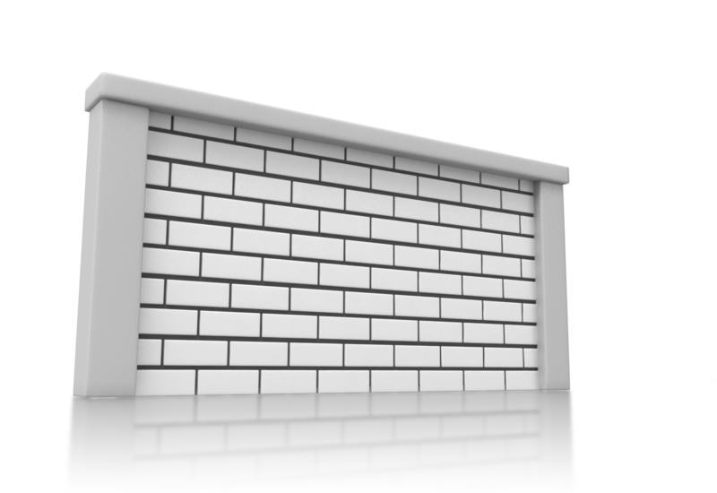

Respects Property Outside of the Home
061 Repeatedly stole property or money 064 Deliberate and severe damage to property | 067 Committed acts (more than once) that would be considered delinquent if child were older (such as vandalism) | 072 Minor problems not satisfactorily resolved (such as damaging plants in neighbor’s garden after previously being corrected for doing so)
30
20
10

Slide 42


Appropriate Peers
059 Associates or hangs around with older children who are involved in illegal or gang activities 060 Does favors or tasks for older children who are likely involved in illegal or gang activities | 068 Often chooses to play with children who get into delinquent-like trouble | 073 Sometimes plays with children who get into serious trouble
30
20
10

Slide 43


Sexual Misconduct/Mistrust
062 Does or attempts inappropriate sexual acts with other children (N/A if victim only) | 069 Sexually inappropriate such that adults have concern about welfare of other children who may be around the child unsupervised | N/A
30
20
10

Slide 44


Fire-setting Behavior
065 Deliberate fire-setting with malicious intent | 070 Repeatedly and intentionally plays with fire such that damage to property or person could result | 074 Plays with fire (and has previously been educated about the dangers of fire)
30
20
10
Fire-setting has potential impact on the entire community. Use these items no matter where the fire-setting behavior happens (e.g. at home)

Slide 45
Subscale Review Question #1
Mike, age 6 has been repeatedly caught playing with matches and lighting small pieces of paper towels in the kitchen despite warnings about the danger of fire.
20
Item: 070
Rationale: Repeatedly plays with fire such that damage persons or property could occur

Slide 46
Subscale Review Question #2
Child, age 5, has repeatedly stolen toys and comic books from neighborhood store. Child is fully aware that it is wrong to steal.
30
Item: 061
Rationale: Repeatedly stolen property or money outside the home and is aware that it is considered wrong to steal.

Slide 47
Subscale Review Question #3
Katie, age 4, once got in trouble after being caught picking roses from a neighbor, but problem was resolved after neighbor spoke to child.
0
Item: 077
Rationale: Minor problems, satisfactorily resolved

Slide 48
Subscale Review Question #4
4-yr old sometimes plays with other children who have been known to bully younger children in the neighborhood.
10
Item: 073
Rationale: Sometimes plays with children who get into serious trouble [if the children get into delinquent-type behavior it’s (20) item 68 or if children are likely involved with illegal or gang activities it (30) item 59]

Slide 49
Subscale Review Question #5
5-year-old boy has attempted, on more than one occasion, to get 3-year-old child next door to touch his penis.
30
Item: 062
Rationale: Does or attempts inappropriate sexual acts with children

Slide 50
Subscale Review Question #6
5-year-old child plays with dolls in such a way that they appear to be having sex – he does this repeatedly and parents of neighbor kids don’t want their children to play with him – they are worried about the welfare of their children.
20
Item: 069
Rationale: Sexually inappropriate – adults are worried about the welfare of other children

Slide 51
Subscale Review Question #7
4-year-old took candy from the local gas station even though mom has caught her before and told her that it is wrong to steal.
10
Item: 072
Rationale: Minor problems not satisfactorily resolved (takes candy from store).

Slide 52
Behavior Toward Others
30
20
10
0
SEVERE
Severe disruption or incapacitation
MODERATE
Major or persistent disruption
MILD
Significant problems or distress
MINIMAL/NO
No disruption in functioning
Behaviors to Assess
Interactions with people
Interactions with animals
Makes/maintains friendships
Aggressiveness
Frustration tolerance

Slide 53
This subscale captures behaviors that impact relationships with all other people (and animals too).
This means that some behaviors that were already rated for impairing functioning in an environment will also be rated here for impairing relationships.

Slide 54



Detached and Unrelatable Behaviors
080 Consistently bizarre or inappropriate - others avoid because of extremely unpredictable or odd behavior 084 No age-appropriate peer interactions due to deficit in ability to relate to others 084 Always plays alone 084 Avoids interacting with other children | 093 Prefers to be alone or play alone even when there are opportunities for peer play (atypical for age) | 106 Does not engage in typical recreation activities because ignored or rejected by peers 107 Does not engage in typical recreation activities because overly timid or withdrawn
30
20
10

Slide 55
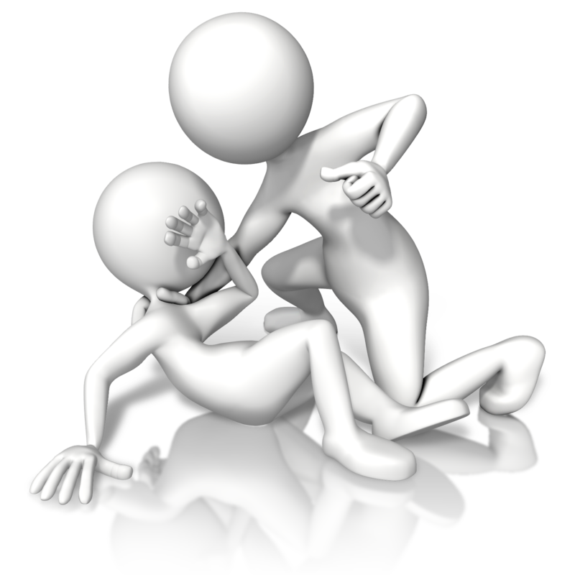
Assaultive or Victimizing Behaviors
081 So disruptive or dangerous that harm to others is likely (i.e., hurts or tries to hurt others, such as hitting, biting, throwing things at others, using or threatening to use a weapon or dangerous object) 082 Inappropriate behavior of a sexual nature toward another child (despite having been told that behavior is inappropriate) 083 Deliberately physically cruel to animals | 086 Behavior persistently inappropriate causing problems for others 087 Inappropriate sexual behavior in the presence of others or directed toward others (despite having been told that the behavior is inappropriate) 090 Persistently mean to others 091 Bullies others when with friends 091 Persistently bullies others | N/A
30
20
10

Slide 56

Chronic Conflict Behaviors
N/A | 086 Behavior persistently causing problems for others (EX: belligerence) 088 Deliberately and persistently annoying 089 Intense or prolonged anger outbursts 091 Harasses others when with friends 091 Persistently antagonizes others | 095 Frequently argumentative 096 Temper tantrums 097 Quick tempered 098 Annoys others by teasing 099 Socially immature 100 Overreacts to others 101 Frequently sulks 101 Frequently stubborn 102 Has trouble sharing 103 Bossy 104 Plays too rough 105 Stays upset when not getting own way 106 Rejected by peers
30
20
10

Slide 57
Subscale Review Question #1
Chris, age 4 and her playmates will playfully tease one another about liking boys in their class, but Chris stomps away and won’t talk to friends for a couple of days afterwards when she is the target of the teasing.
10
Item: 100
Rationale: Stays upset or overreacts to teasing.

Slide 58
Subscale Review Question #2
5-year-old is encopretic (has bowel movement in pants) at pre-school and doesn’t change his clothes after defecating until his teacher makes him, resulting in all of the other children in the school rejecting him.
30
Item: 085
Rationale: You can score as an exception). (Exc. extreme social withdrawal/rejection)

Slide 59
Subscale Review Question #3
4-year-old boy has had a couple of arguments with his best friend over toys within the last month. Previously, he and his friend have gotten along very well. After arguing, they were able, with mom’s help, to talk about the problem and resolve it.
0
Item: 110
Rationale: Occasional problems, reasonably resolved)

Slide 60
Subscale Review Question #4
Child, age 4, usually plays by himself, even though he is enrolled in after-school childcare and there are many opportunities for child to play with others his age.
20
Item: 093
Rationale: Often plays alone even when there are opportunities for peer play.

Slide 61
Subscale Review Question #5
5-year-old has no friends, due to physically hitting and pushing other kids. Parents of other children have complained about the child’s aggressiveness.
30
Item: 81,84
Rationale: Behavior is disruptive/dangerous – 81 - harm to others likely; item 84 – no age appropriate peer interactions due to deficit in ability to relate to others [extreme social withdrawal/rejection])

Slide 62
Subscale Review Question #6
Neighborhood children make fun of 5-year-old who often cries when he doesn’t get his way.
10
Item: 099
Rationale: Child’s immature behavior [crying] leads to poor interaction [rejection] with peers)

Slide 63
Subscale Review Question #7
5 year old girl throws temper tantrums, often in restaurants, stores and other public places, several times a day.
20
Item: 089
Rationale: Angry outbursts, temper tantrums – more than once a day

Slide 64
Moods/Emotions
30
20
10
0
SEVERE
Severe disruption or incapacitation
MODERATE
Major or persistent disruption
MILD
Significant problems or distress
MINIMAL/NO
No disruption in functioning
Behaviors to Assess
No excessive sadness
No excessive worry
Moods are relatable
Self-esteem
Somatic complaints
Experiences range of emotions

Slide 65
Remember, this subscale assesses problems with internal regulation of moods and emotions: anxiety, depression, sadness, fear, worry, irritability, tenseness, panic, anhedonia, and emotional restriction.
One important emotion that this subscale does not assess is anger. Anger problems lead to functional impairments in relationships, so anger behaviors are rated on the Behavior Toward Others subscale.

Slide 66

Emotional Disconnect
114 Emotional responses are uninterpretable by others 114 Emotions have no apparent connection to internal states or environmental events 121 No or few signs of emotion, affect is flat | 129 Has notable difficulty expressing strong emotions such as fear, hate, love | 136 Never plays energetically 136 Never expresses joy or delight
30
20
10

Slide 67

High Reactivity
119 Looks unhappy, sad, or anxious most of the time; nothing seems to please or comfort the child 120 Cries a lot (with no physical explanation) and cannot be consoled | 128 Has emotional flare-ups frequently, but not most of the time (EX sobbing uncontrollably) | 132 Overreacts compared to other children; disproportionate expression or irritability, fear, or worries 139 Frequent nightmares or awakenings (≥2 times/week) 140 Overreacts to changes in schedule or routine
30
20
10

Slide 68

Preamble to Rating Depression
If a child is experiencing depression, evidence for a SEVERE level of functional impairment is persistent sadness with incapacitation in one of these critical areas:
Will to live
Interest in others
Engagement
Eating
Ability to respond to comfort

Slide 69
Preamble to Rating Depression
If a child is experiencing depression, evidence for a MODERATE level of functional impairment is persistent feeling of worthlessness, or persistent expression of sadness, melancholy, or irritability with a disruption from personal baseline in specific areas:
Sleep – (quantity/pattern) trouble falling asleep or staying asleep, early awakening, sleeping too much
Eating – decreased appetite, significant weight loss or gain
Energy level - primarily fatigue, no energy
Concentration – less ability to focus or sustain attention
Anhedonia – diminished interest or pleasure in normal activities

Slide 70

Depression
117 Depression with failure to do school/daycare activities (e.g. play) 117 Depression with refusal to eat/disinterest in eating 117 Depression with marked disinterest in other children 118 Depression with suicidal intent (regardless of lethality) 119 Looks unhappy or sad most of the time; nothing seems to please or comfort the child | 126 Sadness is persistent with one or more symptoms of significant disruption 126 Irritability or anhedonia is persistent with two or more symptoms of significant disruption 127 Persistent self-criticism, feelings of worthlessness | 131 Often sad, with related symptoms. EX: nightmares, stomachaches 132 Disproportionate irritability 134 Sad, withdrawn or hurt if criticized 135 Sad, depressed or anhedonic in at least one setting for up to a few days at a time 136 Never plays energetically or expresses joy or delight
30
20
10

Slide 71

Anxiety
115 Marked distress when separated from caregiver and cannot be consoled 116 Fear, anxieties, or desire to be with caregiver lead to poor attendance at school or daycare (absent ≥1 day/week on average) 119 Looks very anxious most of the time; nothing seems to please or comfort the child | 123 Overreacts to being away from caregiver but can be eventually consoled 124 Extremely tense or fearful (e.g., overacts to noises) 125 Worry is persistent with one or more symptoms of significant disruption | 131 Tends to be anxious, fearful, with related symptom. EX: nightmare, stomachaches 132 Disproportionate fears or worries 133 Easily distressed if makes mistakes 134 Anxious if criticized 135 Anxious in at least one setting for a few days at a time 137 Too worried about neatness, cleanliness 138 Child has nervous habits (e.g., scratching or twitching)
30
20
10

Slide 72
Subscale Review Question #1
4 year old girl is depressed and refused to go to school for 2 weeks after mother was diagnosed with breast cancer. Child seems worried and doesn’t want to leave mother.
30
Item: 116
Rationale: Poor attendance (at least one day/wk) due to be with caregiver, fearfulness or anxieties), regardless of “good” reason.

Slide 73
Subscale Review Question #2
John’s (age 5) feelings are hurt very easily if he makes even minor mistakes. He is more distressed by this than most kids his age.
10
Item: 133,134
Rationale: Sad, withdrawn, hurt or anxious if criticized: feelings are too easily hurt.

Slide 74
Subscale Review Question #3
5-year-old insists on sleeping in bed with her mother, despite mother wanting the child to sleep in her own bed, because child is extremely frightened of typical “old-house” creaks.
20
Item: 124
Rationale: Extremely tense or fearful [overreacts to sound or noises]

Slide 75
Subscale Review Question #4
5-year-old child generally acts her age but since a new baby sister has arrived, sometimes sucks her thumb.
0
Item: 145
Rationale: Item 145: occasional temporary regressions due to family circumstance.

Slide 76
Subscale Review Question #5
5 year old is sad much of the time, takes a long time to fall asleep at night despite trying, and has decreased appetite.
20
Item: 126
Rationale: Persistent sadness or unhappiness with sleeping and eating problems.

Slide 77
Subscale Review Question #6
4 year old child cries all day at preschool because “he wants to be with his mother,” and preschool staff have been unable to calm him.
30
Item: 115
Rationale: Expresses marked distress when away from caregiver and cannot be consoled [stays highly upset]).

Slide 78
Subscale Review Question #7
5 year old boy has become anxious- has nightmares about three times a week.
10
Item: 131,139
Rationale: Item 131: Anxious, fearful, tense or sad with: nightmares or stomachaches, nail biting, wakes up at night, has trouble getting to sleep. Item 139: nightmares or awakenings [at least 2 per week]

Slide 79
Self-Harmful Behavior
30
20
10
0
SEVERE
Severe disruption or incapacitation
MODERATE
Major or persistent disruption
MILD
Significant problems or distress
MINIMAL/NO
No disruption in functioning
Behaviors to Assess
Suicidal intent
Habitual self-harm
Impulsive self-harm
Threats of self-harm
Hopelessness
Ambivalence about living

Slide 80
A child does not need to be depressed to have a self-harm impairment. Any statements or actions that would typically prompt supervision for safety would be rated here.
However, don’t rate playful behaviors or accidents.

Slide 81

Self-Harmful Behavior
150 Non-accidental self-destructive behavior – potential for or did self-injury EX: Suicide attempt with intent to die; Persistent head-banging 151 Seemingly non-intentional self-destructive behavior – potential for or did self-injury and child aware of the danger (for a younger or inarticulate child making suicidal attempts, may use unsophisticated or incompetent methods) 152 Has a clear plan to hurt self, even if impractical or non-lethal | 154 Non-accidental self-harm, mutilation, or injury which is non-life-threatening & non-trivial EX: suicidal gestures without intent to die 155 Talks or repeatedly thinks about harming self, killing self, or wanting to die | 157 Repeated non-accidental behavior suggesting self-harm, yet behavior is very unlikely to cause any serious injury EX: repeatedly pinching self EX: scratching skin with a dull object
30
20
10

Slide 82
Subscale Review Question #1
4 year old boy has talked about wanting to kill himself several times. Says he doesn't really want to be dead.
20
Item: 155
Rationale: Talks or repeatedly thinks about harming self, killing self or wanting to die

Slide 83
Subscale Review Question #2
5 year old girl runs out into the busy street when angry even though parents have made her aware of the danger.
30
Item: 151
Rationale: Seemingly accidental self-destructive behavior has resulted or could likely result in serious self injury (runs into path of car, opens car door in moving vehicle) and child is aware of the danger.

Slide 84
Subscale Review Question #3
6 year old boy likes to play “Superman” by jumping down a couple of steps with his “cape” flowing behind him.
0
Item: 159
Rationale: Behavior is not indicative of tendencies toward self-harm.

Slide 85
Subscale Review Question #4
5-year-old girl used scissors to cut her arm repeatedly after being transferred to a new school. Denied wanting to kill herself.
20
Item: 154
Rationale: Non-accidental self-harm, mutilation or injury which is not life-threatening but not trivial (suicidal gestures or behavior without intent to die; cuts self)

Slide 86
Subscale Review Question #5
5 year old has numerous small marks on hands. He indicated that it is from using a paper clip to scratch himself.
10
Item: 157
Rationale: Repeated non-accidental behavior suggesting self-harm yet behavior is very unlikely to cause any serious injury [pinching or scratching skin with dull object]

Slide 87
Subscale Review Question #6
5 year old boy repeatedly bangs head hard against the wall despite efforts to stop him.
30
Item: 150
Rationale: Non-accidental self-destructive behavior has resulted in or is likely to result in serious self-injury or self harm [suicide attempt])

Slide 88
Subscale Review Question #7
5-year-old boy says that he is going to kill himself with his toy gun after frequently telling family members that he doesn’t want to live anymore.
30
Item: 152
Rationale: Has a plan to hurt self, even if impractical or nonlethal

Slide 89
Thinking/Communication
30
20
10
0
SEVERE
Severe disruption or incapacitation
MODERATE
Major or persistent disruption
MILD
Significant problems or distress
MINIMAL/NO
No disruption in functioning
Behaviors to Assess
Purposeful behavior
Coherent communication
Perceptions based in reality
Logical thought processes
(for age)
Not bizarre in thought or action

Slide 90


Subscale Structure
Many of the impairments assessed by this subscale are symptoms of diagnoses that may be managed across a life-time (e.g. autism, schizophrenia, bipolar disorder). To guide taking a fresh look each rating period at how much impairment these symptoms have caused for the youth, the additional severity level criteria must be met for an item to be endorsed.
30
20
10
SEVERE
Severe disruption or incapacitation as evidenced by:
Cannot attend a normal school or daycare situation
OR
Does not have normal peer interactions
OR
Cannot interact adequately in the community
MODERATE
Major or persistent disruption as evidenced by:
Frequent problematic behavior or difficulty in interaction with others
OR
Specialized setting or supervision needed
MILD
Significant problems or distress as evidenced by:
Occasional problematic behavior
OR
Difficulty in interactions with others

Slide 91
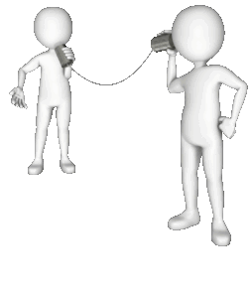
Odd Communications
162 Communications which are impossible or extremely difficult to understand due to incoherent thought or language 163 Speech or nonverbal behavior is extremely odd & is non-communicative (echolalia, idiosyncratic language) as seen in autism | 170 Communications do not “flow,” are irrelevant, or are disorganized (i.e., more than other children of the same age) | 177 Eccentric or odd speech, relative to other children of the same age
30
20
10

Slide 92



Limited Communication
166 Refuses to talk or is selectively mute (and not due to documented physical or sensory disability, etc.) 167 Does not respond when spoken to (and not due to documented physical or sensory disability, etc.) | 175 Extremely limited in expressing self verbally (and not due to documented physical or sensory disability, etc.) | 180 Limited in ability to express self verbally (more than other children of the same age) (and not due to documented physical or sensory disability, etc.)
30
20
10

Slide 93

Odd Cognitions
N/A | 174 Preoccupying cognitions or fantasies with bizarre, odd, or gross themes, given child’s age | 178 Often expresses unnatural or strange ideas for his/her age
30
20
10

Slide 94
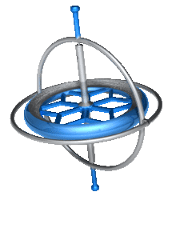
Non-Purposeful or Odd Behaviors
165 Most of the time involved in aimless, non-purposeful activities 168 Repeats an idea, thought, or action over and over (e. g., rocking) | 171 Frequent and strange or odd behavior (e.g., eats non-food items, smears feces) 173 Frequently involved in aimless, non-purposeful activities | N/A
30
20
10

Slide 95
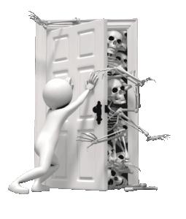
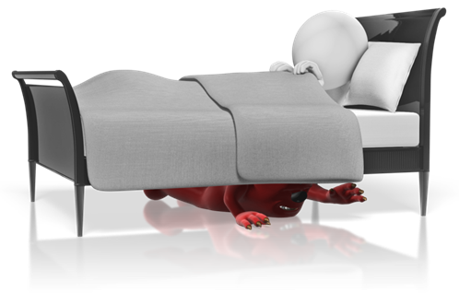
Apparent Faulty Sensory Perceptions
164 Strange or bizarre behavior indicating an inability to distinguish fantasy from reality | 172 Apparent intermittent hallucinations that interfere with normal functioning | 179 Unusual perceptual experiences that are not pathological hallucinations. EX: sees wolves before going to sleep but knows they are not real
30
20
10

Slide 96
Subscale Review Question #1
4 year old child sometimes pretends to talk to “imaginary friends”(i.e., pretends that friends are in the car or at the restaurant with family). Mother reports that her brother did the same thing at her age.
0
Item: 182
Rationale: Thought, as reflected by communication, is not disordered or eccentric when compared to other children of same age

Slide 97
Subscale Review Question #2
6 year old boy constantly rocks back and forth in his seat, humming loudly. He has been removed from specialized preschool classroom for the disruption that he caused to the classroom environment.
30
Item: 168
Rationale: Repeats an idea thought or action over and over [e.g., repeatedly rocks body or head

Slide 98
Subscale Review Question #3
Teacher reports that a 5 year old is preoccupied with death; he is constantly drawing pictures of dead people and animals. His interest in this, as reflected in writing and artwork, is much more than is typical for kids his age. Referred to counselor for these concerns.
20
Item: 174
Rationale: Preoccupying cognitions or fantasies with bizarre, odd or gross themes

Slide 99
Subscale Review Question #4
4 year old won’t talk to others outside of his family, despite being capable of doing so; he hasn’t been diagnosed with any physical or sensory disability. Mother says that this is unusual for her family/culture.
30
Item: 166
Rationale: Refuses to talk is selectively mute – NOT due to physical or sensory disability, speech impediment or lack of familiarity with English)

Slide 100
Subscale Review Question #5
5 year old child frequently shares thoughts that are disorganized and not relevant to situation, more than other children of the same age.
20
Item: 170
Rationale: Communications are disorganized; more than other kids same age

Slide 101
Subscale Review Question #6
6 year old expresses that others are out to get him, blames explosive behaviors on command voices, and states that he sees aliens when he looks outside.
30
Item: 164
Rationale: Strange or bizarre behavior indicating an inability to distinguish fantasy from reality)

Slide 102
Subscale Review Question #7
4 year old frequently eats pencil erasers
20
Item: 171
Rationale: Frequent and strange or odd behavior (eats non-food items, smears feces)

Slide 103
Caregiver: Material Needs
30
20
10
0
SEVERE
Severe disruption or incapacitation
MODERATE
Major or persistent disruption
MILD
Significant problems or distress
MINIMAL/NO
No disruption in functioning
Assess access to:
Stable housing
Balanced nutrition
Appropriate clothing
Medical care
Neighborhood safety

Slide 104

Preamble – Caregiver Scales
Reflects on caregiver resources & caregiving environment
Consider all caregivers within the home
Not necessarily a reflection of “good” or “bad” parenting
Often factors are beyond the caregiver’s immediate control, or the child’s needs are simply too great for the environment currently available

Slide 105


Separate but identical scales for:
Primary Family
Parent(s) who is rearing the child or with whom the child lives most of the time (e.g., biological parent, adoptive parent, grandmother)
Where the child was before treatment and where the child will return. If more than one parent in the home, rate greater level of impairment.
Non-custodial Caregiver
Parent(s) who has a psychological impact on the child yet is non-custodial or is not living in the same home as the child
Surrogate Family
Person(s) substituting as parent(s), such as foster parent(s)

Slide 106

Preamble – Caregiver Material Needs
Lack of material needs must negatively impact child’s functioning to be rated.
Even in low income bracket, parent may be able to use community and family resources to meet basic needs of child.
Needs may not be met because of problems other than poverty (e.g., parent buys alcohol rather than food).
Safety issues related to sexual or physical abuse are not rated here.
Basic material needs include:
Food (i.e. balanced diet)
Housing (i.e. a home that is free from major safety hazards, provides adequate privacy)
Clothing (i.e. appropriate for the weather)
Medical attention (i.e. immunizations, care when sick)
Safety (i.e. live in a neighborhood that is reasonably safe; street violence and drug dealing are not immediately present or common)

Slide 107
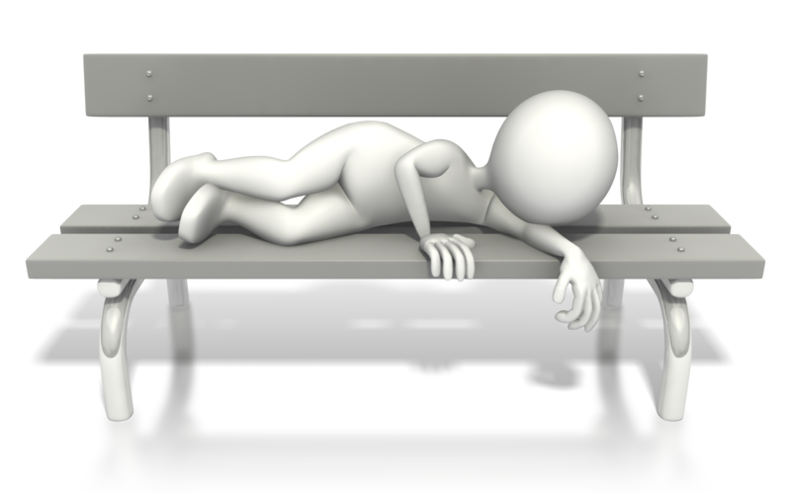
Caregiver: Material Needs
185 Child’s needs are not being met such that severe risk to health or welfare of child is likely | 187 Frequent negative impact on child’s functioning 187 A major disruption in the child’s functioning | 189 Occasional negative impact on the child’s functioning
30
20
10

Slide 108
Caregiver: Family/Social Support
30
20
10
0
SEVERE
Severe disruption or incapacitation
MODERATE
Major or persistent disruption
MILD
Significant problems or distress
MINIMAL/NO
No disruption in functioning
Assess access to:
Nurturance
Guidance
Supervision
Protection from harm
Skill development
Problem-solving communication

Slide 109

Preamble – Caregiver Family/Social Support
Impairment in caregiver’s ability to provide a safe, secure, and healthy home environment in which the youth’s developmental needs can be met.
Developmental needs are youth’s need to receive guidance and support relative to their unique needs in areas of:
Regulation of impulses (appropriate limits, supervision, understanding and managing feelings)
Social (getting along with others, developing friendships)
Emotional (nurturance, unconditional positive regard)
Academic/educational development
Life skills

Slide 110

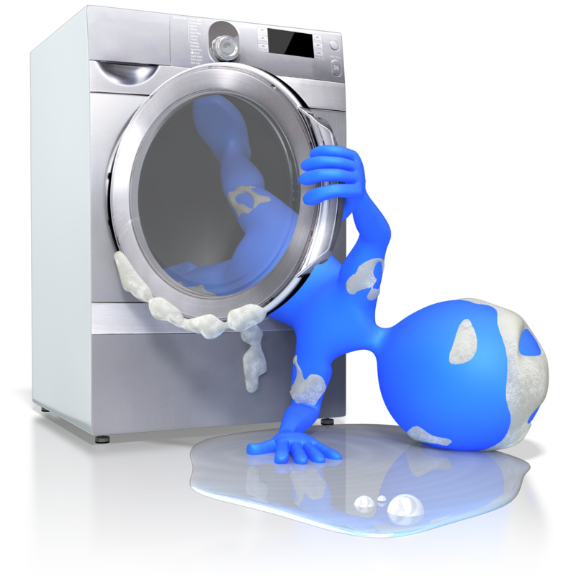

Developmental Support
195 Sociofamilial setting is potentially dangerous to the child due to lack of family resources required to meet the child’s needs/demands EX: caring for child with psychosis with limited resources | 206 Child’s developmental needs cannot be adequately met | 214 Family not able to provide adequate warmth, security, or sensitivity
30
20
10

Slide 111


Parental Judgment and Functioning
196 Gross impairment in parental judgment or functioning. EX: psychosis, substance abuse, severe personality disorder, severe intellectual disability 203 Caregiver is openly involved in unlawful behavior or contributes to or approves of child being potentially involved in unlawful behavior | 207 Marked impairment in parental judgment or functioning. EX: emotional instability, psychiatric illness, substance use, physical illness | N/A
30
20
10

Slide 112


Supervised Home
197 Caregiver does not want child to return to the home 204 Marked lack of parental supervision or consistency in care. EX: allows child to “roam” or be under the influence of older, impulsive children | 212 Not able to provide adequate supervision or consistency in care over time | 217 Not able to provide adequate firmness
30
20
10

Slide 113

Safe Home Environment
198 During the rating period, child is subjected to sexual abuse in the home by a caregiver 199 During the rating period, child is subjected to physical abuse or neglect in the home 200 Child currently removed from the home due to sexual abuse, physical abuse, or neglect. 201 Failure of caregiver to protect from known/knowable safety risks EX: allows sex offender to babysit EXPTN: Parent’s rights terminated | 210 Failure of caregiver to provide emotional support to child who has been traumatized or abused | N/A
30
20
10

Slide 114

Family Violence or Conflict Management
197 Frankly hostile, rejecting to child 202 Severe or frequent domestic violence | 211 Domestic violence or serious threat of domestic violence 208 Conflict is pervasive (across areas) and continual (chronic) EX: hostility, tensions, scapegoating 209 Family members are insensitive, angry, and/or resentful to the child | 215 Frequent family arguments and/or misunderstandings resulting in bad feelings 216 Family relations are characterized by poor problem solving, poor communication, or emotional insensitivity
30
20
10

Slide 115

The Reliability Test: Vignettes
Rate behavior in vignettes; not the “clinical summary” in your head.
Start with severe level of impairment. Do not “jump” to a true item which is the incorrect answer because it is not the most severe, true item about the Child.
Rate every scale based on entire vignette, not just a “subsection” of the vignette.
Rate the behavior if anyone reports it, and it is believable
Read carefully. Try to avoid “fatigue errors.”

Slide 116
The “Test” Instructions
Time period to rate is the last three months. If there is no comment about time, assume behavior is current.
Reliability based on subscale scores (30, 20, 10, 0) in left margin.
Include item number from the subscale chosen
Must write/type in a justification (not wording from PECFAS item).
Please remain muted while in the “testing room” and you must have your video on AT ALL TIMES
Notes:
If you are having trouble using this document, please message the moderator directly and an alternative document can be provided

Slide 117
The Reliability Test: Vignettes
If you need assistance or coaching please use the “raise your hand” function to get the attention of the moderator who will move you into the break-out room with your assigned trainer
Each time you complete a vignette, use the “raise your hand” function or type in the chat if that function is not available to you
Please be patient! Sometimes there will be a wait to be moved into a break out room
Once you are done with all the vignettes, you will need to save the Word Document and email it to to receive you certificate on DWC.

Slide 118
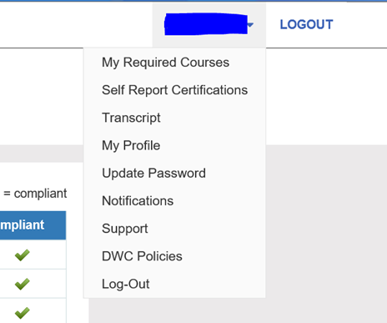
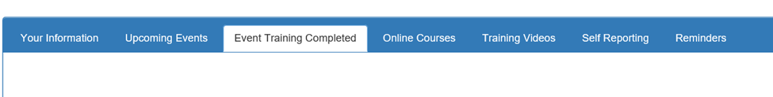
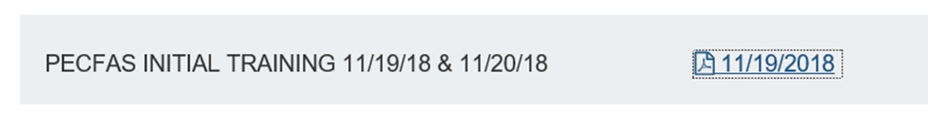
Where is My Certificate?
On DWC (where you registered for this training) under “Transcript”, then “Event Training Completion” tab
Click here to view your certificate!
Notes:
Reminder, you must email all of your vignettes to the moderator once completed to receive your certificate

