Slide 1


Critical/Sentinel Events 3 Year Comparative Analysis
and
FY 2024/2025 annual report

Slide 2

During FY 2024/2025, DWIHN served 123,000 members throughout Wayne County, this number represents the significant increase 75,000 members during the mid 2000 to where we are today. Looking at these figures, the Quality Performance Improvement Team's (QPIT) review of the annual and comparative data surmised that there is most likely significant under-reporting of Critical/Sentinel Events throughout the system which has doubled while the number of members served increases.
During the next fiscal year, the QPIT will focus on increasing reporting through more collaboration with other DWIHN departments, increased technical assistance, training provider staff, and monitoring of Recipient Rights Complaints which also highlight areas where Critical Events should have been reported. Through this process, the QPIT will be able to identify any significant trends and patterns of risk within the system of care. In addition, the process can identify areas of training, coaching, and/or mentoring will increase the skills of the workforce, while improving the quality of care for members.

Slide 3
3 YEAR COMPARATIVE DATA

Slide 4
NETWORK STAFF TRAINING
TECHNICAL ASSISTANCE
FY 2024/2025
During this fiscal year, Quality Performance Improvement Team (QPIT) provided seven (7) monthly training opportunities for DWIHN Clinically Responsible Provider Staff. 190 staff across both Behavioral Health and Substance Use Disorder programs completed and passed the test demonstrating competency.
In addition to providing training, the QPIT provides technical assistance to every level within DWIHN. This includes front line staff in our residential facilities up through executive leaders. When the QPIT identifies trends or patterns of events, technical assistance is offered to assist in ensuring the best quality of care is made available to each of our members and their families. This collaborative process has resulted in improved services through this oversight.

Slide 5
FY 2024/2025 DATA

Slide 6
TOTAL AGGREGATE DATA BY MAJOR CATEGORY
CATEGORY | TOTAL # | GENDER
 |  | Male |  | Female
Administrative | 139 | 67 | 48.2 % | 72 | 58%
Arrest | 102 | 82 | 80.39% | 20 | 19.61%
Behavior Treatment | 190 | 105 | 55.26% | 85 | 44.74%
Death of Recipient | 379 | 220 | 58.05% | 159 | 41.95%
Environmental Emergency | 16 | 9 | 56.25% | 7 | 43.75%
Injuries requiring Emergency Room | 166 | 107 | 64.56% | 59 | 35.54%
Injuries requiring Hospitalization | 52 | 35 | 67.31% | 17 | 32.69%
Media (New FY 2024) | 14 | 8 | 57.14% | 6 | 42.86%
Medication Error | 26 | 18 | 69.23% | 8 | 30.77%
Physical Illness Requiring Emergency Room | 207 | 114 | 55.07% | 93 | 44.93%
Physical Illness Requiring Hospitalization | 216 | 130 | 60.19% | 86 | 39.81%
Serious Challenging Behavior | 460 | 254 | 55.22% | 206 | 44.78%
TOTAL | 1967 | 1149 | 58.41% | 818 | 41.59%

Slide 7
FY 2024/2025 DATA
Administrative | 139 | 67 | 72
Alleged Neglect/Abuse | 132 | 64 | 68
Critical No Show | 1 | 0 | 1
Exploitation | 2 | 2 | 0
Illegal Activity | 2 | 1 | 1
Impaired Worker | 2 | 0 | 2
Arrest | 102 | 82 | 20
Arrest | 53 | 42 | 11
Assault | 12 | 6 | 6
Behavior | 5 | 3 | 2
Convicted | 5 | 5 | 0
Criminal Charges Pending | 22 | 21 | 1
Police Intervention | 1 | 1 | 0
Violation of Probation | 4 | 4 | 0
The Administrative category is comprised of events reported to the Office of Recipient Rights, Adult/Child Protective Services, or the Police Department for investigation of a violation of the Mental Health Code, Abuse/Neglect issues, or Criminal Law statutes.
Arrests are only reported when a member of law enforcement informs staff that the member is being arrested for violation of the law and will possibly be prosecuted. This table provides outcomes reported from those arrests as received.

Slide 8
Behavior Treatment | 190 | 105 | 85
911 Calls | 38 | 18 | 20
Arrests | 3 | 2 | 1
Emergency Hospitalizations | 18 | 13 | 5
Injury | 39 | 19 | 20
Physical Health Hospitalizations | 69 | 40 | 29
Psychiatric Hospitalizations | 20 | 11 | 9
Use of Physical Management | 3 | 2 | 1
This data represents events for member on a Behavior Treatment Plan – detailed information is contained in the Behavior Treatment Annual Report.
Environmental Emergency | 16 | 9 | 7
All Members Relocated | 1 | 0 | 1
Bed Bugs | 8 | 4 | 4
Fire | 4 | 3 | 1
Member Relocated | 2 | 1 | 1
Other | 1 | 1 | 0
As Environmental issues arise requiring members to be relocated, verification of remediation to demonstrate that members were kept safe while the facility is repaired. Bed Bugs continues to be the most reported environmental issue throughout the provider network.

Slide 9
Injuries requiring Emergency Room | 165 | 106 | 58
Accidents or Loss of Limb or function | 23 | 17 | 6
Assault | 8 | 5 | 3
Behavior | 2 | 1 | 1
Injury | 120 | 77 | 43
Physical Illness | 4 | 3 | 1
Suicide Attempt | 2 | 0 | 2
Suspected Overdose | 6 | 3 | 2
Injuries requiring Hospitalization | 52 | 35 | 17
Accidents or Loss of Limb or function | 6 | 5 | 1
Injury | 41 | 28 | 13
Medication | 1 | 1 | 0
Physical Management | 1 | 0 | 1
Suspected Overdose | 3 | 1 | 2
22% or 36 of Injuries requiring Emergency Room visits; and, 37% or 19 of Injuries requiring Hospitalizations were also a result of members falling. Based on the 2016-2018 DWIHN Performance Improvement Project (PIP) focusing on falls, this data highlights the need for higher scrutiny on the medication regimens of our members. The PIP highlighted the fact that individuals on 5 or more medications should have their medications monitored for contraindications of falls, and therefore the Plans of Care should include referrals to Occupational and/or Physical therapy along as well.

Slide 10
Media (New FY 2024) | 14 | 8 | 6
Accidents or Loss of Limb or function | 1 | 1 | 0
Arrest | 1 | 1 | 0
Homicide | 2 | 1 | 1
Missing Persons | 10 | 5 | 5
Extensive details regarding this data is found later in this report in the Media Section.
Medication Error | 26 | 18 | 8
Double Dosage | 8 | 5 | 3
Missed Dosage | 12 | 9 | 3
Wrong Medication | 6 | 4 | 2
Medication Errors resulting in the members need to have medical follow-up were found primarily for members living in residential facilities. Typically, the reasons documented for medication errors includes staff not following the protocols of medication administration requiring re-training. There is no indication that members living independently who had medication errors were encouraged to utilize electronic reminder notifications or other means to ensure medication compliance which could assist in reducing the number of missed dosages.

Slide 11
Physical Illness Requiring Emergency Room | 206 | 113 | 93
Admitted | 80 | 44 | 36
Released | 123 | 67 | 56
COVID-19 | 3 | 2 | 1
Physical Illness Requiring Hospitalization | 216 | 130 | 86
Admitted | 105 | 67 | 38
COVID-19 | 3 | 3 | 0
Death Cause Unknown | 1 | 1 | 0
Diabetes | 3 | 3 | 0
Medication Error | 1 | 0 | 1
Orthopedic | 1 | 1 | 0
Physical Health Reason | 33 | 16 | 17
Physical Illness | 49 | 28 | 21
Released | 2 | 1 | 1
Respiratory | 7 | 5 | 2
Seizure Disorder | 8 | 4 | 4
Stroke | 3 | 1 | 2

Slide 12
Suicide and Suicide Attempts
FY 24/25
There were 8 Suicides & 116 Suicide Attempts entered into MH-WIN by CRSPs.
Suicide events are determined by the Medical Examiner Reports and/or Death Certificate Verification

Slide 13
Suicide Data

Slide 14
SUICIDE ATTEMPTS BY AGE/GENDER
Suicide Attempt by Age/Gender | TOTAL | Male | Female
9 years - 12 years old | 15 | 7 | 8
13 years old - 15 years old | 41 | 6 | 35
16 years old - 17 years old | 13 | 6 | 7
18 years old - 20 years old | 13 | 3 | 10
21 years old - 26 years old | 6 | 2 | 4
27 years old - 29 years old | 3 | 2 | 1
30 years old - 35 years old | 5 | 3 | 2
36 years old - 40 years old | 6 | 2 | 4
41 years old - 50 years old | 12 | 5 | 5
51 years old - 64 years old | 2 | 0 | 4
65 years old + | 0 | 0 | 0
TOTAL | 116 | 36 | 80

Slide 15
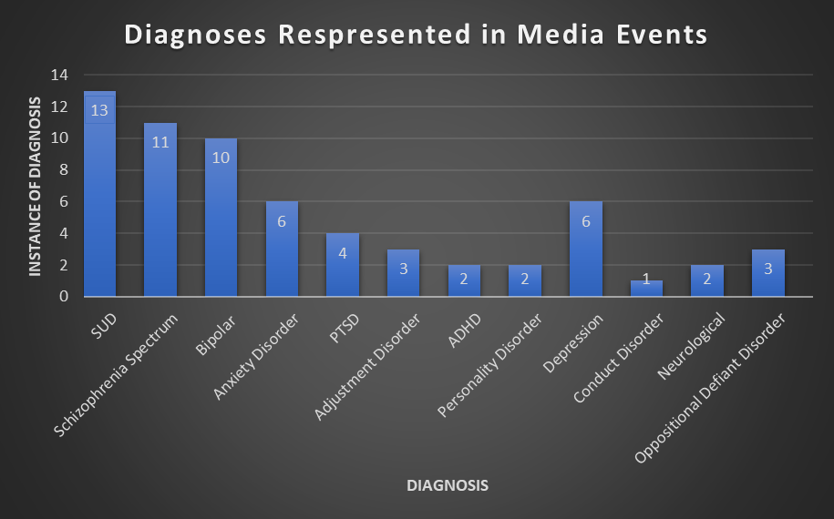

Slide 16
Provider Trends
Upon review of members’ records, the following issues were identified as causal factors:
Lack of diversified follow up
1-3 phone calls made maximum
No contact with emergency contacts/family
Lack of home visits
No closure of cases
Boilerplate language rather than Individualized Notes
Lack of documentation in coordination of services
Missing ASAM

Slide 17
Subcategory: Missing
53% of the Media event cases were subcategorized as Missing cases
53% were children between the ages of 11 and 16 years old
88% in private residence, while 12% were homeless
47% of the cases were adults between the ages of 26 to 62 years old.
57% of the adults were living in an AFC home, while 43% were living in a private residence.

Slide 18
Subcategory: Missing Children
Most prevalent diagnoses represented were: adjustment disorder, posttraumatic stress disorder, and oppositional defiant disorder
In 71% of youth cases, the member was located
29%, there has been no further contact with the member or their family, thus their status remains unknown
Girls were the only gender among the youth identified in the missing subcategory
A history of sexual abuse or human trafficking was present.
A prevalence of unstable or unsafe housing was also noted

Slide 19
Subcategory: Missing Adults
Most prevalent diagnoses represented were: schizophrenia spectrum disorders and SUD
In the cases in which members were residing in AFC homes, half of the members reported either being dissatisfied with their home, requested a new housing placement, or expressed dissatisfaction with homes rules, thus triggering a ULOA
With the prevalence of schizophrenia spectrum disorders in adult missing cases, it is possible that medication adherence or access could be a contributing factor, however it is unclear based on the documentation available in these cases.

Slide 20
Trend Recommendations:
Re-Engagement Follow Up
Develop/Monitor a standardized policy for re-engagement attempts
Monitoring of the re-engagement process should be a standardized that will identify when an in-person visit, or wellness check should be completed when there is no response from the member to re-engagement attempts.
The policy should include a clause that states, “after ‘x’ failed attempts, then the case should be closed.”
Improved documentation surrounding missing members
When a member is reported missing, it should be required that the occurrence be documented in their chart in the “Health and Safety” area. If the member is located, this should also be documented/updated, including any additional services or recommendations that were provided as a response to the event.
This would demonstrate adequate follow-up when a member is reported missing, as this information is pertinent to the member’s history and future plan of care.

Slide 21
Trend Recommendations:
Level of Care Transitions & Referrals
Increased SUD referrals for co-occurring members… There should be a standardized follow-up
Improved SUD screening processes inclusive of all assessment areas and identification and inclusion of all prior SUD use and treatment
Improved collaboration with probation officers and other external service providers for each member
Quarterly reviews of member assessments and clinical needs
Better assessments to strengthen the level of care members receive

Slide 22
Trend Recommendations:
Access to Documentation
One charting system for better access to all members’ record to monitor and ensure level of service provision
With the use of different electronic health systems amongst providers, the ability to receive and review documentation in a timely fashion is challenging. This impacts accuracy of the quality measures and standards reviewed, creating blind spots in member charts and treatment.
This challenge also affects the providers, as comprehensive care between SUD and MH providers has been in a deficit
To meet this need, it is imperative that one charting system be utilized to better review and serve our members. This will allow for increased collaboration and information shared between providers. For the QPIT team, it will allow for timely case closure and reporting to MDHHS, as well as more thorough reviews of member events for quality standards.

Slide 24
Continued

